Slide 1
FEMINISM
Definition- History- Development
Debates: 1st Wave, 2nd Wave & 3rd Wave
4th Wave??
Feminism in Pakistan
History- Development
Debates & Actors
Achievements

Slide 2
Feminism --- Defined
The theory of the political, economic, and social equality of the sexes
Organized activity on behalf of women's rights and interests
Feminism is both an intellectual commitment and a political movement that seeks justice for women and the end of sexism in all forms
Motivated by the quest for social justice, feminist inquiry provides a wide range of perspectives on social, cultural, economic, and political phenomena
Ref. Feminist Philosophy Plato.stanford.edu

Slide 3
Feminism
There are millions of people who both inwardly and outwardly do not support the idea that there should be equal rights and equal opportunities for men and women
There are thousands of people who feel we’ve already arrived at equality for men and women.
There are also thousands of people who believe we’re not at all there yet, and support continuing efforts to pave the way for equal rights for men and women.
There are thousands who believe in equal rights but find “feminism” a word and a movement that doesn’t align with their personal beliefs or values
It’s abundantly clear that our specific views on these issues are rooted deeply in our own personal and direct experiences, rather than on any data, research or science surrounding the issues
In other words, if we’ve personally faced discrimination, we know beyond doubt that it exists. But if we haven’t faced it ourselves, we often doubt that it happens
Finally, both conscious and unconscious gender bias is rampant within us, but most us aren’t aware of it

Slide 4
Why do so many hate the term feminism and the feminist movement?
1. Feminism has been associated with strong, forceful and angry women, and our society continues to punishes forceful women
2. Many people fear that feminism will mean that men will eventually lose out – of power, influence, impact, authority, and control, and economic opportunities
3. Many people believe that feminists want to control the world and put men down
4. Many people fear that feminism will overturn time-honored traditions, religious beliefs and established gender roles, and that feels scary and wrong
5. Many people fear that feminism will bring about negative shifts in relationships, marriage, society, culture, power and authority dynamics, and in business, job and economic opportunities if and when women are on an equal footing with men

Slide 5
History
Mary Wollstonecraft’s A Vindication of the Rights of Woman (1792), was published in England
Challenged the notion that women exist only to please men
she proposed that women and men be given equal opportunities in education, work, and politics
Women, she wrote, are as naturally rational as men
If Women are silly, it is only because society trains them to be irrelevant

Slide 6
History
In the United States, feminist activism took root when female abolitionists sought to apply the concepts of freedom and equality to their own social and political situations
By the mid-19th century, issues surrounding feminism had added to the tumult of social change, with ideas being exchanged across Europe and North America.

Slide 7
1st Wave of Feminism The suffrage movement
Seneca Falls Convention, New York, 1848
Elizabeth Cady Stanton drew up the “Declaration of Sentiments” that guided the Seneca Falls Convention
Using the Declaration of Independence as her guide to proclaim that “all men and women had been created equal,” she drafted 11 resolutions, including the most radical demands -The right to the vote
Woman’s equal participation with men in the various trades, professions and commerce
Education- Property – Marriage – Divorce
women’s suffrage, a goal that would dominate international feminism for almost 70 years
https://www.britannica.com/topic/woman-suffrage/The-United-States

Slide 8
1st Wave of Feminism The suffrage movement
Like the Americans, British suffragists, led by the National Union of Woman Suffrage Societies, had initially approached their struggle politely, with “ladylike lobbying”
But in 1903 a dissident faction led by Emmeline Pankhurst began a series of boycotts, bombings, and pickets – Militant Feminism
Following the British lead, American women activists, organized mass demonstrations, parades, and confrontations with the police

Slide 9
1st Wave of Feminism The suffrage movement – Major Achievements
Their tactics ignited the nation, and in 1918 the British Parliament extended the vote to women householders, householders’ wives, and female university graduates over the age of 30 – limited Franchise
In1920, American feminism claimed its first major triumph with the passage of the Nineteenth Amendment to the U.S Constitution
https://www.irishtimes.com/culture/heritage/from-new-zealand-to-saudi-arabia-when-women-won-the-vote-worldwide-1.3731396

Slide 10
1st Wave of Feminism - Criticism
Radical feminists challenged the single-minded focus on suffrage as the sine qua non of women’s liberation
Emma Goldman, mocked the notion that the ballot could not secure equality for women, since it hardly accomplished that for the majority of American men
However, the right to vote was won by women due to their sheer resistance, courage and perseverance in face of all patriarchal norms and values that underpin our societies and that deem women as secondary, inferior to men and apolitical
In so many countries, women’s right to vote is not recognized and women still have to fight for their right to vote
In countries like Pakistan, women can be disenfranchised even in the 21st century e.g. in Lower Dir, KPK in 2013 General Election

Slide 11
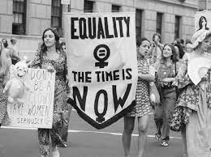
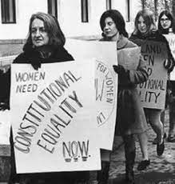
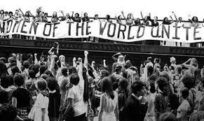
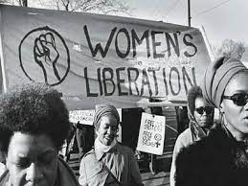

Slide 12
2nd Wave Feminism – 2 important Books
The second wave of the modern feminist movement began with the publication in France in 1949 of Simone de Beauvoir's book The Second Sex
This sweeping account of the historical and current status of women in the Western world argues that men set the standards and values, and women are the Other who lack the qualities the dominants exhibit
Men are the actors, women the reactors
Men thus are the first sex, women always the second sex
Men’s dominance and women's subordination is not a biological phenomenon, de Beauvoir insisted, but a social creation: "One is not born, but rather becomes, a woman ... ; it is civilization as a whole that produces this creature ... which is described as feminine“
In The Feminine Mystique (1963), American author and feminist Betty Friedan referred to “the problem that has no name,” in which women felt constrained, unsatisfied, and unhappy in their roles as wives, mothers, and homemakers
The Bitch Manifesto by Jo Freeman https://www.jofreeman.com/joreen/bitch.htm

Slide 13
2nd Wave Feminism (1960s-1980s) Background & Demands
Civil Rights Movement
Protests against Vietnam War
Demands
Discrimination in the Pattern of employment to be removed
Unequal pay to be made equal
Legislative guarantees of equal pay for equal work, equal job opportunities, and expanded child-care services
Legal inequality removed, and ample support services for working women to be provided
Recognition of Violence against women & its Elimination
Social Equality – Education, Health to ensured
Sexual equality to ensured – Marriage – Divorce- Childbirth – Family Planning Contraceptives
Abortion to be legalized– My Body My Choice

Slide 14
2nd Wave Feminism (1960s-1980s) – Impacts
second-wave feminism provoked extensive theoretical discussion about the origins of women’s oppression, the nature of gender, and the role of the family
Kate Millett’s Sexual Politics 1970 - she broadened the term politics to include all “power-structured relationships” and posited that the personal was actually political
Shulamith Firestone 1970, a founder of the New York Radical Feminists, published The Dialectic of Sex in the same year, insisting that love disadvantaged women by creating intimate shackles between them and the men they loved—men who were also their oppressors
One year later, 1971, Germaine Greer, published The Female Eunuch, in which she argued that the sexual repression of women cuts them off from the creative energy they need to be independent and self-fulfilled

Slide 15
2nd Wave Feminism (1960s-1980s) – Impacts
Consciousness Raising Groups – CR Groups
Widespread effort to reform the negative and inferior image of women in popular culture to a more positive and realistic one
Women created their own popular culture and the movement spread through feminist films, music, books and even restaurants
In 1966, the National Organization for Women (NOW) was created, with Betty Friedan named the first President
The founding statement of NOW demanded the removal of all barriers to “equal and economic advance” and declared “the true equality for all women” as its aim

Slide 16
Achievements
Many goals of the second wave were met
More women in positions of leadership in higher education, business and politics
Abortion rights; access to the pill that increased women’s control over their bodies
More expression and acceptance of female sexuality
General public awareness of the concept of and need for the “rights of women” (though never fully achieved)
A solid academic field in feminism, gender and sexuality studies
Greater access to education
Organizations and legislation for the protection of battered women
Women’s support groups and organizations
An industry in the publication of books by and about women/feminism
public forums for the discussion of women’s rights
A societal discourse at the popular level about women’s suppression, efforts for reform, and a critique of patriarchy

Slide 17
Critique
While the Second Wave was a hugely successful movement that comprised many legal and cultural victories leading to greater equality, it had its shortcomings
At the time in the United States, the movement against racism was active too. Women of colour found themselves to be under-represented by the feminist movement
Prominent feminists were white middle-class women who wrote feminist theory centered around their own experiences and troubles
While there were many black, Latina, Asian and Native American members of the movement, they felt excluded from the narrative and ignored
The agenda of the leading white feminists were often a contrast to theirs
Many women felt that it was unwise to discuss gender equality without taking into consideration racial inequality too
This gap between white and People of Colour feminists motivated women of colour to form their own organizations to represent their interests in the movement. One such organization was the Third World Women’s Alliance.

Slide 18
Feminism / Feminist Movements in Pakistan
Feminism and the Women’s Movement in Pakistan Actors, Debates and Strategies Dr. Rubina Saigol
https://library.fes.de/pdf-files/bueros/pakistan/12453.pdf

Slide 19
Feminist Movements in Pakistan From 1947-2022

Slide 20
“For realizing, in letter and spirit, the ideals of a democratic welfare state, it is necessary to institute a system which fully guarantees human rights, generates conducive environment for the pragmatic use and beneficial enjoyment of human rights and provides operative safeguards and expeditious remedy against any violation of human rights”. Critically evaluate the statement with special reference to Pakistan. 2020
Outline and explain the three major waves of feminist movements in the West. Discuss the influence of these waves on feminist movements in Pakistan. 2019
short notes – APWA and WAF 2018
“Women active political participation could stabilize democracy and boost economic development.” Comment on this statement within context of socio-economic realities of Pakistani society. 2017

Slide 21
Welfare Feminism-1950s-1960s
1947- Women’s Relief Committee, founded by Fatima Jinnah
1949-Begum Ra’ana Liaqat Ali, founded the All-Pakistan Women’s Association
Moral, social and economic welfare of Pakistani women
The 1960s saw the proliferation of women’s welfare and development organizations but it was the All Pakistan Women’s Association (APWA) that became the face of the women’s movement in the country in that decade

Slide 22
Welfare Feminism-1950s-1960s
The passage of the Muslim Family Laws Ordinance (1961), pushed by APWA, reflected a minor ingress by the state in the private sphere as it placed certain procedural limits on the men’s arbitrary right of divorce
It gave women some rights regarding child custody and maintenance
Even the small changes repeatedly stirred public controversy with clerics clamouring for the reversal of the ordinance

Slide 23
Welfare Feminism-1950s-1960s-1970s
APWA’s approach was characterised by two salient features:
Social welfare and development work for education and income-generation activities;
Collaboration with the state to achieve its aims
APWA shied away from an overtly political position in that it did not contest dictatorship
It preferred to play it safe even when Fatima Jinnah, a woman, remained the sole campaigner against dictatorship
The cooperation and collaboration of women leaders with the state to attain women’s rights continued during the civilian rule of the Pakistan Peoples Party (1971-1977)

Slide 27
تمھارے سر پہ یہ آنچل بہت ہی خوب ہے لیکن تم اس آنچل سے اک پرچم بنا لیتی تو اچھا تھا مجاز
The scarf looks good on your head, but it would have been great if you could have turned it into a flag

Slide 29
Resistance

Slide 30
Feminism in Pakistan- 1970s-1980s
The feminist movement and the women’s rights struggle that arose in the 1980s, spearheaded by Women’s Action Forum 1981 (WAF) in the urban areas and Sindhiani Tehreek in rural Sindh, were significant for their overtly political stance.
Both these movements were formed in the context of a absolute dictatorship that relied on a particular version of religion for legitimacy
Women consistently challenged both the military rule and the incursion of religion in politics

Slide 31
Feminism in Pakistan- 1970s-1980s
WAF struggled for a democratic, inclusive, plural and secular state
While Sindhiani Tehreek strove for an end to feudalism and patriarchy
.Restoration of democracy and championed the principle of federalism and provincial autonomy
These movements represent a significant break from the former paradigm of collaboration and cooperation with the state

Slide 32
Feminism in Pakistan 1970s-1980s
They challenged patriarchal power in every domain — political, religious and legal.
Unlike the welfare and social uplift-oriented movements of the 1950s &1960s, the struggles launched by women in the 1980s were essentially political movements anchored in the ideas of democracy, basic rights and sociopolitical change

Slide 33
Feminism in Pakistan - 1970s-1980s
Women confronted the authoritarian state, and were engaged in frequent street protests and demonstrations.
They took risks and were beaten, jailed, baton-charged and otherwise threatened by the dominant religious-military patriarchies of the time
Reflection & Action

Slide 34
Radical Feminism 1970s-1980s - A glimpse from the past - Poetry
چادر اور چار دیواری
حضور میں اس سیاہ چادر کا کیا کروں گی
یہ آپ کیوں مجھ کو بخشتے ہیں بصد عنایت
نہ سوگ میں ہوں کہ اس کو اوڑھوں
غم و الم خلق کو دکھاؤں
نہ روگ ہوں میں کہ اس کی تاریکیوں میں خفت سے ڈوب جاؤں
نہ میں گناہ گار ہوں نہ مجرم
کہ اس سیاہی کی مہر اپنی جبیں پہ ہر حال میں لگاؤں
سیاہ چادر تو بن چکی ہے مری نہیں آپ کی ضرورت
کہ اس زمیں پر وجود میرا نہیں فقط اک نشان شہوت
حیات کی شاہ راہ پر جگمگا رہی ہے مری ذہانت
زمین کے رخ پر جو ہے پسینہ تو جھلملاتی ہے میری محنت
یہ چار دیواریاں یہ چادر گلی سڑی لاش کو مبارک
کھلی فضاؤں میں بادباں کھول کر بڑھے گا مرا سفینہ
میں آدم نو کی ہم سفر ہوں
کہ جس نے جیتی مری بھروسہ بھری رفاقت
Fehmida Riaz

Slide 35
Radical Feminism 1970s-1980s - A glimpse from the past- Poetry
ہم گنہ گار عورتیں ہیں
جو اہل جبہ کی تمکنت سے نہ رعب کھائیں
نہ جان بیچیں
نہ سر جھکائیں
نہ ہاتھ جوڑیں
یہ ہم گنہ گار عورتیں ہیں
کہ سچ کا پرچم اٹھا کے نکلیں
تو جھوٹ سے شاہراہیں اٹی ملے ہیں
ہر ایک دہلیز پہ سزاؤں کی داستانیں رکھی ملے ہیں
جو بول سکتی تھیں وہ زبانیں کٹی ملے ہیں
یہ ہم گنہ گار عورتیں ہیں
کہ اب تعاقب میں رات بھی آئے
تو یہ آنکھیں نہیں بجھیں گی
کہ اب جو دیوار گر چکی ہے
اسے اٹھانے کی ضد نہ کرنا!
کشور ناہید

Slide 36
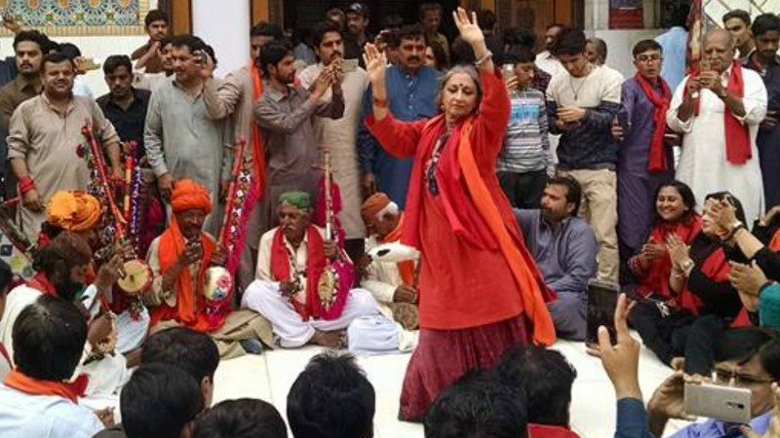
Radical Feminism 1970s-1980s A glimpse from the past – Performing Arts- Sheema Kirmani – Nighat CHoudhry

Slide 37
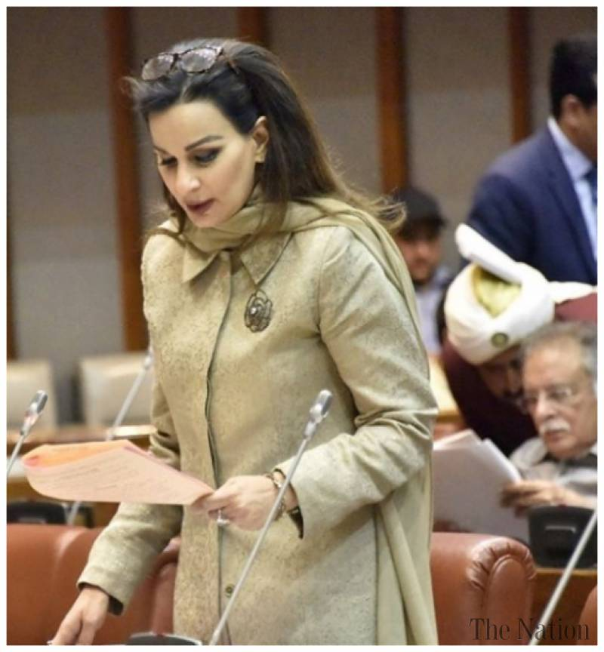
Radical Feminism 1970s-1980s A glimpse from the past - Journalism

Slide 38
Feminism in Pakistan-2000 & onwards
The new wave of feminism includes people from all classes, genders, religions, cultures and sects without any discrimination or prejudice
The young feminists are diverse, yet inclusive.
There are no leaders or followers — they are all leaders and followers
The young groups of women say openly what their grandmothers could not dare to think and their mothers could not dare to speak
But the entire framing of the narrative around the body, sexuality, personal choices and rights can be best understood in the global context and in the context of 3rd Wave of Feminism

Slide 39
Feminism in Pakistan -2000 & onwards
Aurat March – 2018 - Karachi
Reactions to Aurat March, held on the International Women’s Day 2018, onwards ranged from supportive to condemnatory and everything in between
Reaction of the Clergy – Anti Religion
Reaction of the patriarchal mindset – Anti-Culture
The national conversation that followed raised some important questions not only about the role and status of women in the Pakistani society but also the significance of the issues highlighted by the marchers

Slide 40
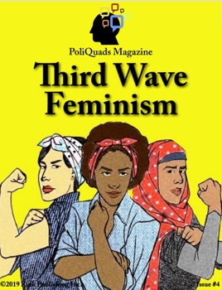

Slide 42
3rd Wave Feminism
The historical and political conditions in which the Second Wave feminism emerged no longer exist and therefore it does not chime with the experiences of today’s women
1990s – A new Wave of Feminism – Media- Music
The feminism of a younger generation of women who acknowledge the legacy of second wave feminism, but also identify what they see as its limitations
This Wave seeks to challenge the definitions of femininity based on experiences of upper middle-class white women
The third-wave sees women’s lives as intersectional, demonstrating how race, ethnicity, class, religion, gender, and nationality are all significant factors when discussing feminism
It examines issues related to women’s lives on an international basis

Slide 43
3rd Wave Feminism
“Third Wavers” pride themselves on their global perspective
Very much at the heart of feminism’s third wave is the sense of generational conflict – one generation claiming its own space and fashioning the movement in its own image
Third-wavers do not completely reject the agenda of second-wave feminism rather they want to add and change it in accordance with there time
Third-wave feminism emphasizes an inclusive and nonjudgmental approach that refuses to police the boundaries of feminist ideas and debates – for instance sexuality
It is certain that third wave activism is still in its relative infancy and that more academic commentaries will gradually emerge

Slide 44
4 Major claims of 3rd Wave Feminism
First claim, third-wavers emphasize that because they are a new generation, they want their own version of feminism that addresses their different societal contexts and the particular set of challenges they face
Young women today face a world colonized by the mass media and information technology, and they see themselves as more sophisticated and media savvy than feminists from their mothers’ generation – Virtual CR Groups

Slide 45
4 Major claims of 3rd Wave Feminism
Second Claim, third-wavers claim to be less rigid and judgmental than their mothers’ generationWhich is often represented as antimale, antisex, antifemininity, and antifun
In contrast to their perception of their mothers’ feminism, third-wavers feel entitled to interact with men as equals, claim sexual pleasure as they desire it (heterosexual or otherwise), and actively play with femininity – cosmetics, surgeries, body piercing , tattoos etc.

Slide 46
4 Major claims of 3rd Wave Feminism
Third Claim, third-wavers depict their version of feminism as more inclusive and racially diverse than the second wave
Third-wave feminism respects not only differences between women based on race, ethnicity, religion, and economic standing but also makes allowance for different identities within a single person – bisexual – asexual –transgender
Women can now be religiously devout or into sports or beauty culture, and still be a feminist

Slide 47
4 Major claims of 3rd Wave Feminism
Fourth Claim, third-wavers claim to have a broader vision of politics than second-wave feminism, to have no “party line,” and to focus on more than just women’s issues – climate change

Slide 48
Critique of 3rd Wave Feminism
Because third-wavers frequently overstate their distinctiveness while showing little knowledge of their own history, the movement has been widely criticized by second-wavers
Third-wave feminism can be viewed as the rebellion of young women against their mothers and as their desire to have a feminism of their own, even though their political remains quite similar to that of their mothers
Second-wave CR in its classic form occurred in face-to-face settings
Third Wave CR also takes place virtually – Social Media
The phrase “the personal is political” still forms the core of feminism, and sharing personal experiences functions as a form of CR & virtual CR Groups within the third wave – Times Up, Me Too
Third Wavers have yet to come up with their own theoretical perspectives on matters like gender, violence, patriarchy, discrimination and many more

Slide 49
3rd Wave Feminism – Horizon
Prostitution – Sex Industry – protection of workers
Pornography – Revenge Porn (RP) – laws against RP
Commercial Surrogacy
Gender and Cyber Crimes – digital harassment
LGBTQ Rights – Laws and behaviours
Protecting the achievements – rise of anti-feminist , anti-women policies

