Slide 1

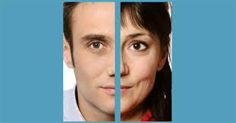

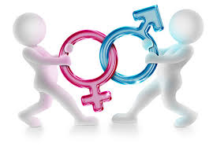
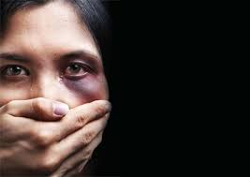

Slide 2
Food for Thought
Awagawan?
If given a chance and asked, what would you like to be in the next life - a female or a male & WHY?
Think over the following before you jump to answer
  Celebration at the time of birth
  Status and position in the Family
  Access to food, education, health facilities – Family + Society
  Access to financial resources Family + Society
  Participation in the decision making processes – Self -Family + Social Life – Economic Activity – Political Presence & Voice
  Freedom to choose profession
  Participation in sports
  Recreation – Tourism – dinning out – spending time with friends

Slide 3
Few Concepts
Feminism – Feminist
“Feminism is the radical notion that women are people” Marie Shear - 1986
Patriarchy - refers to the male domination both in public and private spheres- to describe the power relationship between men and women
Sexism - unfair treatment of people on the basis of sex or gender.
  is any expression (act, word, image, gesture) based on the idea that some persons, most often women, are inferior because of their sex –
Mansplaining & Manterrupting
Misogyny - is the hatred of, contempt for, or prejudice against women or girls
Gender Discrimination - is unequal or disadvantageous treatment of an individual or group of individuals based on gender
Violence – Violence against women- Gender based violence
Date Rape – Period Poverty – Female Genital Mutilation- Femicide

Slide 4
Few Concepts
Sexuality - A central aspect that encompasses sex, gender identities and roles, sexual orientation, eroticism, pleasure, intimacy and reproduction. ( World Health Organization)
Cisgender - (sis-gender): A term used to refer to an individual whose gender identity aligns with the sex assigned to them at birth.
Intersex - is an umbrella term used to describe people with differences in reproductive anatomy, chromosomes or hormones that don't fit typical definitions of male and female
  term used to refer to people who are biologically between the medically expected definitions of male and female. This can be through variations in hormones, chromosomes, internal or external genitalia, or any combination of any or all primary and/or secondary sex characteristics.
  Hermaphrodite - An offensive term for an individual who is intersex .

Slide 5
Few Concepts
Transgender - an umbrella term used by people who feel their assigned sex does not match up to their gender identity, behaviour, expression, or general sense of self.
  So, transgender men (trans men) are people who were assigned female at birth but identify and opt to live as men; while transgender women (trans women) were assigned the male gender at birth but identify and live as women.
Transsexual -This term is used to refer to individuals who refuse to accept the gender they were assigned at birth, and even take medical steps to change different aspects of their body to match the gender that they believe they are.
  Transgender and transsexual should not be used interchangeably, since they do not mean the same. While transsexual people transition from one sex to the other, transgender people only associate with their identity.

Slide 6
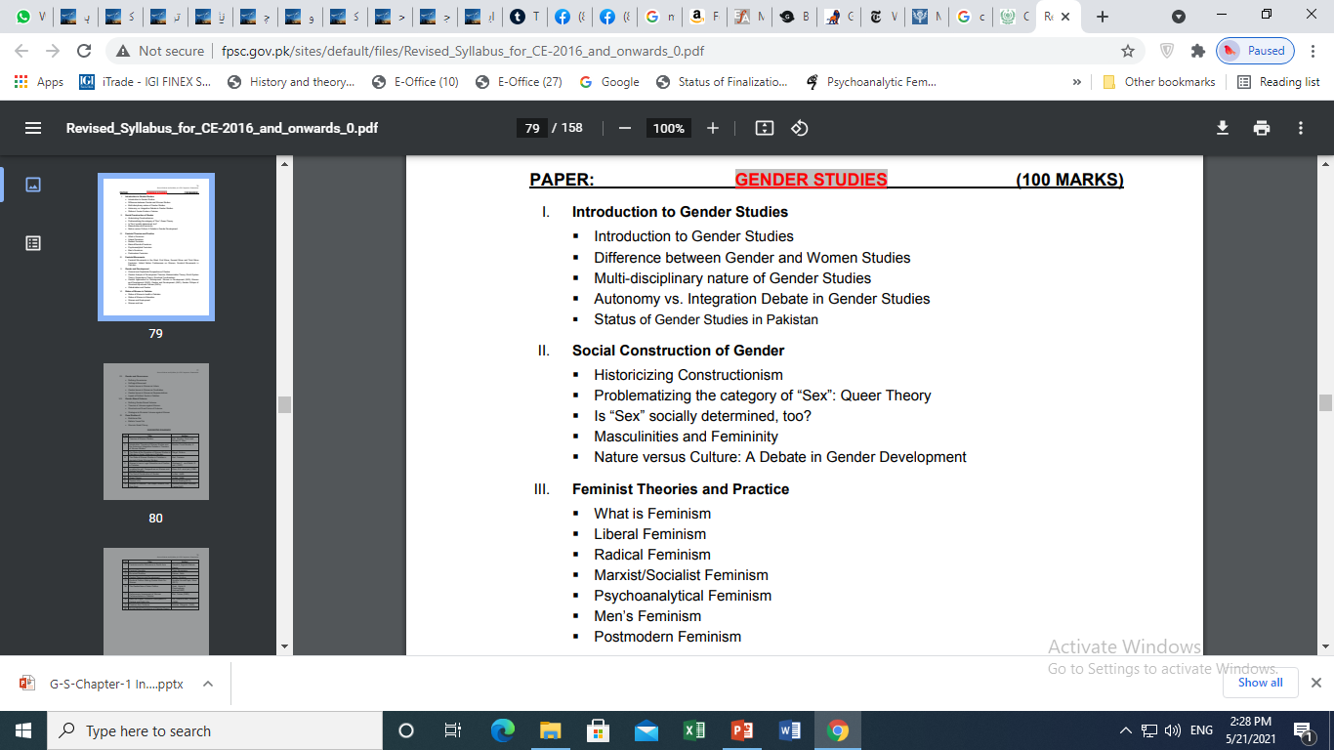
Syllabus

Slide 7
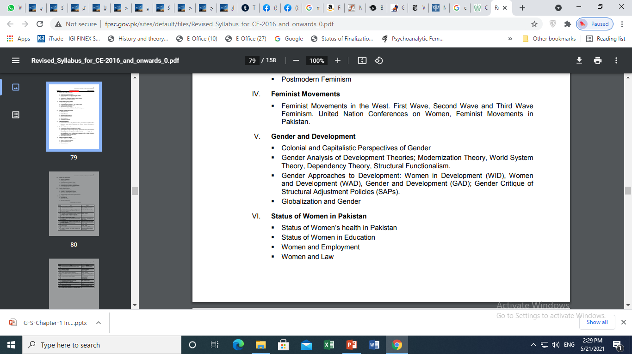

Slide 8
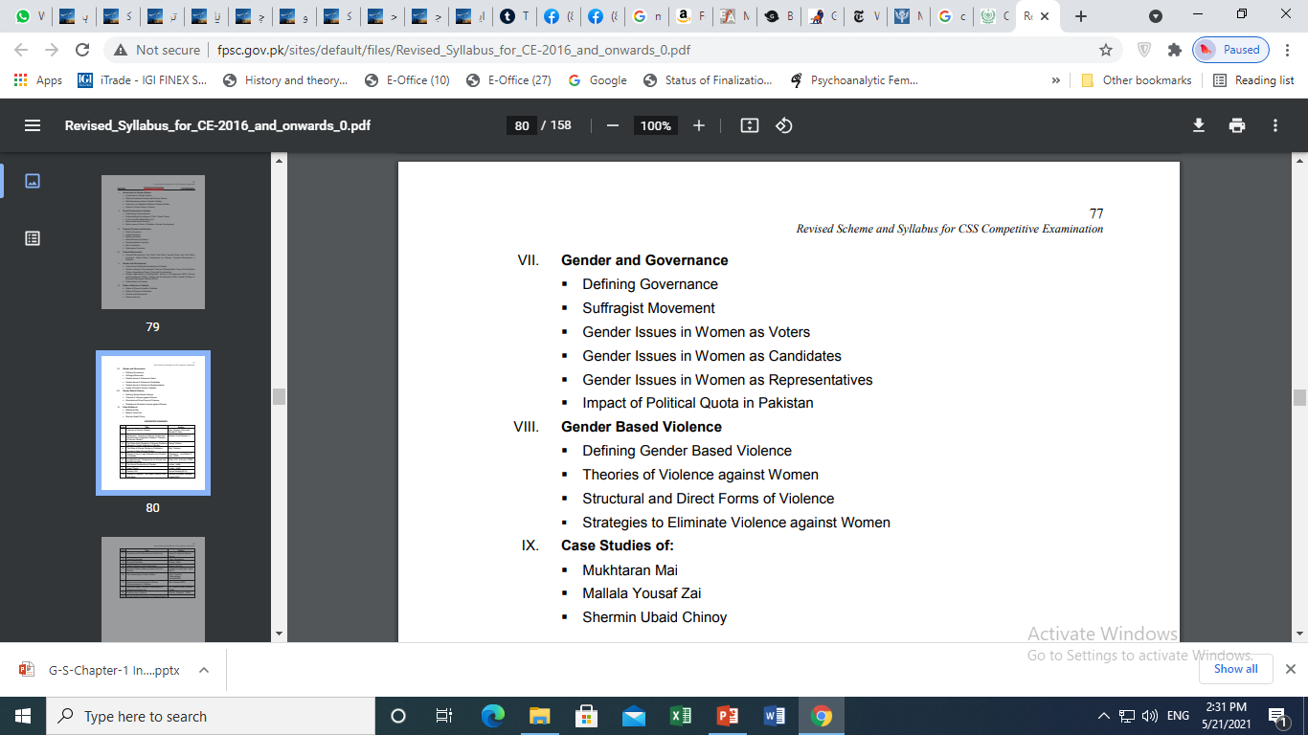

Slide 9
Resources
50 Key Concepts in Gender Studies by Jane Pilcher & Imelda Whelehan
What is Gender Studies? Understanding Basic Concepts from CSS Gender Studies (Gender-Focused) from the FB Group
https://antifeministpraxis.files.wordpress.com/2017/05/chapter1-what-is-gender-studies_-understanding-basic-concepts.pdf

Slide 10
1. Introduction to Gender Studies

Slide 11
SEX – Definition
Biological Categories
Biological differences - male and female differences in chromosomes, anatomy, hormones, reproductive systems, and other physiological components
Physiological concepts
Natural
Based on reproductive potential
Can’t be changed.
  Is it so?

Slide 12
Gender – Defined
The concept of gender, as we now use it came into common parlance during the early 1970s
It was used as an analytical tool to draw a line of demarcation between biological sex differences.
‘One is not born, but rather becomes, a woman’ (de Beauvoir)
Gender is not something we are born with, and not something we have , but something we do (West & Zimmerman-1987)
Gender is something we perform (Judith Butler-1990)
Hence, gender refers to the socially given attributes, roles, activities, responsibilities and needs connected to being men (masculine) and women (feminine) in a given society at a given time

Slide 13
The World is Gendered
Clothing is gendered
Girls – Skirts, shalwar-kurtas, saris ……as feminine
  More colourful
  Decorated with sparkles & shiny materials
Boys – Trousers, shirts , sherwanis…… as masculine
Overlap in clothing
  Both wear denim jeans
  Neckties
  Trousers and jackets
  School Uniforms
Physical Space is gendered

Slide 14
The World is Gendered – Few Masculine Characteristics
Men
Aggressive
Competitive
Independent
Rational
Courageous
Brave
Tough
Adventurer
Active
Takes initiatives

Slide 15
The World is Gendered-Few Feminine Stereotypes
Woman
Caring
Nurturing
Loving
Compassionate
Emotional
Weak
Passive
Gentle
Sympathetic

Slide 16
Gender Studies – G.S
G.S is a field of study that looks at the world from the perspective of gender - Study of the phenomenon of gender
To study something like distribution of resources, development projects, legislation, decision making , access to power- with different outcomes for people of different genders
Socio-cultural analysis of gender include variables like class, race, poverty level, ethnic group, age etc.
Gender Studies, an intellectual and scholarly field, is profoundly linked with the history of the women’s movement

Slide 17
2. Difference Between Gender Studies and Women Studies

Slide 18
Gender Studies | Women studies
3rd Wave Feminism More generic & encompassing and concerns itself with both women and men- the power relationship | 2nd wave of Feminism , women's issues; psychology of women, women's history, literature, etc. problems faced by women W.S a political activity connected to social change From Academic Feminism to activism
how gender affects people, ensure or denies access to power, and want to examine both women's and men's experiences – also experiences of other genders | primary focus is how does knowledge excludes women’s interest & identity women are worthy of study in their own right feminist epistemology (theory of knowledge) the theory of knowledge, especially with regard to its methods, validity, and scope, and the distinction between justified belief and opinion How knowledge is gained and who has the right to possess it
Gender Studies addresses the struggle for gender equality in politics, education, the family, the labour force, in literature and the media; and, in many courses, this involves cross-cultural studies of gender relations | Women's Studies addresses not only the need for a fuller understanding of women in society but also for new criteria and methods of assessing the status of women Not only critique of existing knowledges, but it also provides further analyses of women’s lives

Slide 19
Gender Studies | Women Studies
Gender studies is a field of interdisciplinary study devoted to gender identity. This field includes women's studies, men's studies, and LGBTQ studies. G.S studies gender and sexuality in the fields of literature, language, geography, history, political science, sociology, anthropology, cinema, media studies, human development, law, and medicine | Women’s studies is interdisciplinary or multidisciplinary and often it is taught by academics coming in from their own fields
Work is done both by man & women and by people of other genders | Most of work is done by women about women

Slide 20
3. Multi-disciplinary Nature of Gender Studies

Slide 21
Multidisciplinary approach provides methodological and theoretical tools to study
  Visible and invisible power mechanisms that influence women’s access to posts of responsibility in social, economic, political, religious, intellectual and cultural life.
  sexuality, family, gender-identity, women’s health issues, and reproductive rights.

Slide 22
Economics
Political Science
Sociology
G-Studies
Anthropology
Psychology
Linguistics

Slide 23
4. Autonomy vs. Integration Debate

Slide 24
Autonomy
Autonomy has the appeal of Separatism
Pro-women literature to be produced to counter the existing pro-male literarure
Women Specific research - Women-centric knowledge
Proposes some freedom from constraints imposed by traditional disciplines and departments
GS programmes are free to focus all of their energies on teaching and scholarship about women and gender
No Political affiliation as it would divide women
  Jobs only for women
Focus is Changing the larger society by studying and theorizing the Change

Slide 25
Integration
Marginalization of women couldn’t be understood without integrating into Politics & Economics
Integration to create pro-women male through academia
To attract funds integration is imperative as male aren’t interested to understand causes of women oppression
It goes beyond studying and theorizing the Change as it attempts to bring Change e.g. Academia and society
Focus on persons who have prestige & influence within the system
  Those who don’t study GS, non-feminist, faculty and administration
It requires a different approach & different message from the usual discourse of GS – not exclusive but inclusive
Transformation of the Academia is expected to be more pragmatic than a single programme focusing on women.

Slide 26
Criticism
Different strategies and approaches are appropriate for different goals and places
Both strategies are needed for expansion & growth of GS
W.S was not ready to integrate in mainstream discourses- As it was focused on white, middle-class, hetero-sexual, young, able women
GS has the potential & has successfully been integrated across academia
G.S can never be autonomous as long as it is in the academy
Integration strategies tend to undermine women studies and some feminist goals like the freedom to set feminist agenda

Slide 27
Scope of G.S in Pakistan – Home work
Social Sciences in Pakistan: A profile Chapter No. 15 by Robina Saigol page 343. This would give you the background. Update the statistics through googling.
Good Luck

