Slide 1
Pakistan Affairs
NOA CSS/PMS

Slide 2
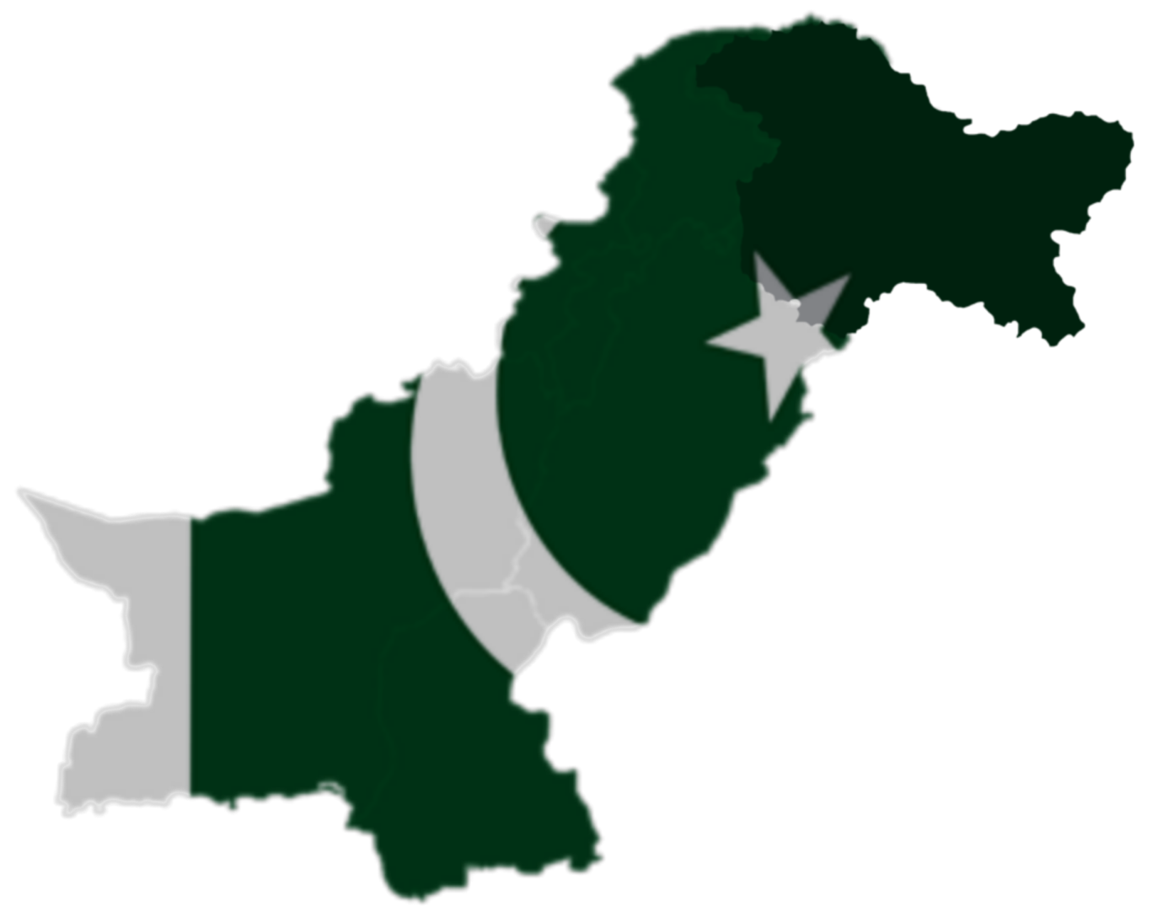
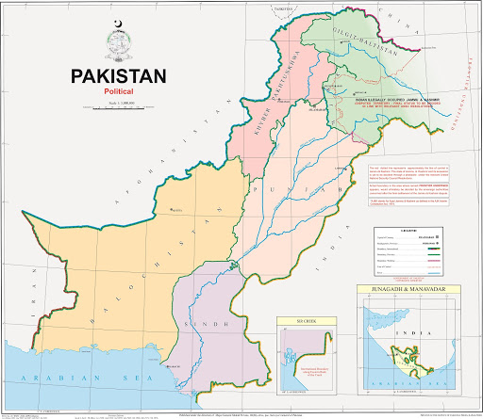

Slide 3
Is History boring?
Study the past if you would define the future. Confucius
"Who controls the past controls the future: who controls the present controls the past." George Orwell

Slide 4
Introduction - Syllabus
A. Muslim rule in the sub-continent and its down fall. Muslim renaissance, reform and educational movements. Pakistan Movement; Role of Sir Syed Ahmad Khan, Allama Iqbal and Quaid-e-Azam in the making of Pakistan.
B. Land and People of Pakistan. Geography, Society, Culture, Natural Resources, Agriculture, Industry, Education.

Slide 5
Introduction - Syllabus
Syllabus
Ideology of Pakistan-----definition and elucidation, historical aspects
Muslim rule in the Sub-Continent, its downfall and efforts for Renaissance.
Movements for reforms-- Shaikh Ahmad Sarhindi, Shah Waliullah, Sayyid Ahmad Shaheed
Aligarh, Deoband, Nadwah, and other educational institutions-------Sindh Madrassah and Islamia College Peshawar
Pakistan Movement – historical developments, important events
Ideology of Pakistan in the light of Speeches and statements of Allama Iqbal and Quaid- i Azam Muhammad Ali Jinnah

Slide 6
Introduction - Syllabus
Chapter- 02
Land and people of Pakistan
Geography, Society, Natural resources
Agriculture, Industry & Education with reference to characteristics, trends and problems

Slide 7
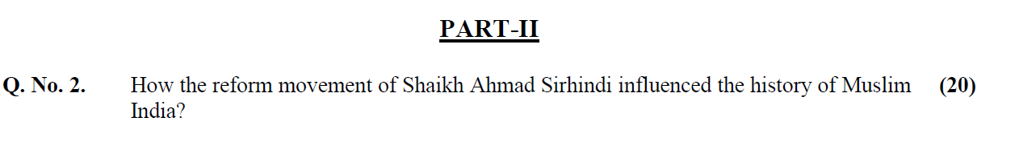
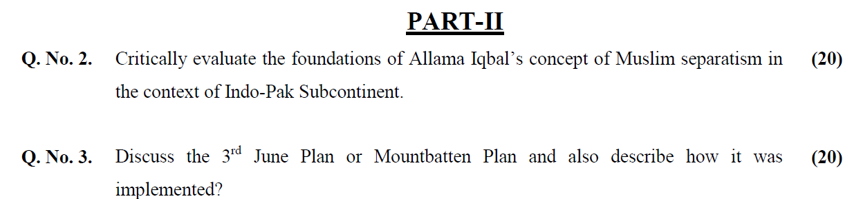
Questions

Slide 8
Introduction
Resources
CSS Compendium Pakistan Affairs by NOA Publication
A Brief History of Pakistan by James Wynbrandt

Slide 9
Muslim rule in the Sub-Continent, its downfall and efforts for Renaissance
1 | 712-14 | Conquest of Sind and Multan by Muhammad Bin Qasim New civilization- culture, langauge
2 | 998-1030 | Reign of Mehmud of Ghazna / Mahmud Ghaznavi
3 | 1020 | Lahore Annexed – Impact on Punjab- Spread of Islam- emergence of Lahore as centre of culture and learning
4 | 1192 | Defeat of Prithvi Raj by Muhammad Ghuri at Tarain 1192 *Muʿizz al-Din Muhammad ibn Sam) Spread of Muslim Rule in the North of India – Delhi , Ajmair etc.
5 | Beginning of Sultanate Period 1206-1526 | Death of Ghouri and beginning of the Sultanate Period Qutab-u-Din Aibak- 1st Muslim Independent Sultan – Founder of Slave Dynasty

Slide 10
712-14
Conquest of Sind and Multan by
Muhammad Bin Qasim
Beginning of Muslim Rule
  "The Brahmanabad settlement"
The basic principle was to treat the Hindus as "the people of the book," and to confer on them the status of the zimmis (the protected) and impose Jizya -A tax of protection levied on non-Muslims
Intellectual Achievements – Cultural exchange
Medicine- Pharmacology, toxicology, philosophy, and astrology, music etc.
Writing of History
Land Measurement & construction of Cantonments

Slide 11
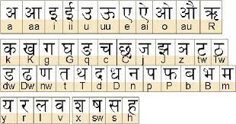
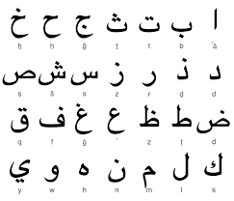
712 Conquest of Sind and Multan
Change of Script from Devanagari to Arabic Script
8. Beginning of a new civilization-Language- culture-

Slide 12
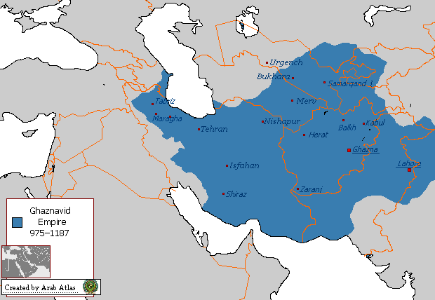
Empire of Mahmud of Ghazna / Mahmud Ghaznavi
998-1030

Slide 13
Reign of Mahmud of Ghazna
Impact on Muslim Civilization in India
1020- Lahore’s Annexation - conquered
Land Rout established between Lahore & rest of the Muslim world
Movement of people, scholars, saints, traders , travelers
Spread of Islam in Punjab
Subsequent emergence of Lahore as a centre of learning and cultural hub
Attacks on India- superiority of Muslim arms- Psychological superiority of Muslims
Inspiration for the successive Muslim rulers to invade and establish a Muslim Sultanate in the Northern India

Slide 14
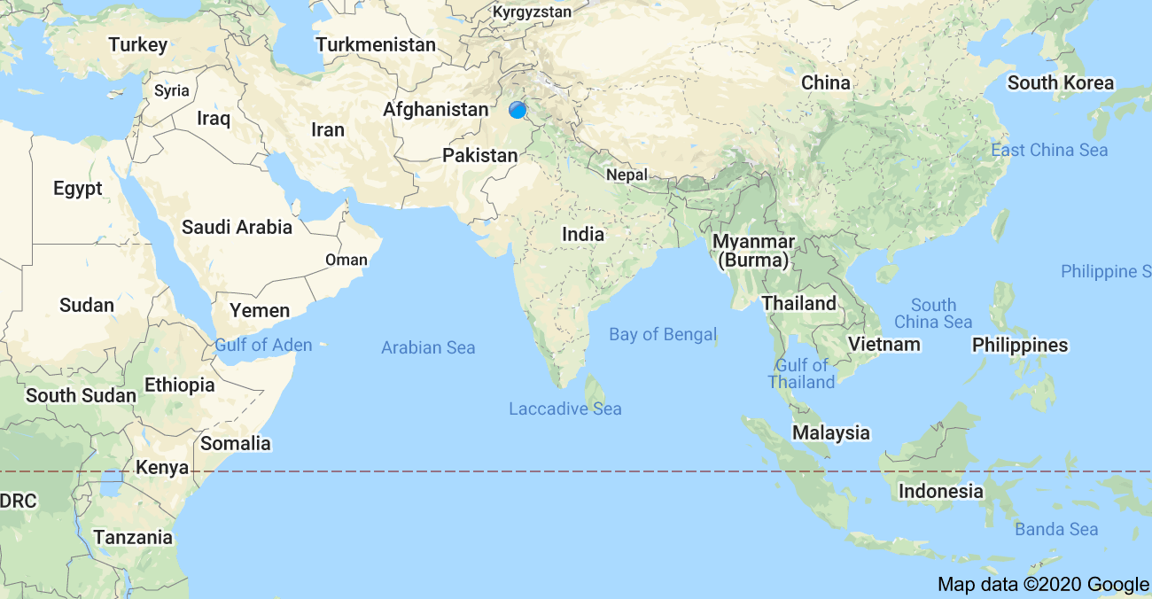
W-India
N-India
Eastern India
South India

Slide 15
1192
Defeat of Prithvi Raj by Muhammad Ghuri at Tarain
Conquest of Northern India – Dehli & Ajmer
Qutb-ud-Din Aibak as viceroy or Deputy
In 1193, Aibak occupied Delhi, the future seat of Muslim power in India
1206- Ghuri was killed
Beginning of Sultanate Period

Slide 16
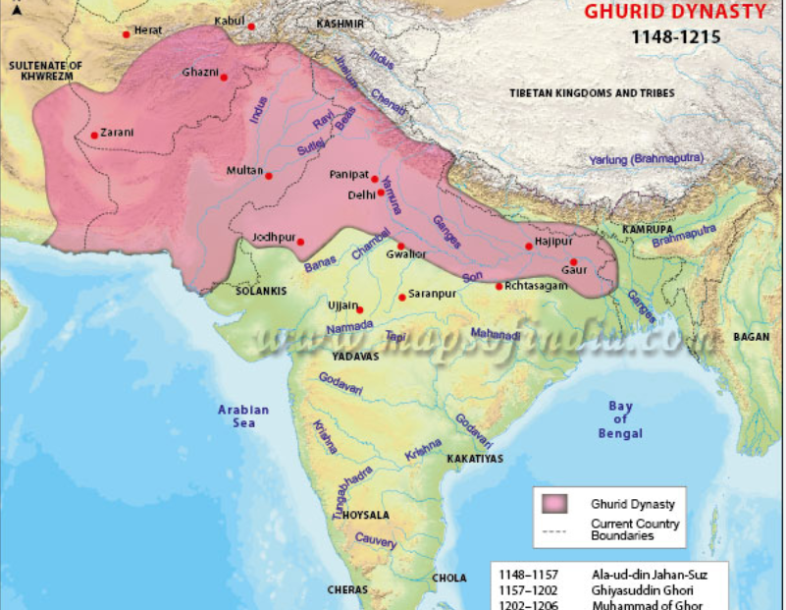

Slide 17
Sultanate Period 1206-1526
Qutb-ud-Din Aibek- the 1st Muslim Sultan of India 1206-1210
Established the Slave dynasty and Delhi Sultanate
Established Delhi as his Capital
Died in 1210
Buried in Anarkali, Lahore

Slide 18
Slave Dynasty 1206-1290
Sultans | Period | Contribution
Sultan Qutab-u-Din Aibak | 1206-1210 | 1st Independent Muslim Ruler of India Muslim Sultanate Slave Dynasty
Sultan Shams-u- din Iltutmish (Altamash) | 1211-1236 | Consolidation and strengthening of Muslim Empire Administrative system New territory to the sultanate
Sultan Ghiyas -u-Din Balban | 1266 to 1287 | Fought off several Mongol invasions Defeated Hindu chiefs (principally Rajput) Introduced elaborate ceremonies Strict Administration f Justice

Slide 19
Sultanate Period 1206-1526
Iltutmish 1211-1236
Internal vs external threats
Internal Threats - Independent Muslim governors , Hindu Rajas, religious orthodoxy
External Threat - Mongol attack
Consolidation of the nascent Muslim empire
Fabric of a new administration
Organized different departments of the central government at Delhi
Qutab Minar- Hauz-e- Shamsi - Madrasa-i-Nasiri,

Slide 20
Sultanate Period 1206-1526
Ghiyas-ud-din Balban1265-1287
Iranian theory of kingship-
Kingship next to Prophethood
Court decorum- Grandeur
Reforms in government – centralization- reduction in the power of nobility (Chihilgan or "the Forty)- standing army
Successfully defended Muslim Empire against Mongol Attack

Slide 21
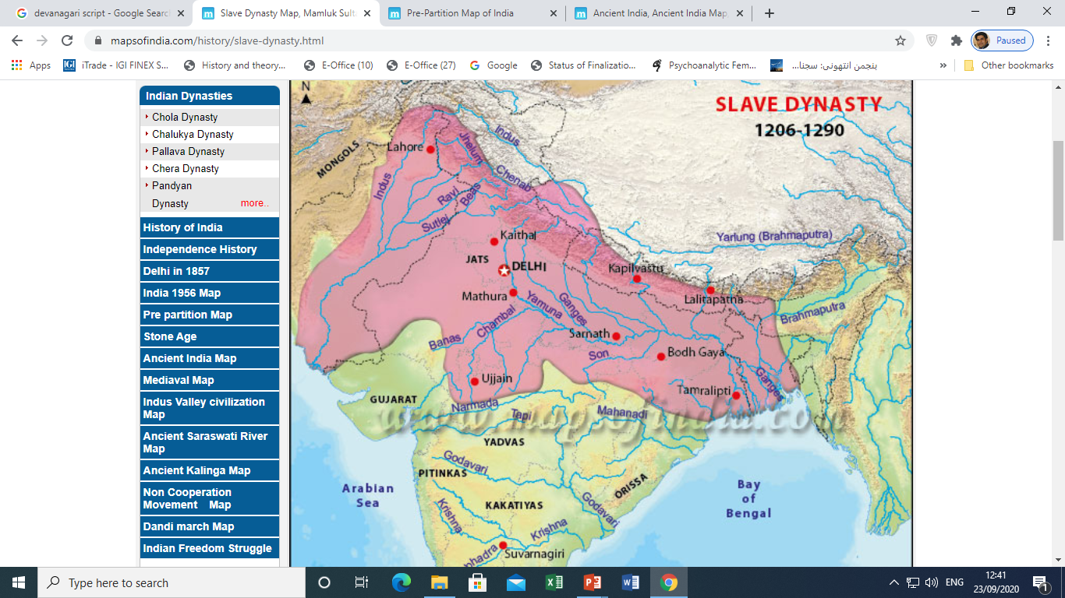

Slide 22
Other Dynasties in the Sultanate Period
Dynasty | Period | Features
Khilji Dynasty | 1290-1320 AD | Sultan Jalaludin Firuz Khilji – 1290-1296 Sultan Alaudin Khilji (Juna Khan)– 1296-1316 Conquests of Gujrat, Rathanbhor, Chittor, Malwa & Deccan
Tughluq Dynasty | 1320-1414 AD | Ghiyasudin Tughlaq 1320-1325 Muhammad Tughlaq 1325-1351 New Capital in Deccan—Doulatabad -1327 New currency Feroz Shah Tughluq 1351-1388 Amir Taimur’s Invasion 1398
Syed Dynasty | 1414-1451 | Khizer Khan Muubarak Shah Muhammad Shah Ala-u-Din Shah
Lodhi Dynasty | 1451-1526 | Bahlul Lodhi 1451-1489 Sikander Lodhi 1489-1517 Ibrahim Lodhi 1517-1526

Slide 23
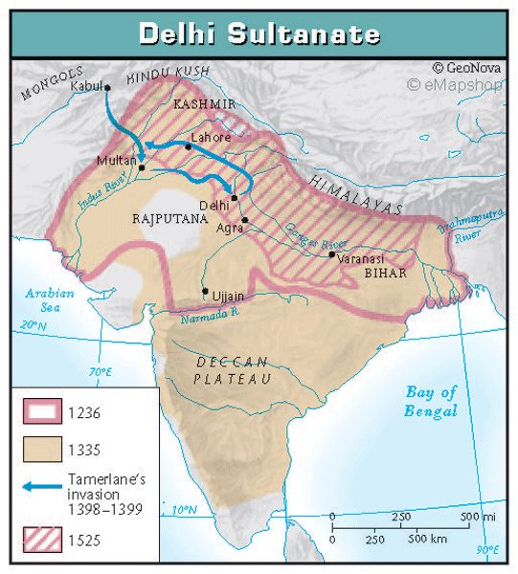

Slide 24
Mughal Period-Age of Empire
Emperor | Period | Features
Zahirudin Babur | 1526-1530 | Attacked & conquered India - 1st battle of Panipat 1526 Established Mughal Dynasty 1526-1857 Battle of Khanua -1527 against Rana Sangha
Hammayun | 1530-1540 & 1556 | Conquered Gujrat -1535 Was defeated by Sher Shah Suri-1540. he went to Iran
Sher Shah Suri (Suri Dynasty 1540-1555) | 1540-1545 | Established new dynasty Administration Law & order Incompetent successor
Hammayun | 1555-1556 | Retuned to India –captured Dehli & restored his monarchy Died after 6 months

Slide 25
Mughal Period-Age of Empire
Emperor | Features
Jalaludin Akkbar 1556-1605 | Crowned at the age of 13 2nd battle of Panipat 1556 with Hemu– the Hindu ruler, defeated him and recaptured Dehli The policy of vigrous conquest Consolidation and strengthening of Mughal Empire Marriages with Rajput Princesses –impact of such marriages Appointment of Hindus in the Mughal court like Raja Baghwan Das & Raja Man Singh Religious Policy The principle of sulah-i kul, or universal tolerance 1564- Akbar abolished “Pilgrimage Tax” 1565-abolition of Jizya Patronage of the classical Indian arts – painting- music- dancing Din e Elahe Orthodox response against Secular Policies—reform movement

Slide 26
1st Revival/Reform Movement
Sheik Ahmed Sirhindi 1564-1624 also known as Mujjadad Alf Sani (Thani)
literally means Reviver of Islam during the second millennium
Sheikh Ahmed , the most prominent disciple of Khawaja Baqi Billah- who started Naqshbandi Order in India
“The most forceful and “original thinker” in India, before Shah Waliulla & Iqbal- SM Ikram
A high place in the Muslim world –Tawhid-i-shahudi
Self-confidence to the Muslim thinking in India

Slide 27
1st Revival/Reform Movement
Main Concerns
Low position of Islam under Akbar
Hindus in the court, Hindu wives worshiping in palaces, abolition of Jizya and of pilgrimage tax, rehabilitation and construction of Hindu temples etc.
"Non-muslims carried out aggressively the ordinances of their own religion in a Muslim state and the Muslims were powerless to carry out the ordinances of Islam; if they carried them out, they were executed” SM Ikam
Muslims…….. “humiliated and powerless”
Non-Muslim enjoyed high positions

Slide 28
1st Revival/Reform Movement
Main Concerns
Withdrawal of patronage of Islam
Aggressive Hindu religious revival
Demolishing of mosques & setting up of temples
Ban on cow slaughter
Cultural influences of Hindus on Muslims
Weakening of Islamic principles
Empowering Hindus would weaken Muslim rule and end it eventually
Akbar’s policy has emboldened Hindus it must be reversed

Slide 29
1st Revival/Reform Movement
Strategy
Advocated re-imposing Jizya and cow slaughter
Hindus & Muslim are different people- Two Nation theory
Muslim shouldn’t intermingle- inter-dine- and intermarry with Hindus
Muslim ruler should distance themselves from Hindus
Hindus to be expelled from the court and removed from important positions
Muslim rulers should distance themselves from the Hindus

Slide 30
1st Revival/Reform Movement
Methodology
Sheikh Ahmed Sirhindi used
  Sermons
  Wrote Letters to influential people/ nobility, governors, Ullema and Mashaikh
  Wrote Booklets
  Books and treatises
Paid price for his views / actions- was arrested by Jehangir and imprisoned for two years

Slide 31
1st Revival/Reform Movement
Success and Legacy
He couldn’t achieve his targets during his life time
But his dreams were realized when Aurangzeib became the Emperor in 1659
Aurangzeib’s policies and regime are considered to be influenced immensely by his ideas

Slide 32
Success and Legacy
Jizya was re-imposed
Pilgrimage Tax was re-imposed
Patronage of Hindu fine arts was withdrawn
Patronage of Hindu temples was withdrawn
Cow slaughter was allowed
New mosques were built to manifest prominence of Islam like Badshahi Mosque in Lahore

Slide 33
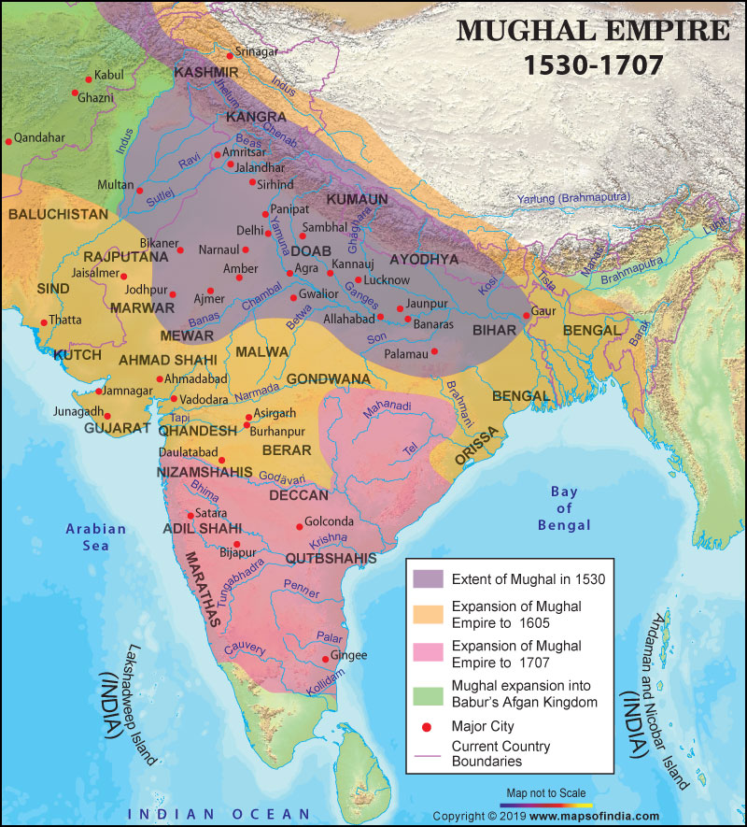

Slide 34
Causes of Decline of Muslim Rule in India
Weak Successor of Aurangzeb
Absence of law of Succession
Wastage of resources in the civil wars
Secular and liberal policies of Akbar
Waning of Jihad Spirit
Luxurious lifestyle—spread of effeminacy
Weakening of Central Authority
Dissipating Military capabilities
Foreign Invasions
Obsolete Education system
Absence of Navy
Internal conspiracies
The role of East India Company (1600-1873)

Slide 35
Reform Movements-Shah Waliullah
Shah Waliullah 1703-1762
Born to a religious family in Dehli –Nobility
Got his early education at madrassa Rahimya & started teaching
Went to Arabia for higher education of Quran and Sunna 1724-1732
After his return, he resumed teaching and started his reform movement

Slide 36
Reform Movements-Shah Waliullah
One of the greatest original thinkers of Muslim India
Deeply troubled at situation of Muslim & Islam in India
Loss of Muslim Political Power
Loss of Muslim Economic Power
Civil war & loss of life, culture and resources
Resurgence of Hindu Power
Conspiracies and betrayal of Muslim elite
Degeneration of Muslim Nobility
Future of Islam and Muslims in India

Slide 37
Reform Movements-Shah Waliullah
Main Ideas
Start of a new reform movement
Rationality of Islam
Preaching pristine values of Islam
Unity among different schools of thought ---Hanafi-Shafi- Malaki-Humbali- Sunni and Shia
Spreading understanding of Quran

Slide 38
Reform Movements-Shah Waliullah
Methodology
Translation of Quran in Persian language as it was language of the educated Muslims in India
Later on the Quran was translated into Urdu by his sons Shah Rafiudin and Shah Abdul Qadir
Writing of Hujjatullah-il-Baligha– suitability of Islam for all people for all the times & the ability of Islam to solve all the problems faced by humanity
Izalat ul Ikhfa wul Khilafat ul Khulufa to remove misunderstanding
Synthesized two philosphies , that is, Wahdat ul wujud & Wahdat ul Shuhud----Thin difference between two
51 books on different problems faced by Muslim community in India
Presented solution to these problems in the light of Quran and Sunna

Slide 39
Methodology
Opposition of Maratha Power
Political Unity among Muslims
Wrote a letters to Ahmed Shah Abdali to attack India
1761, Ahmad Shah Abdali came to India and defeated Maratha confederacy at the 3rd battle of Panipat
Against the hopes of Shah Waliullah, Abdali went back to Afghanistan and didn’t initiate a new Afghan Dynasty in India
The “What if Question” & food for thought

Slide 40
Legacy- Shah Waliullah
Intellectual/ Religious/Educational contribution
Translation of Quran
Decline due to abandoning Islamic principle
Bridging the gap between Sunni and Shia
Importance of Ijthad over Taqlid
Stress on avoidance from social evils
Teaching and researching Islamic though at Madrassa Rahimya
Political Contribution
Unity of Muslim Nobility
Character building of Muslims-spirit of Jihad
Protecting Muslim Community form annihilation by inviting Ahmad Shah Abdali to India
Jihad Movement
Inspiration for late generations – Pakistan Movement

Slide 41


