Slide 1
POLITICAL SCIENCE-I
LEC : 02
MUHAMMAD AFTAB MUNIR (PAS)

Slide 2
TODAY’S AGENDA:

Slide 3
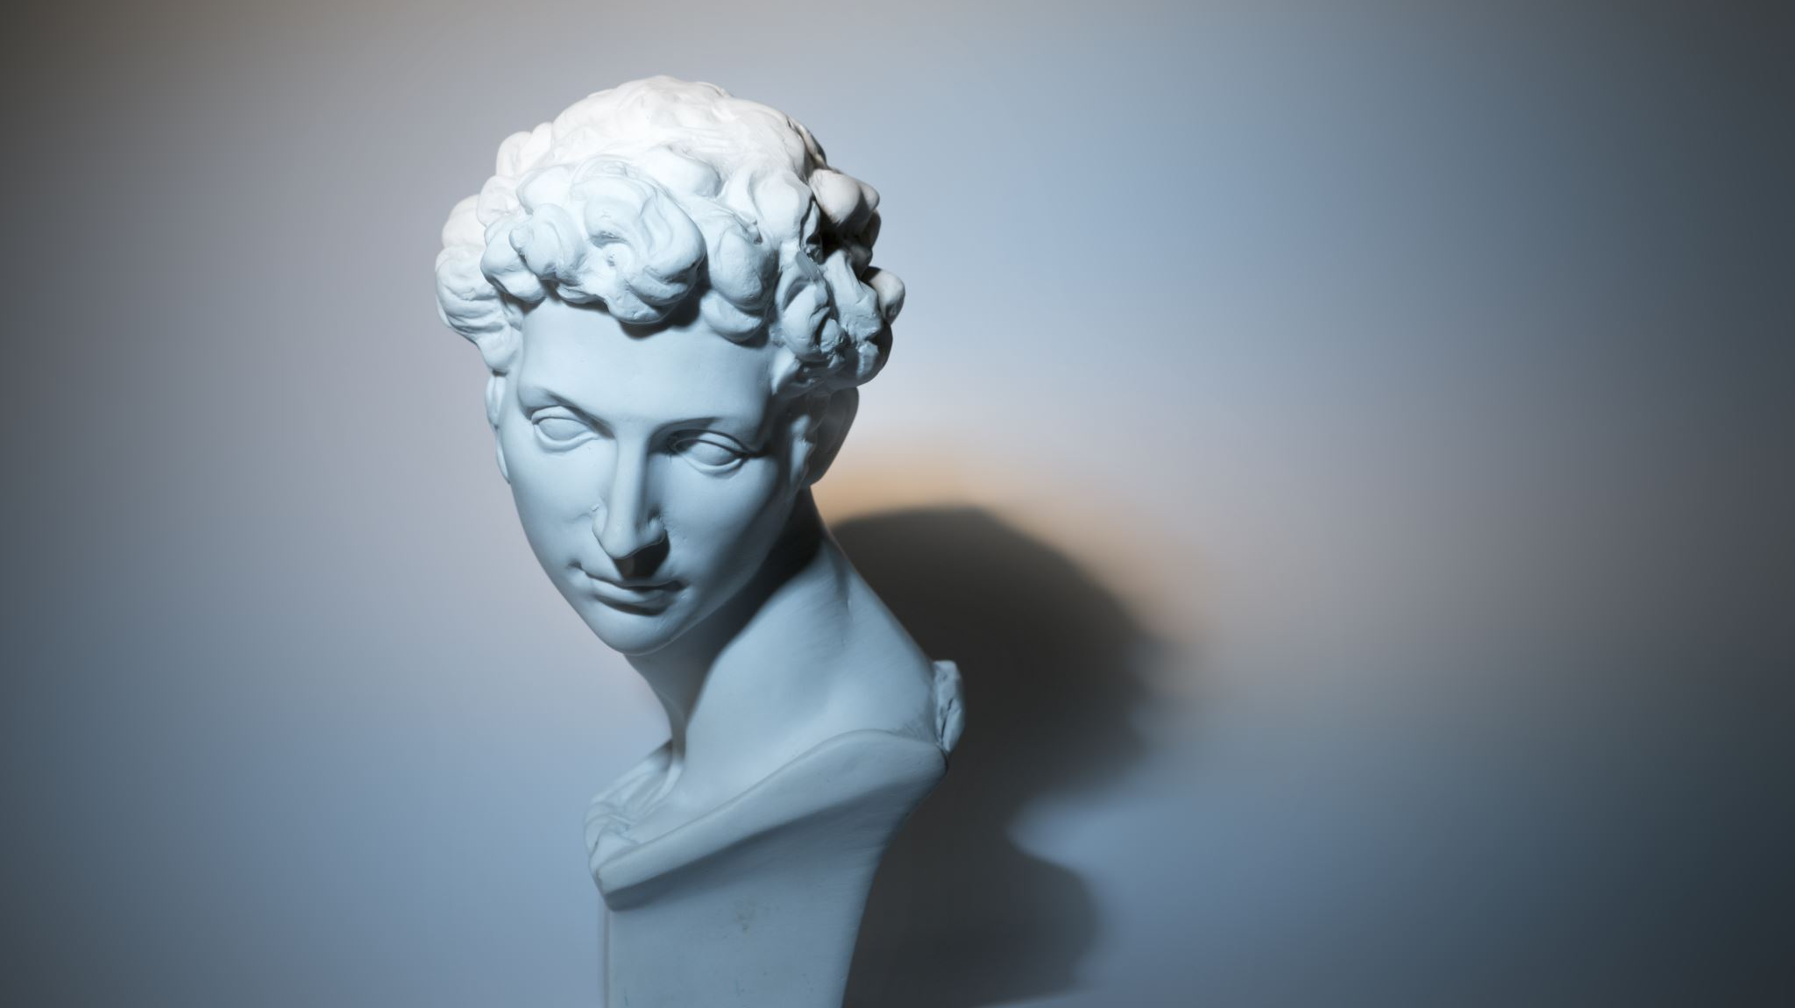
ARISTOTLE- BACKGROUND

Slide 4
ARISTOTELIAN CLASSIFICATION OF STATE

Slide 5
ARSITOTELIAN CYCLE OF CLASSIFICATION OF STATE
MONARCHY
TYRANNY
ARISTOCRACY
OLIGARCHY
POLITY
DEMOCRACY

Slide 6
ARISTOTLE AND CONTITUTIONALISM

Slide 7
ARISTOTLE AND DEMOCRACY

Slide 8
ARISTOTLE’S IDEAL STATE

Slide 9
CRITICAL ANALYSIS

Slide 10
MONTESQUIEU:
BACKGROUND
BOOKS WRITTEN BY MONTESQUIEU
NATURE/TYPES OF GOVERNMENT
CONCEPT OF SEPARATION OF POWERS
MONTESQUIEU: ARISTOTLE OF 18TH CENTURY
CRITICAL ANALYSIS

Slide 11
MACHIAVELLI:
BACKGROUND
BOOKS
APOSTLE OF POWER POLITICS: THE PRINCE
THE DISCOURSES
CRITICAL ANALYSIS

