Slide 1

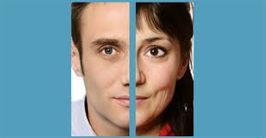
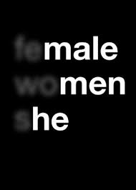
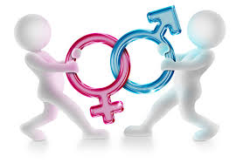
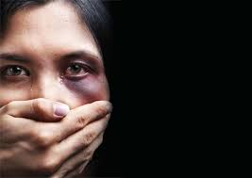

Slide 2
Food for Thought
If given a chance and asked, what would you like to be in the next life - a female or a male & WHY?
Think over the following before you jump to answer
  Celebration at the time of birth
  Status and position in the Family
  Access to food, education, health facilities – Family + Society
  Access to financial resources Family + Society
  Participation in the decision making processes – Self -Family + Social Life – Economic Activity – Political Presence & Voice
  Freedom to choose profession
  Participation in sports
  Recreation – Tourism – dinning out – spending time with friends
  And while you are thinking, take into consideration the lives of millions of girls/women who don’t even know that Gender Studies EXISTS!

Slide 3
Few Concepts
Feminism – Feminist
“Feminism is the radical notion that women are people” Marie Shear - 1986
Patriarchy - refers to the male domination both in public and private spheres- to describe the power relationship between men and women
Sexism - is any expression (act, word, image, gesture) based on the idea that some persons, most often women, are inferior because of their sex –
Mansplaining & Manterrupting
Misogyny - is the hatred of, contempt for, or prejudice against women or girls
Gender Discrimination - is unequal or disadvantageous treatment of an individual or group of individuals based on gender
Violence – Violence against women- Gender based violence
Date Rape – Period Poverty – Female Genital Mutilation- Femicide

Slide 4
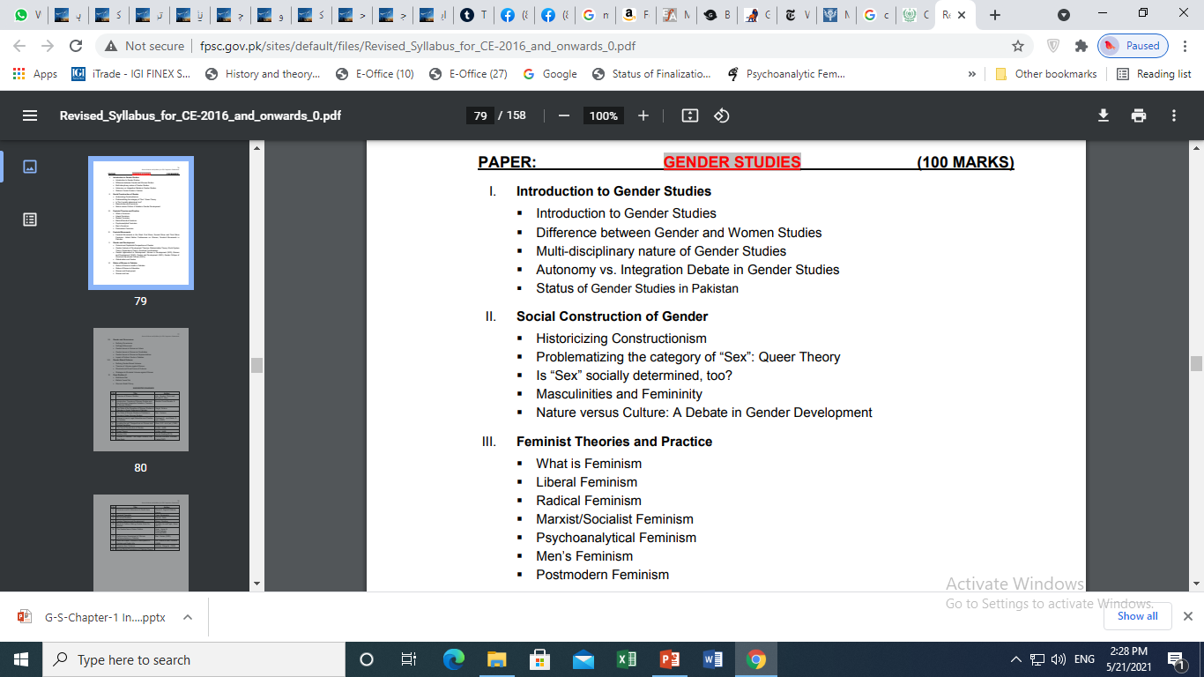
Syllabus

Slide 5
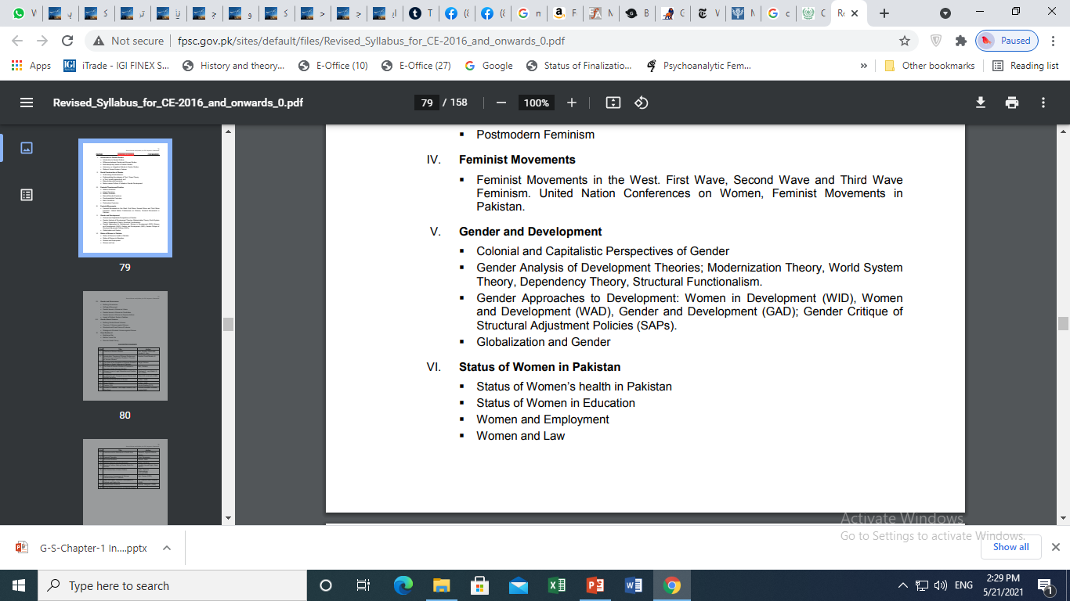

Slide 6
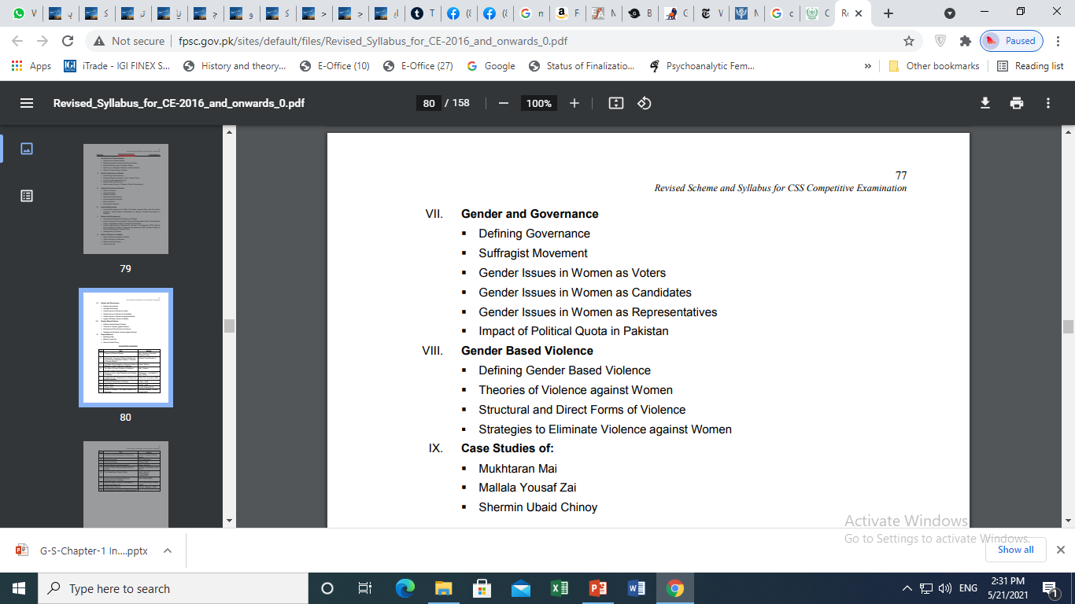

Slide 7
Resources
50 Key Concepts in Gender Studies by Jane Pilcher & Imelda Whelehan
What is Gender Studies? Understanding Basic Concepts from CSS Gender Studies (Gender-Focused) from the FB Group
https://antifeministpraxis.files.wordpress.com/2017/05/chapter1-what-is-gender-studies_-understanding-basic-concepts.pdf

Slide 8
1. Introduction to Gender Studies

Slide 9
SEX – Definition
Biological Categories
Biological differences - male and female differences in chromosomes, anatomy, hormones, reproductive systems, and other physiological components
Physiological concepts
Natural
Based on reproductive potential
Can’t be changed.
  Is it so?

Slide 10
Gender – Defined
  Gender refers to those social, cultural, and psychological traits linked to males and females through particular social contexts.
  Social characteristics that society considers proper for its male & female.
  Traits and characteristics a person is expected to posses by virtue of being male or female.
  Gender seems Natural, and beliefs about gender seems to be obvious truths

Slide 11
Gender – Defined
  Gender is not something we are born with, and not something we have , but something we do (West & Zimmerman-1987)
  Gender is something we perform (Judith Butler-1990)
  Hence, gender refers to the socially given attributes, roles, activities, responsibilities and needs connected to being men (masculine) and women (feminine) in a given society at a given time

Slide 12
Gender Studies – G.S
G.S is a field of study that looks at the world from the perspective of gender - Study of the phenomenon of gender
To study something like distribution of resources, development projects, legislation, decision making , access to power- with different outcomes for people of different genders
Gender Studies, an intellectual and scholarly field, is profoundly linked with the history of the women’s movement

Slide 13
Gender Analysis
G.S enables us to understand differences and inequalities between women and men in
  responsibilities assigned,
  activities undertaken,
  access to and control over resources,
  decision-making opportunities.
Other important criteria for socio-cultural analysis of gender include
class, race, poverty level, ethnic group and age.

Slide 14
How the World is Gendered
Clothing is gendered
Girls – Skirts, shalwar-kurtas, saris ……as feminine
  More colourful
  Decorated with sparkles & shiny materials
Boys – Trousers, shirts , sherwanis…… as masculine
Overlap in clothing
  Both wear denim jeans
  Neckties
  Trousers and jackets
  School Uniforms
Physical Space is gendered

Slide 15
The World is Gendered – Few Masculine Characteristics
Men
Aggressive
Competitive
Independent
Rational
Courageous
Brave
Tough
Adventurer
Active
Takes initiatives

Slide 16
The World is Gendered-Few Feminine Stereotypes
Woman
Caring
Nurturing
Loving
Compassionate
Emotional
Weak
Passive
Gentle
Sympathetic

Slide 17
2. Difference Between Gender Studies and Women Studies

Slide 18
Difference b/w Gender Studies and Women Studies – W.S
Origin of GS in WS
WS- to address gap and imbalance in academic knowledge
Inadequate incorporation of women into academics
Academic disciplines do not take women into account when developing theories and concepts
Unpaid labour of women not part of GDP
  GDP- Total of goods and services produced in a country in a given year

Slide 19
Gender Studies | Women studies
More generic & encompassing and concerns itself with both women and men- the power relationship | women's issues; psychology of women, women's history, literature, etc. problems faced by women
how gender affects people, ensure or denies access to power, and want to examine both women's and men's experiences – also experiences of other genders | primary focus is to be on girls and women and their emancipation
Gender Studies addresses the struggle for gender equality in politics, education, the family, the labour force, in literature and the media; and, in many courses, this involves cross-cultural studies of gender relations | Women's Studies addresses not only the need for a fuller understanding of women in society but also for new criteria and methods of assessing the status of women.
Gender studies is a field of interdisciplinary study devoted to gender identity. This field includes women's studies, men's studies, and LGBTQ studies. G.S studies gender and sexuality in the fields of literature, language, geography, history, political science, sociology, anthropology, cinema, media studies, human development, law, and medicine | the concept of “women’s studies” was narrow, concerned with female identity ignoring broader issues
Work is done both by man & women | Most of work is done by women about women

Slide 20
3. Multi-disciplinary Nature of Gender Studies

Slide 21
Gender Studies has developed mainly in Humanities and Social Sciences
Multi-disciplinary approach is the most important concepts integral to this field of study

Slide 22
Multidisciplinary approach provides methodological and theoretical tools to study
  Visible and invisible power mechanisms that influence women’s access to posts of responsibility in social, economic, political, religious, intellectual and cultural life.
  sexuality, family, gender-identity and the power of representation and language, women’s health issues, and reproductive rights.
Multidisciplinary approach helps to reveal the full extent of women’s lives, which has been hidden because men were the predominant subjects and objects of knowledge

Slide 23
Economics
Political Science
Sociology
G-Studies
Anthropology
Psychology
Linguistics

Slide 24
4. Autonomy vs. Integration Debate

Slide 25
Two Different Strategies in GS
moral, social and economic welfare of Pakistani wome1982- the debate surfaced at NWSA Conference
Florence Howe noted that WS have now two strategies
  Autonomy
  Integration
Integration is to be the ultimate strategy

Slide 26
Autonomy
Autonomy has the appeal of Separatism
Pro-women literature to be produced to counter the existing pro-male literarure
Women Specific research
Women-centric knowledge
Proposes some freedom from constraints imposed by traditional disciplines and departments
GS programmes are free to focus all of their energies on teaching and scholarship about women and gender
GS can study and define the focus in their own terms as long as they stay within the broader confines of academia
No Political affiliation as it would divide women
Jobs only for women
GS works need not to defend the feminist content of their work or to dilute it
Focus is Changing the larger society by studying and theorizing the Change

Slide 27
Integration
Marginalization of women couldn’t be understood without integrating into Politics & Economics
To attract funds integration is imperative as male not interested to understand causes of women oppression
Integration to create pro-women male through academia
It goes beyond studying and theorizing the Change as it attempts to bring Change e.g. Academia itself, society
Focus on persons who have prestige & influence within the system
  Those who don’t study GS, non-feminist, faculty and administration
It requires a different approach & different message from the usual discourse of GS – not exclusive but inclusive
Thorough and unprecedented Transformation of the Academia is far larger than the single small programme focusing on women.

Slide 28
Criticism
Different strategies and approaches are appropriate for different goals and places
Both strategies are needed for expansion & growth of GS
WS was not ready to integrate in mainstream discourses- As it was focused on white, middle-class, hetero-sexual, young, able women
GS has the potential & has successfully been integrated across academia
G.S can never be autonomous as long as it is in the academy
Integration strategies tend to undermine women studies and some feminist goals like the freedom to set feminist agenda

Slide 29
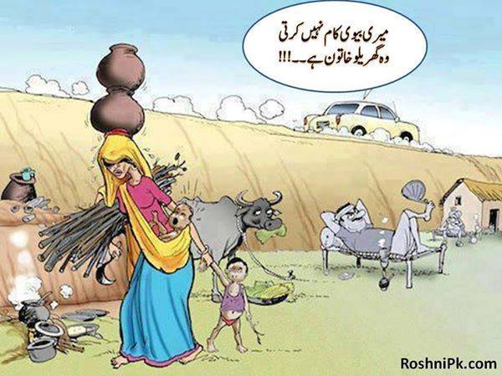
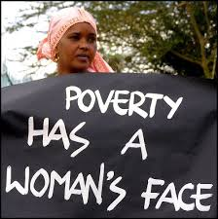
Status of Gender Studies in Pakistan

Slide 30
Conventional, Non Conventional and Socioeconomic Indicators of gender bias
1. Mobility | 8. Sexual subjugation
2. Decision Making | 9. Female infanticide
3. Violence | 10. Witnessing
4. Mental distress and mental well-being | 11. Inheritance
5. Clothing requirements | 12. Property ownership
6. Right to divorce | 13. Right to Contract
7. Access to Education | 14. Choice of Profession

Slide 31
Global status of Women
Half of the world’s population
Role in Development of human civilization
Fewer opportunities to acquire land, property, credit, education, skills and paid job hinder their status – Oxfam 2021
50% of the global poor are women– the World Bank – 2018
Women are doing more housework than man---60% of total unpaid labour is done by women (a UN report 2007)
Hard work and contribution to economy , 1 % of world assets in women’s name

Slide 32
Violation of women productive rights is common
HIV (positive) is increasing worldwide in women
Early marriages lower down women’s status in term of income, education and awareness
48% (10 million) are married before the age of 18 in South Asia – UNICEF-2010

Slide 33
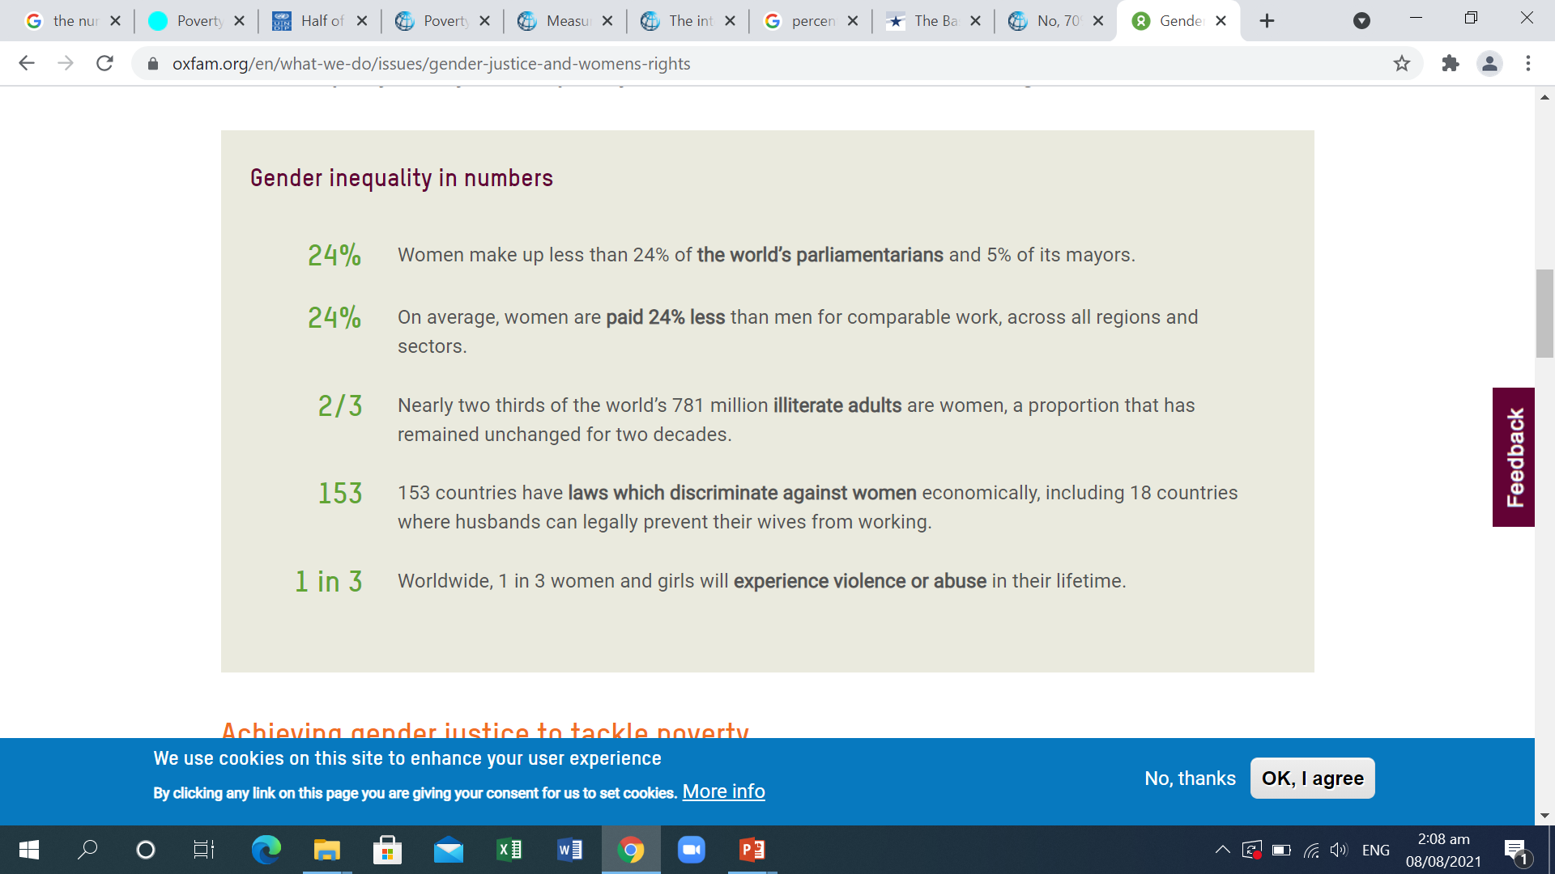
Global status of Women – Oxfam -2021

Slide 34
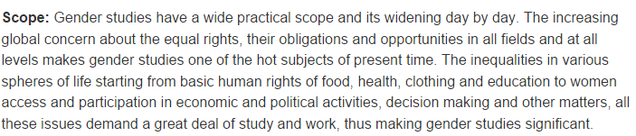
Scope of G.S in Pakistan

Slide 35
Scope of G.S in Pakistan – Home work
Social Sciences in Pakistan: A profile Chapter No. 15 by Robina Saigol page 343. This would give you the background. Update the statistics through googling.
Good Luck

