Slide 1
Pakistan and Regional Organizations
SARFRAZ HUSSAIN ANSARI (CSP)
          34th Common- PA&AS
          Director Finance
        MBA (Int. Fin) - UIBE Business School, Beijing
        M.Sc. Public Administration (PF) - QAU Islamabad
        Fellow Pakistan Institute of Public Finance & Accountancy
        SAP-FI Certified, Certified Performance Auditor

Slide 2
Regional & global organizations
Current Affairs & Pakistan Affairs

Slide 3
Multilateralism for Regional & Global Cooperation
Globalism---IGOs
Regionalism: Regional Organizations
SAARC
ECO
SCO
EU
NAFTA
ASEAN
OIC
Gulf Cooperation
Council
Arab League
International Political Order
LoN
UN
ICJ
International Economic Order
World Bank
IMF
WTO
Lecture-1
Lecture-4
Lecture-2
Lecture-5
Lecture-3

Slide 4
Sources of Study
NOA Current Affairs Book by Fareed Khan
NOA Pakistan Affairs Book
My Lectures
Official Websites of these Organizations
CSS Five Year Papers
Watch BBC ‘Outside Source’ Aljazera and DW

Slide 5
Talking Points/ Food for thought
Globalism & Regionalism
  Internalization and the notion of ‘Collective Security’
Nationalism Vs Super-nationalism
Which is more important?
If both are important at the same time, whom to accord priority to?
Notes:
Slowbization…..

Slide 6
National Security Vs Collective Security
What is national security?
Who is responsible for national security?
What is ‘Self Defense’? (Article 51 of UN)
What is International Security?
Who’s responsible for Int. Security?
What is ‘Collective Security’

Slide 7
Regional Integration and Regionalism
Regionalism
  the theory and practice of regional rather than national systems of administration or economic, or socio-cultural, or political affiliation.
Regional Cooperation Organizations and Role of Pakistan
  SAARC
  ECO
  SCO

Slide 8
Outline
Introduction
  Background
  Brief History (Genesis)
  Members (and membership criteria)
Charter, Objectives, Principles
Structure
Functions
Issues and Challenges
  Geo-Strategic, Geo-Economic, ideological, trade, cultural etc
  Latest/current developments
Future Prospects
Recommendations
Conclusion

Slide 9
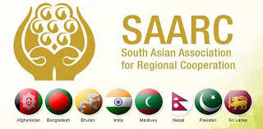
SAARC

Slide 10
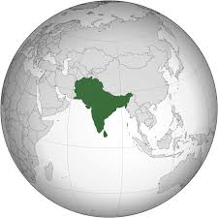
SCO
ECO
SAARC
ASEAN

Slide 11
Historical Background (Why SAARC)
1.Role of Leadership
  President Ziaur Rahman, in December 1977, discussed regional cooperation with the Indian PM.
  in 1977, King Birendra of Nepal stressed for close regional cooperation
2. the Colombo Plan- reaping max. benefits from the aid for South Asian countries.
3. South Asian countries facing common problems
4. A compact landmass perfect for regional Integration.
So, the officials of the seven countries met in Colombo in April 1981
5. Regionalism on the Rise

Slide 12
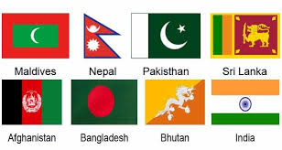
In 1983, the FMs adopted the Declaration on
  South Asian Association for Regional Cooperation (SAARC)
The SAARC Charter was signed in Dhaka on 8 December 1985.
The Secretariat in Kathmandu- since 1987.
Initially seven, now eight member States
  Afghanistan joined SAARC in 2007
Notes:
Afghanistan joined SAARC in 2007

Slide 13
SAARC Members
SAARC Observers
Afghanistan
Bangladesh
Bhutan
India
Maldives
Nepal
Pakistan
Sri Lanka
Australia
China
the European Union
Iran
Japan
the Republic of Korea
Mauritius
Myanmar; and
the United States of America.
observer states—a status that entitles them to express their opinion, engage in dialogues, and give advice but denies them decision making and voting rights.
Notes:
observer states—a status that entitles them to express their opinion and give advice but denies them voting rights.

Slide 14
Article I- SAARC OBJECTIVES
To Promote Welfare Of The Peoples of SOUTH ASIA
To Accelerate Economic Growth and Social Dev.
To Promote Collective Self-reliance
To Dev. Mutual Trust and Understanding of One Another's Problems;
To Promote Cooperation;
  Among Member States
  With Other Developing Countries;
  In International Forums; and
  With International And Regional Organizations

Slide 15
Article II-PRINCIPLES (Values)
Promoting peace, stability, and progress in the region
Respect for the principles of
  Sovereign equality
  Territorial integrity
  National independence
  Non-use of force
  Non-interference in the internal affairs of other states and
  Peaceful settlement of all disputes;
Fostering mutual understanding, good neighborly relations and meaningful cooperation

Slide 16
SAARC-Institutional framework

Slide 17
1. SAARC Summit
Total 18 Summits held. 19th Summit was cancelled in 2016
Once a year
4. Secretariat
5. Programming Committee
Kathmandu. Sec Gen
3-year Term of Office
6. Technical Committees
7. Committee on Economic Cooperation
For particular fields
2. Council of Ministers
3. Standing Committee
Meets twice a year
Foreign Secretaries. Meet twice a year
Commerce & Trade Secretaries

Slide 18
Article III-SAARC SUMMIT
  MEETINGS OF THE HEADS OF STATE OR GOVERNMENT
  once a year
  Unanimous decision
Article V- STANDING COMMITTEE
  The Standing Committee comprising of the Foreign Secretaries
  Assist and facilitate the Council of FMs
Article VI- TECHNICAL COMMITTEES
Article IV-COUNCIL OF Foreign MINISTERS
A) formulation of the policies of the ASSOCIATION;
B) review of the progress of cooperation
C) decision on new areas of cooperation;
D) establishment of additional mechanism under the ASSOCIATION
E) decision on other matters of general interest to the ASSOCIATION.
The council of ministers shall meet twice a year.

Slide 19
Article-VIII SAARC SECRETARIAT
  There shall be a Secretariat of the ASSOCIATION.
  Performs day to day administrative functions
  Esala R. Weerakoon, from Sri Lanka is the current Secretary General from 1st March 2020
  3 year term of office
Article IX- FINANCIAL ARRANGEMENTS
The contribution of each Member State towards financing of the activities of the ASSOCIATION shall be voluntary.

Slide 20
SAARC-A Critical Analysis
key issues/challenges are:
Regional integration & infrastructure development
energy,
climate change, food security, poverty alleviation,
science and technology, education for human developemnt
trade, tourism, culture and people-to-people contact
Terrorism and cooperation in counter-terrorism.

Slide 21
Economic Indicators
SAARC-Geo-Economics

Slide 22
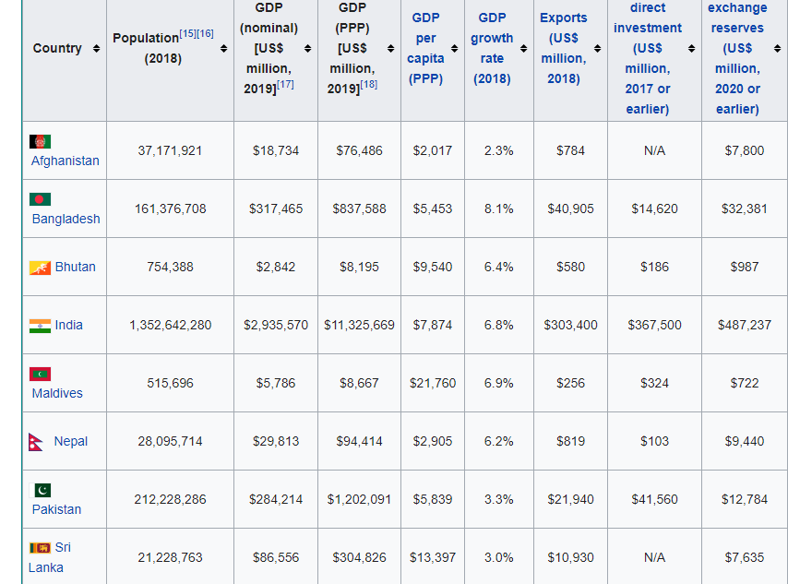
Economic data is sourced from the IMF, current as of December 2019,

Slide 23
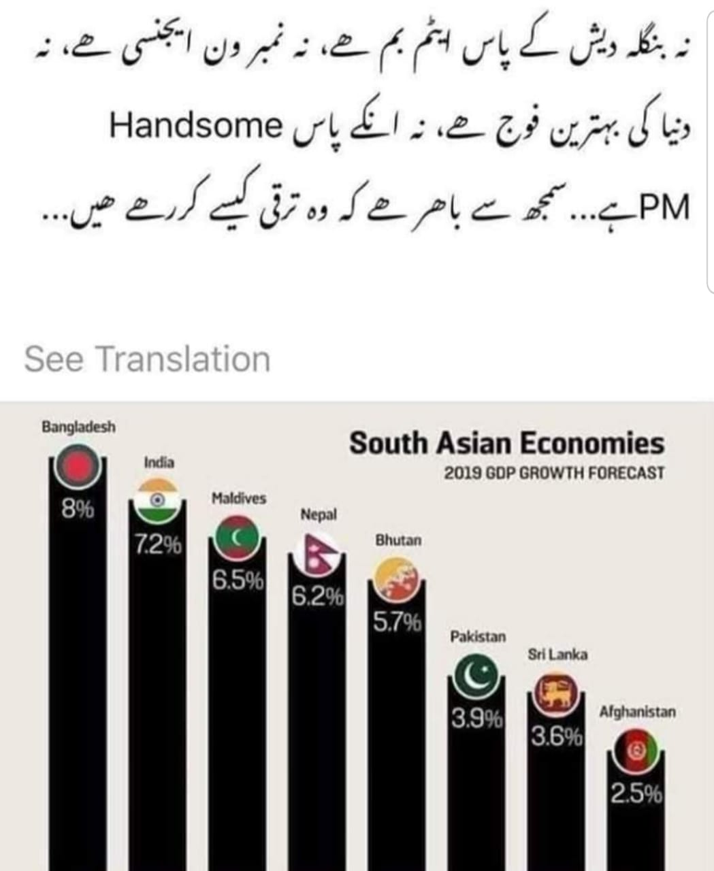
The World Economic Forum: an Outlook on South Asian Economies

Slide 24
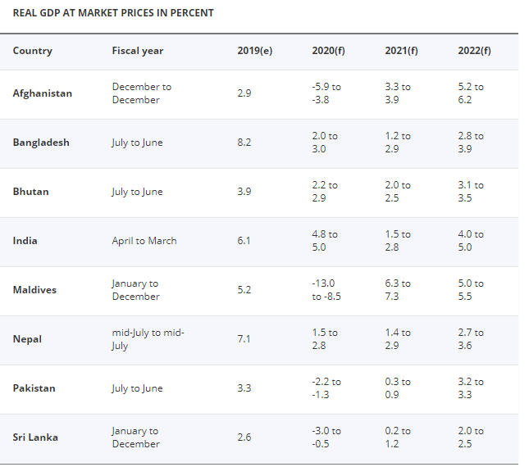
https://www.worldbank.org/en/region/sar/overview

Slide 25
SAARC-geo politics

Slide 26
SAARC- Regional Power Politics
1. Two dominant players-Pakistan and India off setting each other’s influence
  the Balance of Power in South Asia and Nuclear deterrence
  Kashmir issue as the nuclear flash point
  Enmity with India since independence
  India’s influence in Bangladesh, Nepal and Bhutan due to proximity

Slide 27
SAARC-Critical Analysis …conti
2. The Changing Regional Balance of Power & SAARC
  India’s increasing involvement in Afghanistan and our strategic depth
  Pakistan tries to offset it while lobbying with Maldives, Sri Lanka and Afghanistan
3. Increasing influence of China in South Asia
  China also off sets India- it invites other global players in the region
  Recent row between China and India at LAC in Galwan Valley, Laddakh
4. Presence of US in the Region
5. SAARC-ECO-SCO
  The Emerging ‘Asian Order’

Slide 28
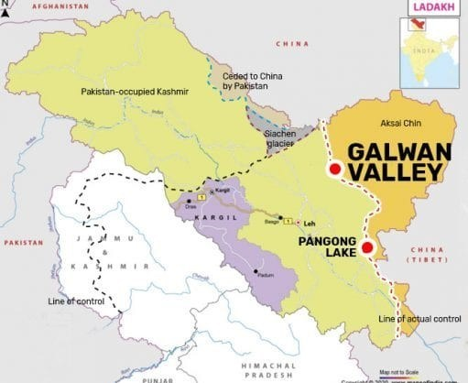
The Geo-Strategic Region Claimed by Pakistan, China and India

Slide 29
SCO
ECO
ASEAN
Geo-Strategic and Geo-Economic importance of Pakistan.
Pakistan: A Regional Hub for
SAARC-ECO-SCO

Slide 30
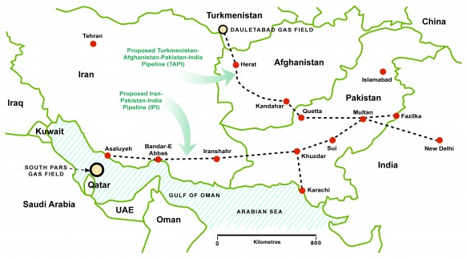
Energy Corridor and Importance of Pakistan

Slide 31
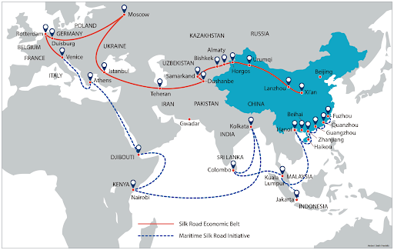

Slide 32
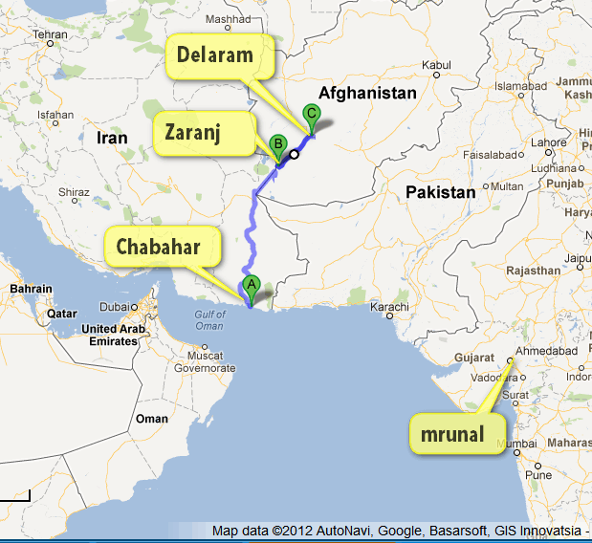

Slide 33
SARC: Successes
SAFTA was negotiated
SAARC has created ‘South Asian Identity’
SAARC Food Bank in 2011 in Pakistan
South Asian University in New Delhi
SAARC Development Fund in 2010
SAARC Arbitration Council
South Asian Regional Standards Organization

Slide 34
Hurdles in SAARC Integration
SAARC Charter Needs Amendments
SAARC-A Region without Regionalism
  India’s Look East Policy
  Bangladesh and Sri Lanka Looking towards ASEAN
  Pakistan’s tilt towards ECO and SCO
Extra Regional Actors Influence Indo-Pacific Politics
Indian Hegemony and Pakistan’s India centric Policies
Lack of Leadership, Trust and mutual Respect
Use of Force as a Tool to Resolve Contentious Issues
Complexity among Diversity

Slide 35
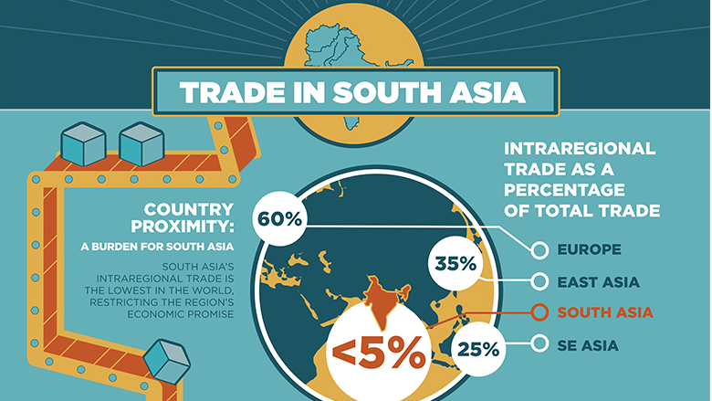
SAARC-Free Trade Area
In 1995, the first step towards a South Asian Free Trade Area (SAFTA)
The SAFTA Agreement was signed on 6 January 2004 during 12th SAARC Summit held in Islamabad, Pakistan.
Leading subsequently towards
  a Customs Union,
  Common Market and
  the Economic Union.
It is still a pipedream

Slide 36
Future Scenarios
Future expansion of SAARC???
Three Scenarios
  SAARC would lose its importance and effectiveness and will be disintegrated- chances are remote and dim
  Status Quo
  Revival and Future Expansion- a challenge

Slide 37
SAARC: Conclusion
Areas of Cooperation
(the Pull Factors)
Areas of Conflict
(the Push Factors)
Human Resource Dev
Agriculture, Food Security, Sustainability, climate change
Poverty Alleviation, health
Biotechnology, IT & Telecom,
Trade and energy corridors
Tourism
Kashmir Issue
Border Disputes
Trade Disputes
Regional Imbalance
Terrorism and interference in internal affairs
Public Opinion of mutual hatred and distrust

Slide 38
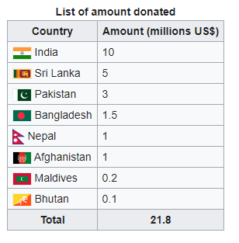
SAARC Latest
SAARC COVID-19 Emergency Fund-March 15, 2020
PM of Pakistan contacted PM of Bangladesh and discussed regional issues and reviving of SAARC

Slide 39
Factors that contribute in Power Politics & Competition
Tangible
Intangible
Strong Economy
Modern Technology
Political Stability
Geography
Leadership
Social Cohesion
Population Quality
Diplomacy
National Identity
On the basis of these factors certain countries start playing defining and leading role in the regional organizations they are member of.

Slide 40
and the emerging ‘Asian order’
The Shanghai Cooperation Organization

Slide 41
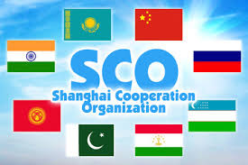

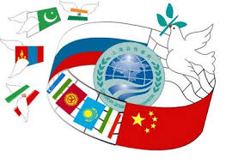
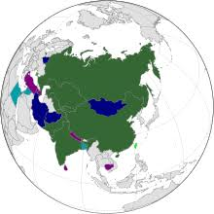
http://eng.sectsco.org/about_sco/

Slide 42
The Shanghai Cooperation Organization (SCO)
A permanent intergovernmental organization
Created on 15 June 2001 in Shanghai (China) by
  the People's Republic of China,
  the Republic of Kazakhstan,
  the Kyrgyz Republic,
  the Russian Federation,
  the Republic of Tajikistan, and
  the Republic of Uzbekistan.
It was preceded by the Shanghai Five mechanism.
SCO Secretary-General VLADIMIR NOROV from January, 2019

Slide 43
SCO-Members, Observers, Dialogue Partners
8 member states
  China,
  India,
  Kazakhstan,
  Kyrgyzistan
  Pakistan,
  Russia
  Tajikistan, and
  Uzbekistan
4 observer states
  Afghanistan,
  Belarus,
  Iran and
  Mongolia
6 dialogue partners
  Azerbaijan,
  Armenia,
  Cambodia,
  Nepal,
  Turkey, and
  Sri Lanka.

Slide 44
The Charter was signed during the St. Petersburg SCO Heads of State meeting in June 2002
It entered into force on 19 September 2003.
This is the fundamental statutory document which outlines
  The Organization's Goals
  Principles
  Structure, and
  Core Activities.

Slide 45
The SCO Goals
The SCO's main goals are;
  strengthening mutual trust among the member states;
  promoting their effective cooperation in politics, trade, the economy, and other areas;
  making joint efforts to maintain and ensure peace, security and stability in the region; and
  Combating three evils-terrorism, separatism, and extremism
  Regional economic linkages
  establishment of a democratic, fair and rational new international political and economic order.

Slide 46
SCO-Policy Principles
Internal Policy
External Policy
based on the principles of
  mutual trust,
  mutual benefit,
  mutual consultations,
  equality,
  respect for cultural diversity
  a desire for common development
is conducted in accordance with the principles of
  non-alignment,
  non-targeting any third country, and
  openness.
  Common and shared future

Slide 47
SCO-Structure
The Heads of States Council (HSC) is the supreme decision-making body in the SCO.
  It meets once a year and adopts decisions and guidelines on all important matters of the organization.
The Heads of Government Council (HGC)
  meets once a year to discuss the organization's multilateral cooperation and priority areas, to resolve current important economic and other issues
  approve the organization's annual budget.
The Council of National Coordinators of SCO Member States (CNC)
  acts as the SCO coordination mechanism.

Slide 48
4. the SCO Secretariat based in Beijing
5. SCO Business Council and SCO Inter-Bank Association
6. the Executive Committee of the Regional Anti-Terrorist Structure (RATS) based in Tashkent.
The SCO Secretary-General and the Director of the Executive Committee of the SCO RATS are appointed by the Council of Heads of State for a term of three years.

Slide 49
Sco and the rise of china

Slide 50
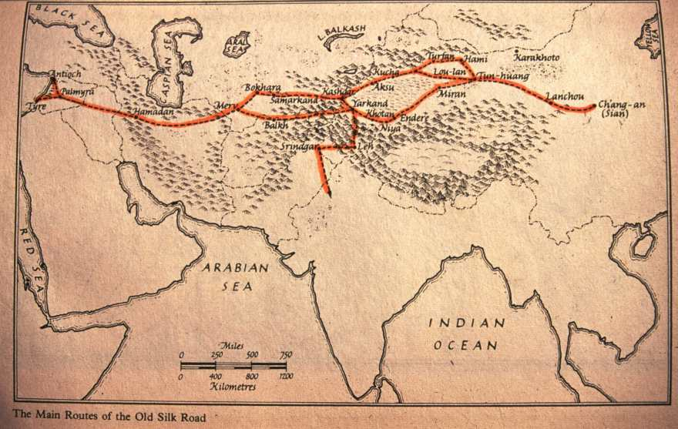
Old Silk Route Map

Slide 51
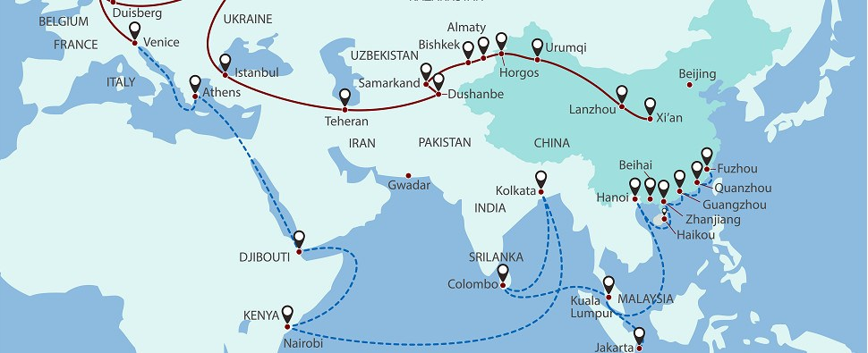
Regional Connectivity: Belt and Road Initiative Map

Slide 52
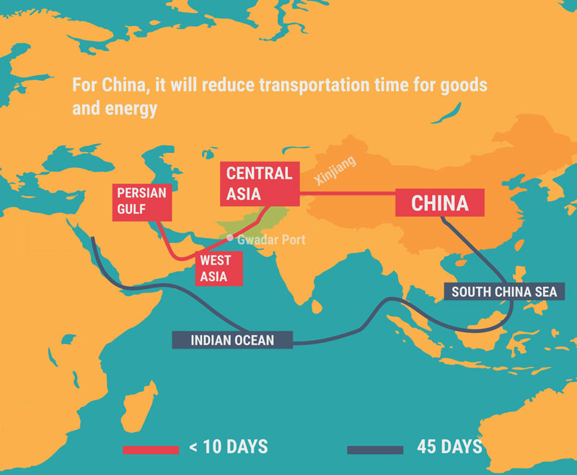

Slide 53
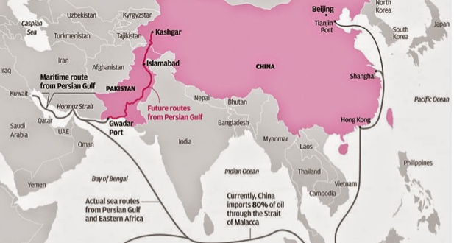

Slide 56
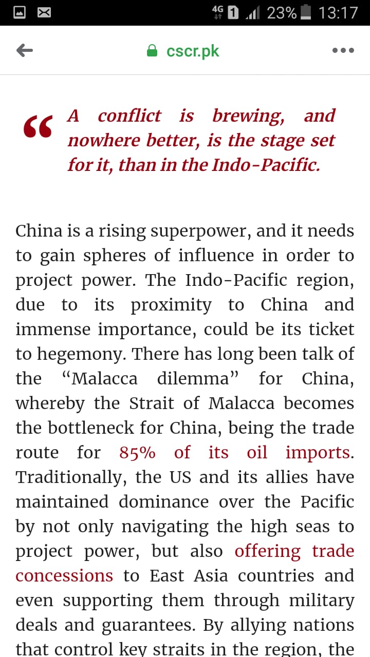
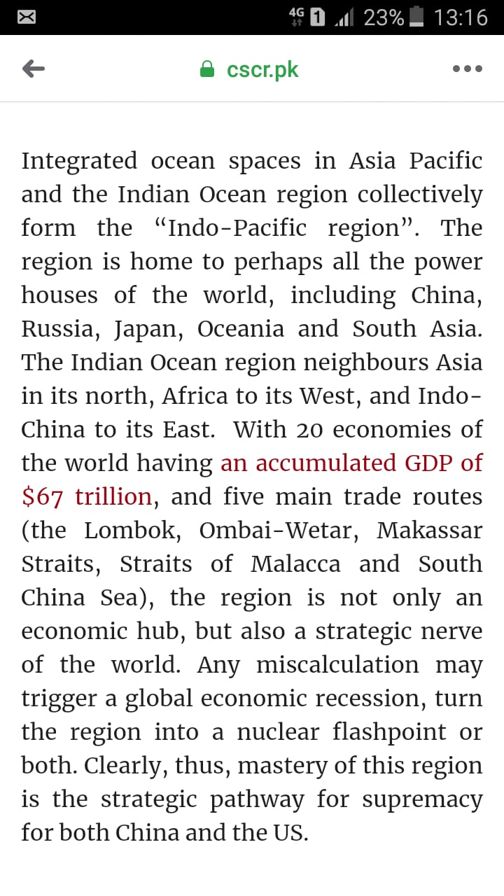

Slide 57
SCO and Pakistan
Pakistan was an Observer from 2005 to 2017
The meeting of the Heads of State Council was held on 8-9 June 2017 in Astana.
Status of a full member of the Organization was granted to India and Pakistan.

Slide 58
SCO has become a matter of significance for Pakistan
the Belt and Road Initiative (BRI) and CPEC
SCO and Geo-Strategic and Geo-Economic Benefits forPakistan
it is expected to become a hub of regional connectivity.
In terms of SCO, based on Pakistan's experience, the country can offer consultation in anti-terror policies for the success of BRI.
SCO can achieve its objectives of security and connectivity with the participation of Pakistan.

Slide 59
Relations with China and Russia strengthened
Pakistan has not been isolated diplomatically
Pakistan can get security, trade and economic benefits from SCO and ECO
Establishing a balance between China and US- a real challenge
Improving Pakistan’s image- a difficult task
Notes:
US-India in August 2016 signed Logistics Exchange Memorandum of Agreement (LEMOA) that will reportedly facilitate the two allies to use each other’s military facilities to check China’s growing influence.

Slide 60
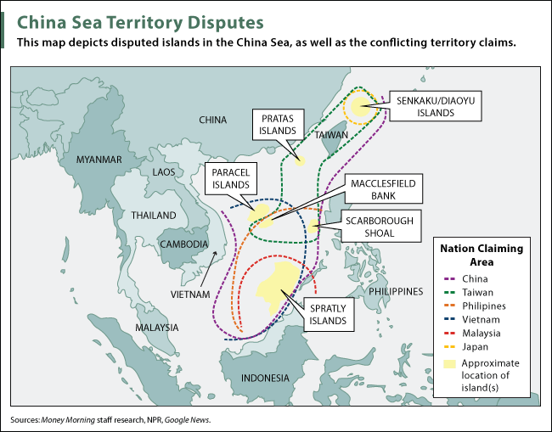

Slide 61
While reviewing the 'Modern Great Game', the SCO is emerging significantly to contain US influence in Central and South Asian region.
The Cold War 2.0 with containment of China
  Central Asia
  South Asia
  East Asia
Therefore, US seriously monitoring the activities of the SCO.

Slide 62
CSS Questions: SCO
China, Pakistan-Russia cooperation will find suitable support mechanism in Shanghai Cooperation organization (SCO). Elaborate. 2020
What are the opportunities and challenges for Pakistan as one of the new members of the Shanghai Cooperation Organization (SCO)? CSS-2018
Q. No. 5. Explore the significance of Shinghai Cooperation Organization (SCO) for Pakistan. CSS-2017

Slide 63
ECO
http://eco.int/index.php
Economic Cooperation Organization

Slide 64
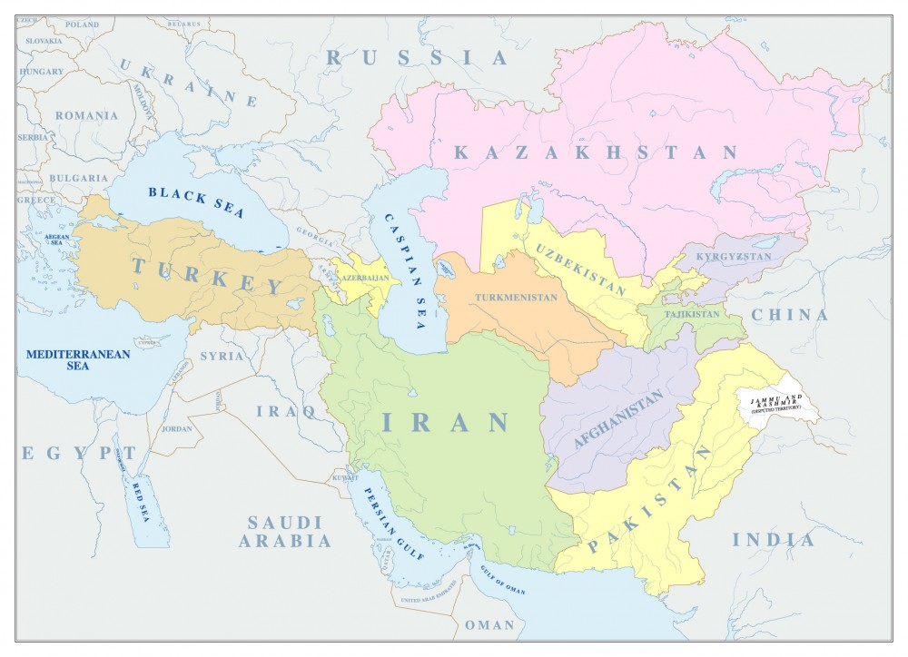

Slide 65
Economic Cooperation Organization (ECO)
An inter-governmental regional organization encompassing countries from
  Europe,
  Central Asia, and
  South Asia
The overall objective of the organization is the sustainable economic development of its member states and the region as a whole

Slide 66
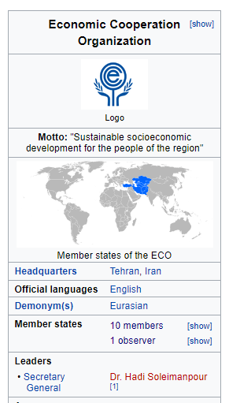
Background
Established as Regional Cooperation for Development (RCD) in 1964 by Iran, Pakistan and Turkey
Renamed as “ECO” in 1985.
The ECO's secretariat in Iran
its economic bureau is in Turkey
its scientific bureau is in Pakistan.

Slide 67
Objectives & Principles of Cooperation
Sustainable economic development-Economic liberalization
Gradual integration with the world economy;
Development of transport & communications infrastructure
Effective utilization of the agricultural and industrial potentials
Ecological and environmental protection
Effective cooperation with other regional and international organizations
Exchanges in educational, scientific, technical and cultural fields

Slide 68
Membership
According to the Article XIII of the Treaty Of Izmir (1977, and 1990)
  “Any State enjoying geographical contiguity with the ECO region and/or sharing the objectives and principles of ECO may apply to become a member of the Organization.”
Currently ten countries from West and South Asia, Caucasus and Central Asia are Members of the Organization:

Slide 69
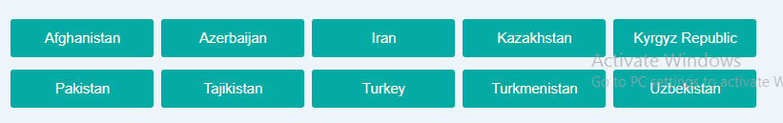
Member States
In 1992 Afghanistan and six Central Asian Republics, also joined

Slide 70
ECO Organs
The ECO functions through its intergovernmental machinery, Secretariat and specialized agencies and regional institutions.

Slide 71
ORGANIZATIONAL STRUCTURE OF ECO
There shall be,
  ECO Summit
  a Council of Ministers,
  a Council of Permanent Representatives,
  a Secretariat, and
  Specialized Agencies in specific fields of cooperation.
  a Regional Planning Council,

Slide 72
1. ECO-Summit
the Article IV of the Treaty of Izmir
  the Heads of State/Government meet biennially or more often if considered necessary.
The Summit meetings review the objective conditions and progress in implementation of ECO programmes and projects
exchanging views on regional and global issues of common interest to the ECO region.
Since ECO enlargement in 1992, 13 Summit meetings held.
The last meeting, 13th Summit, was held on 1st March 2017 in Islamabad, Pakistan

Slide 73
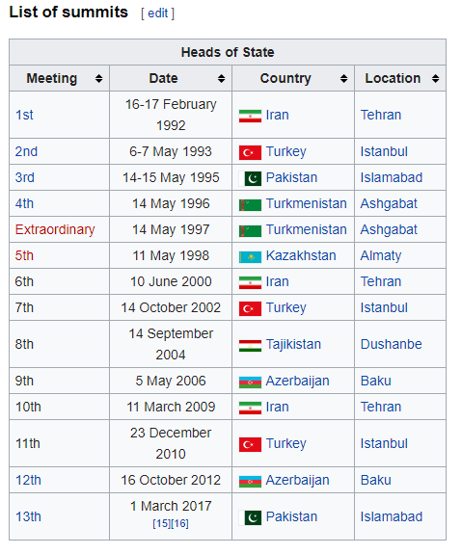
Summits Held So Far

Slide 74
2. COUNCIL OF MINISTERS
  the policy and decision-making body
  It comprises the Ministers of Foreign Affairs or any other representatives of full ministerial rank as may be nominated by the governments
  responsible for decision on/approval of policies, strategies, and work programs
3. SECRETARIAT
  comprises a Secretary-General and staff
  its Headquarters in Tehran
  The Secretary-General is elected and appointed by
    the Council of Ministers
    for a non-renewable term of three years
Notes:
Dr. Hadi​ Soleimanpour (Iranian national) is ECO Secretary General. He is the 12th Secretary General of the ECO who started his tenure in August 2018.

Slide 75
4.The Regional Planning Council (RPC)
The Regional Planning Council (RPC) is the main technical planning body within ECO which comprises the heads of the Planning Organizations of the Member States

Slide 76
Critical Evaluation
it is a trade bloc for the member states connected to
  The Mediterranean through Turkey
  The Persian Gulf via Iran, and
  The Arabian sea via Pakistan
It provides a platform to improve socio-economic development
promotes trade and investment opportunities.
The dream is to establish a single market for goods and services, much like ASEAN or the EU

Slide 77
Terrorism and extremism: a common challenge for all the ECO members
Peace in Afghanistan and the Middle East: a key to ECO success
Iran and Saudi Arabia: Rivalry over Middle Eastern politics and options for Pakistan
Iran under US sanctions and options for Pakistan
  the Iran–Pakistan-India (IPI)gas pipeline, as well as a Turkmenistan–Afghanistan–Pakistan-India (TAPI) pipeline
  Indian influence in Iran and Afghanistan
CPEC as a nodal point for regional connectivity

Slide 78
SCO-SAARC-ECO
CHANGING REGIONAL DYNAMICS & FORMATION OF NEW ALIGNMENTS

Slide 79
The Changing regional Dynamics of South Asia
Dividends of Afghan Peace Process for Pakistan
  India has been sidelined in this peace process
Iran Drops India From Chabahar Project
  Delay In Funding from India
  India gradually reduced its oil imports from Iran since 2017
  China signed a ten year $400 Bil. investment deal with Iran for oil
  India has been sidelined in Iran
  India is moving to US camp---India to be a pivot for the US new containment policy
Russia improving ties with Pakistan and Afghanistan
  Iran already has closed ties with Russia
  The New Great Game and emerging realignments of regional powers
Repercussions for SCO-SAARC-ECO
The questions will be???
  Should we isolate India in the region or bring her back from the US camp?
  What policy options India have in the SCO-SAARC-ECO region?
    India’s ‘Look East Policy’- ASEAN and APEC

