Slide 1
Reform Movements
Deoband

Slide 2
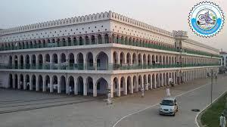

Slide 3
Deoband – A brief History
Legacy of Hazrat Shah Waili Ullah (Allah's mercy be on him)
Established – 30th May, 1866- Muhammad Qasim Nanautavi & Rashid Ahmad Gangohi- Principal founders
1857 – Ulema participated & even led the struggle
Downfall of education – Madaris
The British rule as a threat – Various strategies to stem the tide of decline – Renaissance
Renaissance ---- Political (education) and Religious (education)
Political path led to the creation of Pakistan
Religious path led to the revivalist movements to purify Islam– Bralvi, Ahle Hadith, Nadwa , Tablighi Jamaat, Jamat -i- Islami etc.

Slide 4
The system of Education – Deoband
Syllabus – influenced by Dars-i-Nizami---developed in 18th century
Emphasis on manqualt (revealed sciences) instead of maqulat ( rational sciences)
Create & train a community of believers to serve the spiritual needs of Muslims and defend Islam
Writers- preachers – teachers & prayer leaders (Imam) to disseminate knowledge
Academic excellence & moral character
Guidance from the Quran and sunnah
Belief in theological puritanism
Oppose Western Ideas & values

Slide 5
Services – Contribution – Achievements
Religious service
Free religious education to Muslims
Religion, education, missionary-work and knowledge creation by writing books
A clarion call to the Muslims in the Subcontinent to come to the fold of Islam
Revival of the spirit of Jihad
Bulwark of Islam in India

Slide 6
Services – Contribution – Achievements
Educational Services
Free education to Muslims
Spread of religious teaching
knowledge creation by teaching & writing books etc.
Training of Ulema
Character building
Guidance & leadership

Slide 7
Services – Contribution – Achievements
Political Services
Raising consciousness of Muslim identity in India
Muslim Nationalism
  Separate political identity of Muslims in India based on Islam & Muslim Rule
Resistance to the British Rule
Teaching Muslims the art of resisting foreign rule
Jamiat Ulema-i- Hind ----- Struggle against the British Rule

Slide 8
Changing Character of Deoband
Deobandi Leadership under the banner of Jamiat Ulema-i-Hind opposd the Two Nation Theory of Muslim League
Aligned with the INC to fight the British
After 1947, Deoband played a moderate role by participating in political regimes
Confined to religious education & spiritual guidance
Fatwa against Terrorism -2008

Slide 9
Modern Challenges and Deoband
Conservative Approach
Fatwa against Muslim women to observe veil
Opposed by various groups as fatwa can only be issued on religious maters
Fatwa against Muslim women working in government and private institutions – severely criticized
Opposition of modernizing madaris – undue interference by the govt.

Slide 10
Impact of Deoband
Pakistan--- denunciation of terrorism by Muhammad Tahi ul- Qadri, 2010
Qadri’s fatwa was endorsed by the British govt.
Welcomed by the State Department of the USA
Indonesian religious organization like Nahdatul – Ulema and Muhammadiya also denounced terrorism following Deoaband
Who are you ? Food for thought

Slide 11
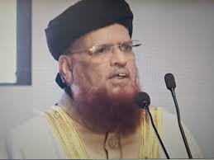
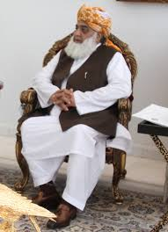
Deoband – legacy in Pakistan
Two strands in Pakistan since 1947
Scholarship vs. Politics
Jihad and Terrorism
Mujahid vs. karkun

Slide 12

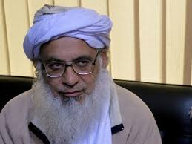
Aligarh Vs. Deoband
A debate between Mr. & Mullah
Unity of Purpose – Revival of Muslim Power in India & protection of Muslims
Difference – Modus operandi
Religious Education VS. Modern Education
Different Political paths – INC Vs. AIML
Connected to Pakistan Movement

Slide 13
Further Readings
https://www.files.ethz.ch/isn/125623/WP219.pdf
http://www.darululoom-deoband.com/english/
https://www.britannica.com/topic/Deoband-school
http://www.islam.ru/en/content/story/what-tariqa-and-shariah-what-difference-between-them

Slide 14


