Slide 1
Galaxy

Slide 2
galaxy
A galaxy is a gravitationally bound system containing black hole, stars, stellar remnants, interstellar gas and dust (nebulae), planets, dwarf planets, small solar system bodies, satellites etc. are all contained with in a galaxy
There are billions of galaxies within our universe

Slide 3
Classification of Galaxies
According to the Hubble Tuning Fork diagram, the types of galaxies are as follow:
Spiral galaxies
Elliptical galaxies
Lenticular galaxies
And more recently another type called the Irregular galaxies have also been added to the classification

Slide 4
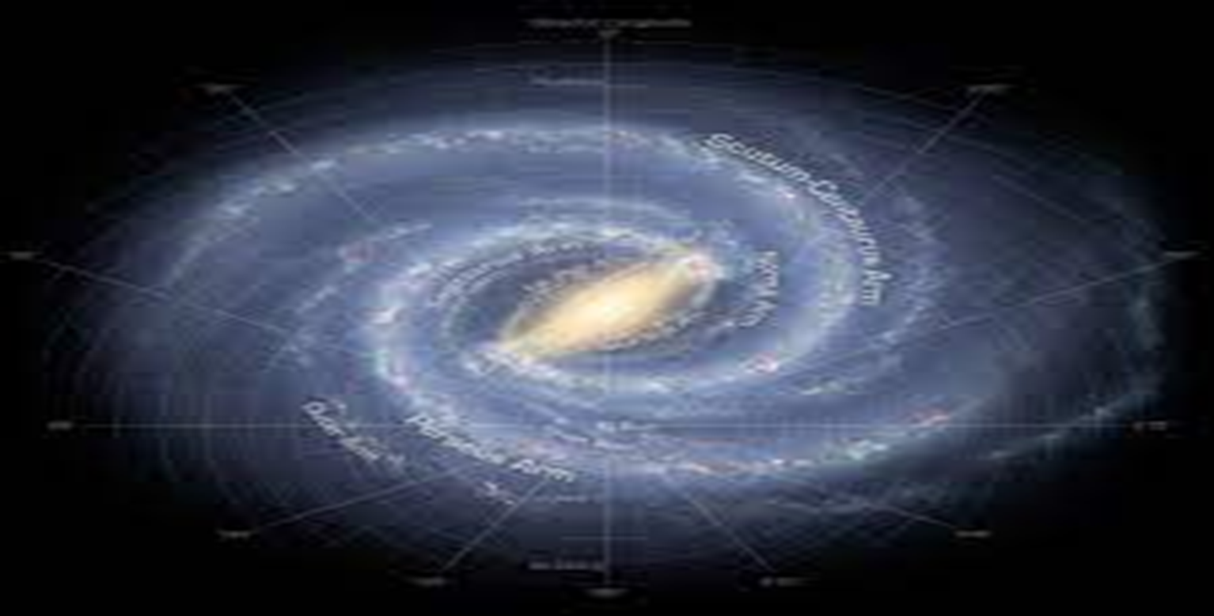
THE Spiral galaxies
They are flat, rotating, spiral structures
Examples include Milky Way & Andromeda

Slide 5
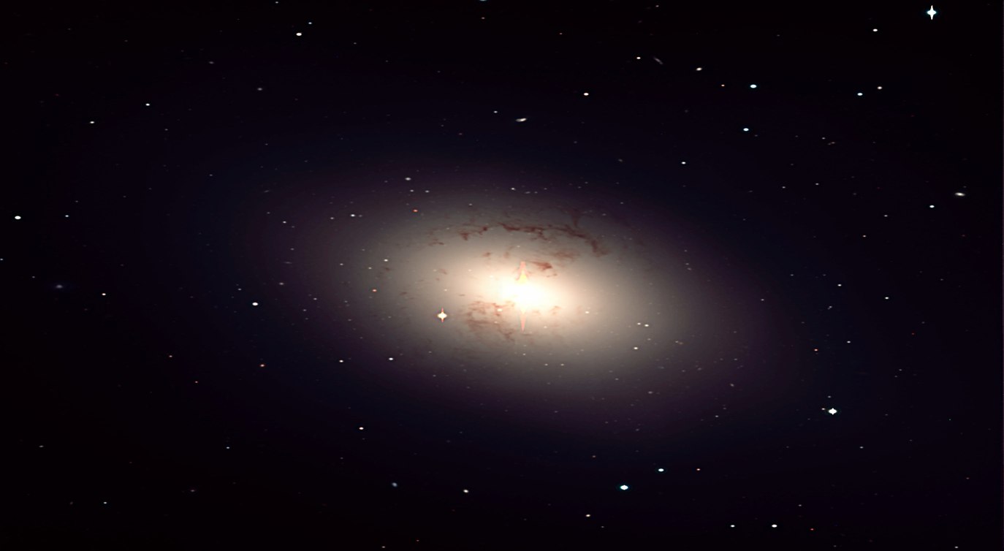
THE Elliptical galaxies
They have an elliptical profile, giving them an ellipsoidal appearance regardless of the angle
Examples include Galaxy M49 & Galaxy M59

Slide 6
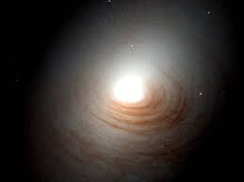
the Lenticular galaxy
An intermediate form which has the properties of both, elliptical as well as spiral galaxy

Slide 7
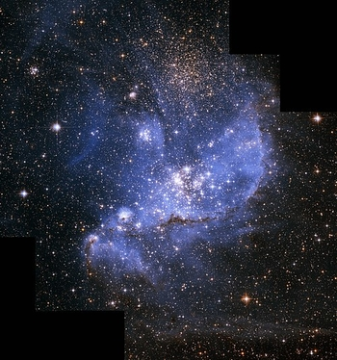
The irregular Galaxies
An irregular galaxy is the catchall name given to any galaxy that does not neatly fit into one of the categories of the Hubble classification scheme.
Structures do not align neatly
Can not be readily classified as spiral, elliptical or lenticular
Examples include The Small Megallanic Clouds & The Large Megallanic Clouds

Slide 8
THE MILKY WAY
SOME BULLET POINTS:
It’s a spiral galaxy
It has a diameter of 100,000 to 180,000 light years
Contains about 100 – 400 billion stars making it a giant galaxy
It is home to our solar system
The solar system is stationed in the orion – cygnus arm of the galaxy
The distance from solar system to the center of the milky way galaxy (galactic disc) is roughly 27,200 light years

Slide 9
CONTINUED…
THE FUTURE OF MILKY WAY:
STUDIES SUGGEST THAT NEAREST GALAXY CALLED ANDROMEDA IS APPROACHING THE MILKY WAY GALAXY AT A SPEED OF 100 - 140 KM/SEC
AT THIS SPEED, THE TWO GALAXIES WOULD COLLIDE IN THE COMING 3-4 BILLION YEARS, MERGING TO FORM A NEW ELLIPTICAL GALAXY

Slide 10
Video!
https://youtu.be/yCo2Tz4sRX8

Slide 11
THE SOLAR SYSTEM!
Address: Orion – Cygnus Arm of the Milky Way
Age: 4.6 billion year
Components: Sun
Planets: Mercury, Venus, Earth, Mars, Jupiter, Saturn, Uranus, Neptune
Dwarf Planets: Pluto, Ceres, Eris, Haumea, MakeMake
Small Solar System Bodies: Asteroids and Comets etc.
Satellite: Natural & Artificial Satellites

Slide 12
THANK YOU!

