Slide 2
Syllabus
1. Introduction:- a. From ancient times to 1492 b. Advent of the Europeans to British supremacy (1492-1606) 2. USA as a British Colony (1606-1783). 3. USA as an Independent Country (1783 - 1819) 4. Expansion of USA: From 13 to 50 States (1820 - 1949) 5. Constitution of the USA: Salient Features a. US Presidential Election b. The US Congress: Role and Functions c. Separation of Powers: Check and Balances 6. Civil War between the North and the East (1850 - 1869) 7. Industrialization and its emergence as one of the world powers (1870 -1916) 8. USA’s role in the Two World Wars (1914 – 1918 & 1939 - 1945) 9. Post 1945 world scenario and emergence of USA and USSR as the Two World Powers. 10. American Role in patronizing UNO and International Organizations 1945 - 2012 11. American Role in Cold War and its emergence as the Sole Super Power (1945 - 1990). 12. International Concerns of USA: An Overview. 13. The War on Terror: The Role of Pakistan and USA (2001 - 2012) 14. Global perceptions of the USA. 15. Progressive Era: Reforms of Theodore Roosevelt and Woodrow Wilson, 16. The Great Depression and the New Deal 17. Civil Rights Movement 18. United States’ role in International Conflicts
Notes:
Distribute print of the syllabus..

Slide 3
Lecture Plan
1. Introduction:- a. From ancient times to 1492 b. Advent of the Europeans to British supremacy (1492-1606)
2. USA as a British Colony (1606-1783). 3. USA as an Independent Country (1783 - 1819)
4. Constitution of the USA: Salient Features a. US Presidential Election b. The US Congress: Role and Functions c. Separation of Powers: Check and Balances 5. Expansion of USA: From 13 to 50 States (1820 - 1949) 6. Civil War between the North and the East (1850 - 1869) 7. Industrialization and its emergence as one of the world powers (1870 -1916) 8. USA’s role in the Two World Wars (1914 – 1918 & 1939 - 1945)
9. Progressive Era: Reforms of Theodore Roosevelt and Woodrow Wilson, 10. The Great Depression and the New Deal 11. Post 1945 world scenario and emergence of USA and USSR as the Two World Powers. 12. American Role in Cold War and its emergence as the Sole Super Power (1945 - 1990). 13. Civil Rights Movement
Notes:
Lecture Plan.

Slide 4
Ancient Civilizations
Caral-Supe
Olmec
Maya
Zapotec
Nazca
Tiwanaku
Wari
Inca
Aztec
Mississippian
Iroquois Confederacy
Powhatan Confederacy

Slide 5
The Arrival of British colonizer
Notes:
Richard Hakluyt, Discourse on western planning (1584), English colonization of the new world would be not only to the benefit of England but furthermore to the benefit of God. Protestant England needs to rescue north America from catholic world. Also social and economic possibilities like jobs, agri, cultural freedom, etc

Slide 6
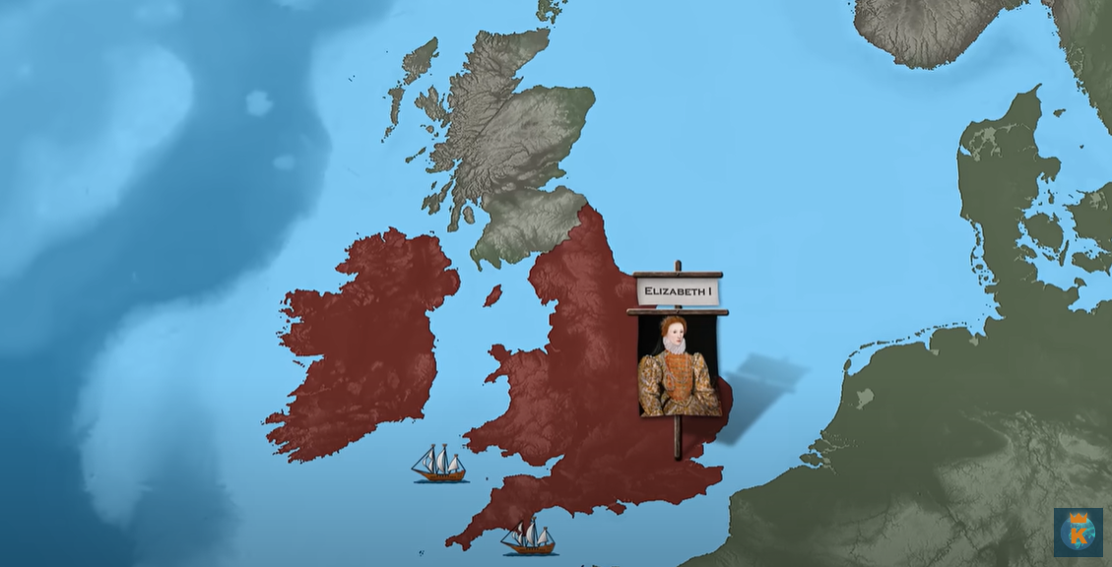
Notes:
Elizabeth 1, queen of England. Seadogs (John Hawkins, Francis Drake), Plundered Spanish ships to the coast of Peru.

Slide 7
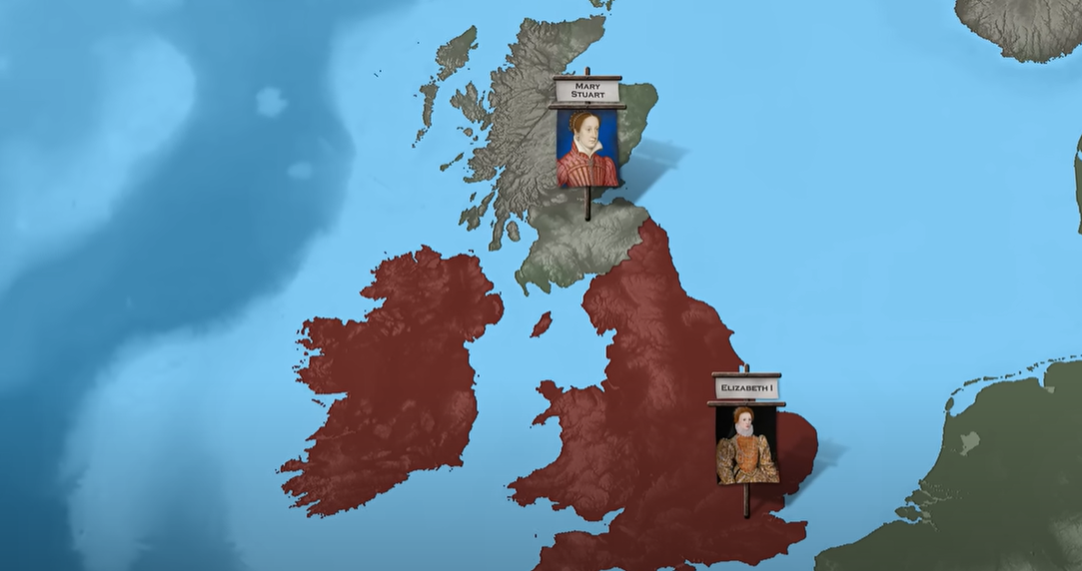
Notes:
Mary Stuart, the catholic queen of England (Scotland). Executed in 1587

Slide 8
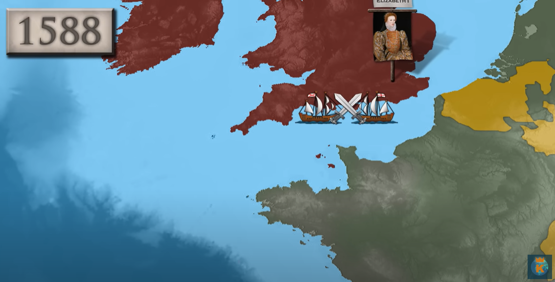
Notes:
Phillip 2 of Spain vs England. Neatherland. Nature favors the British.

Slide 9
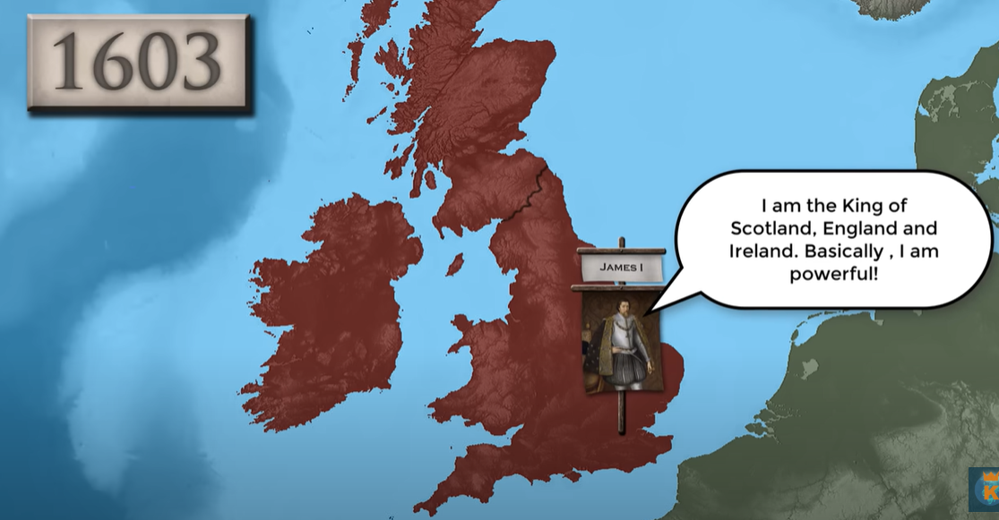
Notes:
Queen passes away in 1603. Following year peace made with Spain.

Slide 10
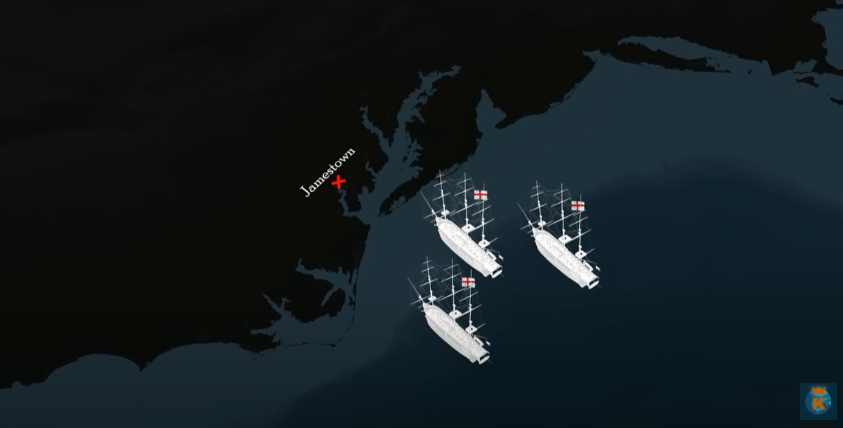
Notes:
The Discovery, the Suzan constant, the Godspeed. The British colonizes the Jamestown. The king also granted a charter to the playmouth company but their phopam colony short lived. By 1617, only 300/17000 lived(Battles with Powhatan), After 40 years first tobacco shipment of value (15m pounds).

Slide 11
Factors for Colonization in 16th and 17th Century
God, Gold and Glory
Pressure of Population
Trade with the East (Asian Countries)
Industrial Growth
Scientific and Technological Advancement
Desire for Fabulous wealth
Religious and Cultural Freedom
Royal Patronage
White Man’s Burden
Imperial Race
Strategic (Sea Power)

Slide 12
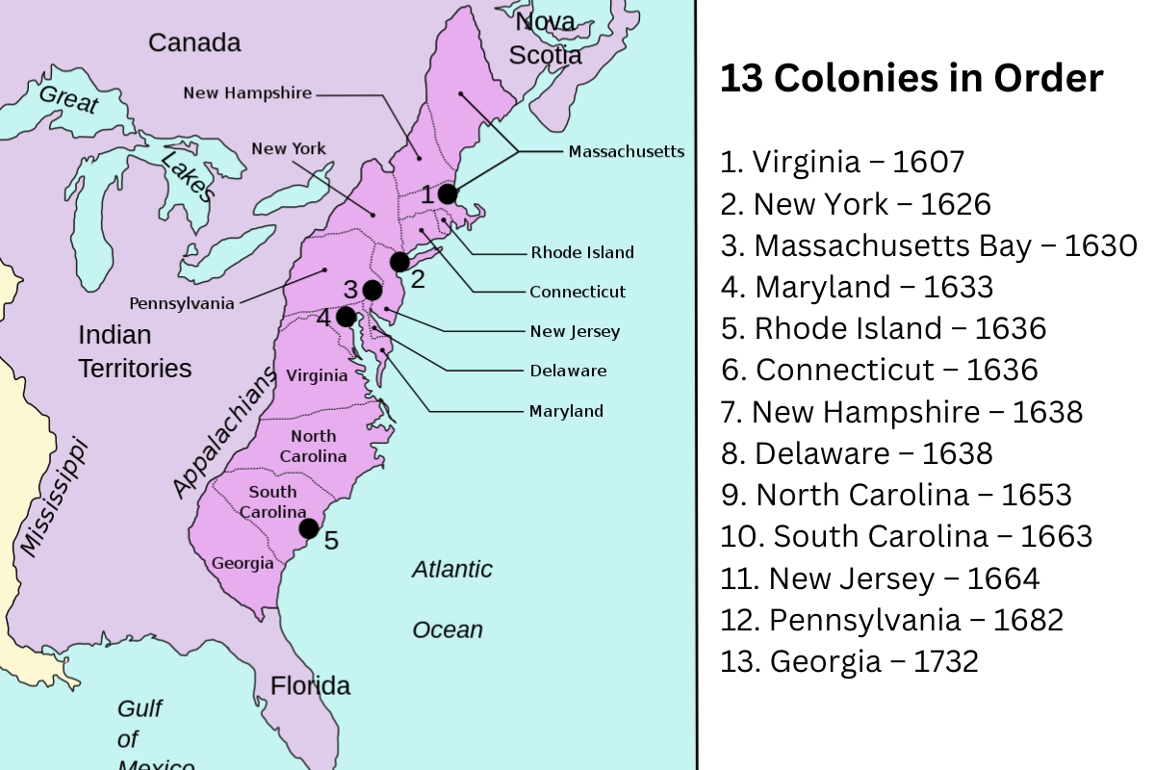

Slide 13
AMERICAN REVOLTUION (1775-1783)
A. Causes
American Attitude (Migrated, better home)
British Attitude
Mercantilism and Navigation Acts
British Restrictions on Manufacture
Removal of French Danger
Policies of Grenville
Townshend Program

Slide 14
Continue…
Resistance to Townshend’s Program
Quartering Act of 1765: Anglo-French war
Circular Letter
Boston Massacre

Slide 15
Two Schools of thoughts
Radicals
Always look to estrange the relations with British
Charles Thomson, George and Thomas Jefferson
Less in number
Boston Tea Party 1773
Conservatives
Always interested in restoring of good relations and forgetting what happened.
Professionals politicians, Royal merchants & Officials
More in Numbers
Colonial protests and Massachusetts formation of committee of correspondence in Boston in 1772
By 1773, committee of correspondence were established in all states excepting Pennsylvania and North Carolina

Slide 16
B. American Colonists Preparation for War
First Continental Congress Meeting(Sept. 5,1774)
Suffolk Resolves
Declaration of Rights and Grievances
Second Continental Congress Meeting (May 10, 1775), Philadelphia
a. Battle of Bunker Hill (June, 1775)

Slide 17
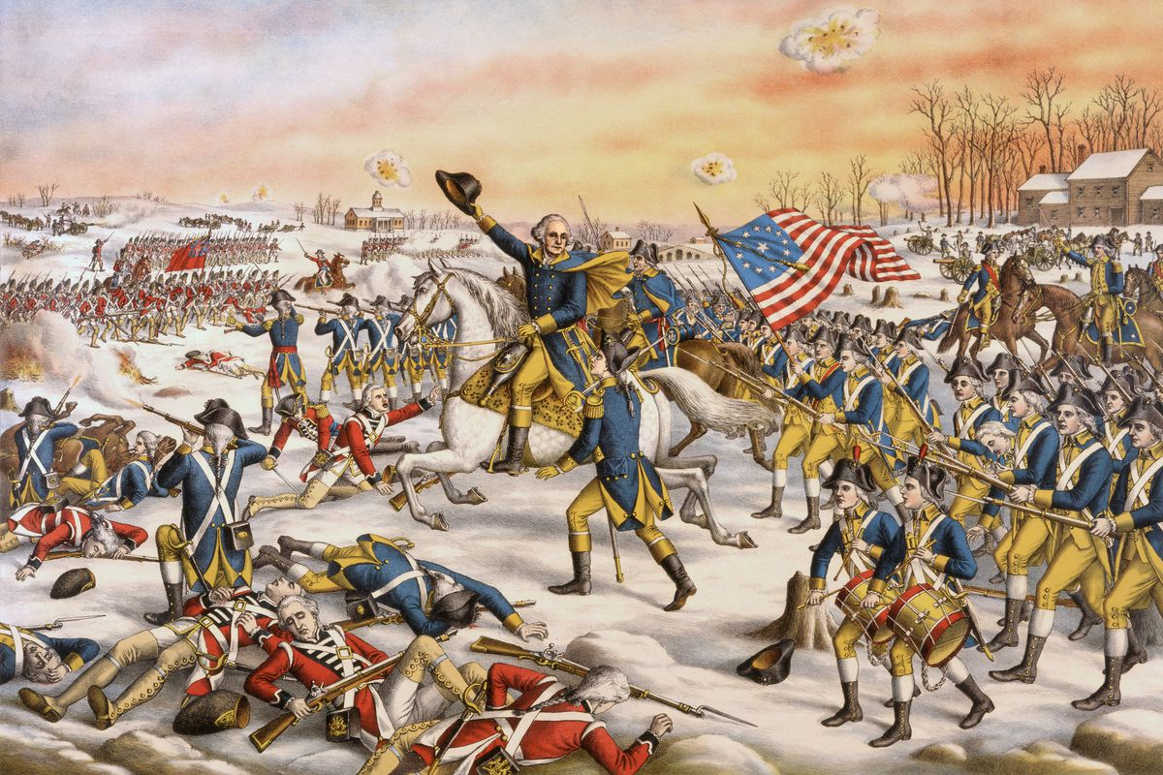

Slide 18
C. American War of Independence
First Phase (1775-77)
Second Phase (1777)
Third Phase (1778-81)
Peace Treaty of Paris (1783)

Slide 19
D. Impacts of American War of Independence
Constitutional Problems
Article of confederation (15 Nov, 1777)
No Bill of Rights
Lack of Central Government
2. Economic Problems
Decline of Commerce
National Debt
Absence of Satisfactory System of Currency
3. Political Problems
Western Land
Foreign Relations (a. With Britain b. With Spain)

Slide 20
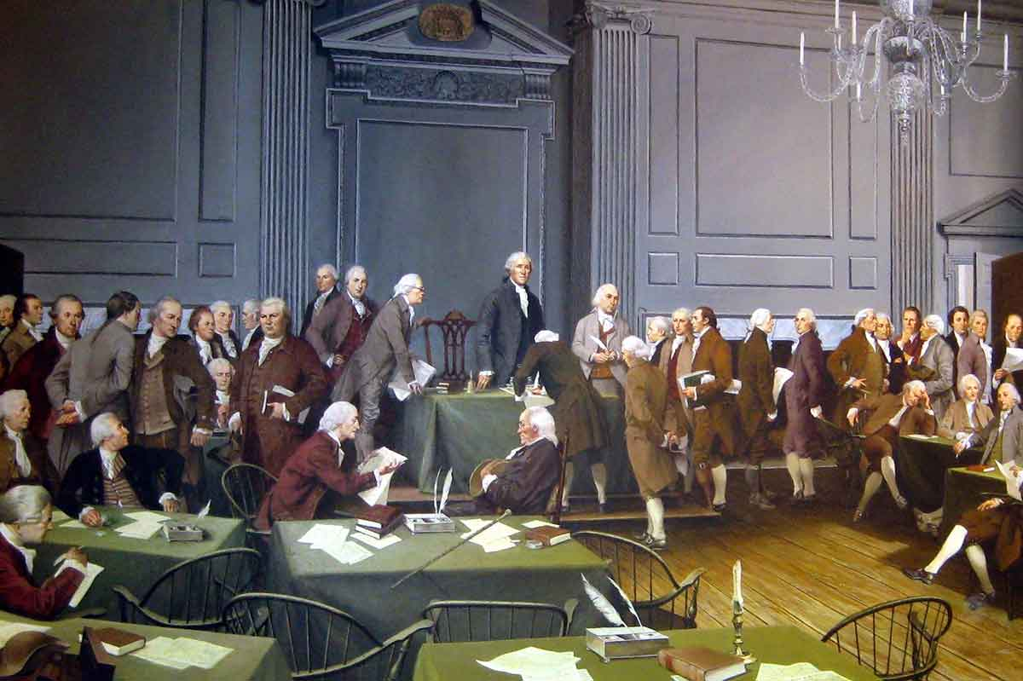

Slide 21
Process of Framing American Constitution (Philadelphia Convention Process in Framing Constitution)
1. Introduction
Convention of Philadelphia
Committee: Examined various proposal
2. Proposed Plans
Virginia plan
New Jersey plan
3. Controversies/Contradiction between the plans on the basis of:
Nature of Government

Slide 22
Continue…
Representation in congress
Slave state and free state
Commercial and Agriculture states
4. Need of compromise
5. Connecticut Compromise
6. Ratification of the constitution

Slide 23
Chief Accomplishments of Federalist Regime
Introduction
Achievements of Federalist Regime
Bill of Rights (1791)
The Judiciary Act (1789)
Whisky Rebellion (1791)
Settlements with Indians (1794)
Rise of Political Parties
Financial Policy

Slide 24
Foreign Policy of America in Federalist Regime
Introduction
Relations with France
Genet Mission
Proclamation of Neutrality
Genet’s Activities
Jay’s treaty (1794)
John Adam’s Administration (1797)
Talleyrand's agents affairs
Convention of 1800

Slide 25
3. Relations with England
Treaty of Paris (1783)
England was encouraging Indians to rise against Americans
Jay’s treaty in 1794, made the tensions reduced
4. Relations with Spain
5. Conclusion

Slide 26
George Washington (Feb 22, 1732-Dec 14, 1799)
Introduction
George as a soldier
Political Career (As a Statesman)

Slide 27
Jeffersonian Democracy (1801-09)
Introduction
Main Features
Faith in common men
Faith in Laissez Faire Theory
Faith in Rural Democracy
Simplicity and Economy
Lapse of Democratic Acts
Attitude Towards Slavery
Faith in Republicanism
Measures to make Judiciary Impartial
Louisiana Purchase

Slide 28
Significance of the Purchase of Louisiana (1803)
Introduction
Some Events During the Purchase
Denial of Right of Navigation
Purchase of Louisiana
Ratification of Treaty
Federalists Attitude
Problems of Effective Control
Q. Elaborate Jefferson’s philosophy of Government.

Slide 29
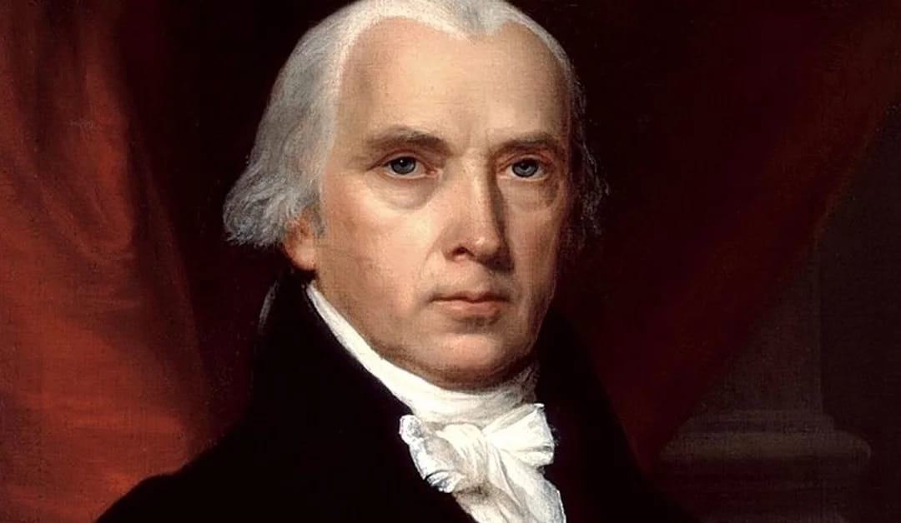
Notes:
President James Madison

Slide 30
War of 1812
Introduction
Causes
Free Sea Trade
Impressments of American Merchant in Royal Navy
British Support to Red Indians
War Hawks
3. Declaration of War
4. Incidents
Invasion of Canada
Burning of White House
5. Treaty of Ghent

Slide 31
The Hartford Convention
Took place from Dec, 1814-January 4, 1815.
Organized by New England (Connecticut, Maine, Massachusetts, New Hampshire, Rhode Island and Vermont.
Held in Secret discussion
The Idea of secession from the union.
Prominent figures: George Cabot and Harrison Gray.
Proposed Constitutional Amendments.
Economic disproportionate Impact
Federal party’s reputation suffered
News of Treaty of Ghent

Slide 32
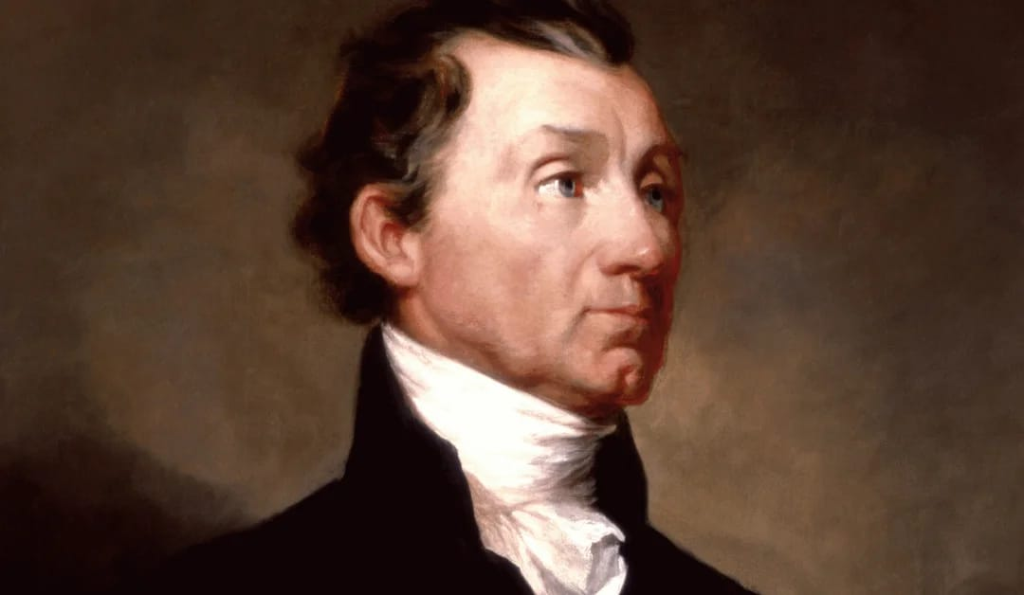
Notes:
President Monroe

Slide 33
Era of Good Feelings (Monroe’s Administration)
Introduction (1817-1825)
Factors Contributed to the Growth of Era of Good Feelings
United Nation
Sectional differences deferred
Increase industrial production
Establishment of 2nd Bank of US
Admission of new states
Internal Improvements
Peace Abroad

Slide 34
Circumstances which led to Monroe’s Doctrine
Introduction
Factors leading to the enunciation of Monroe’s Doctrine
Florida Question
Adams-onis Treaty (1819)
Recognition of New Republics
Efforts to Restore Spanish Colonies to Latin America
Confrontation with Russia (1821)
Monroe’s annual Message (Dec, 1823)
Monroe’s Doctrine
3. Significance of Monroe’s Doctrine

Slide 35
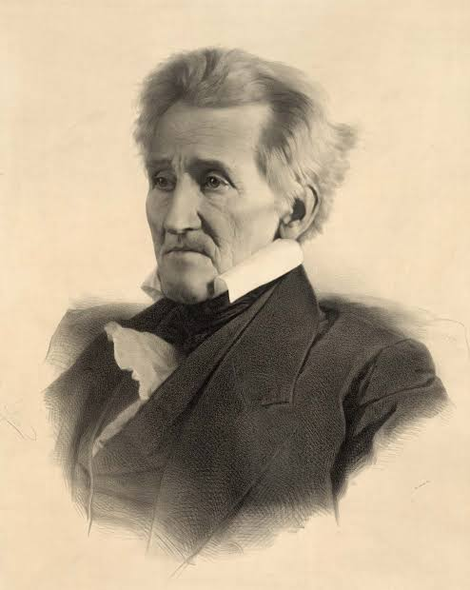
Notes:
President Andrew Jackson: Era of Good Feelings

Slide 36
Significance of Andrew Jackson’s Presidency(1829-37)
Introduction
Chief Features of Jackson’s Presidency
Opposition to privilege classes
Beginning of Party Politics
Policy towards the Bank of US(1832)
Decentralized the States Rights
Preservation of Union(1833)
Relations with Congress
Division of Democratic parties
Policies towards Indians
Foreign Policy

Slide 37
Jackson’s Cabinet and Spoils System
A. Jackson’s Cabinet
Kitchen Cabinet
Jackson’s Rift with Calhoun
Break up of the cabinet
B. Spoils System

Slide 38
Jackson’s Bank Policy and withdrawal of National Deposits
Introduction
1st Bank of the US (1791)
2nd Bank of the United States (1816)
Jackson’s Policy (1832)

Slide 39
The Texas Revolution
Start Date: Officially started on Oct 2, 1835, with the battle of Gonzales.
End Date: April 21, 1836, with the Texan victory at the battle of San Jacinto.
Outcome: Texan forces won the Texas Revolution, securing Independence from Mexico.
Treaty: Velasco
Slogan: “Remember the Alamo”.

Slide 40
Mexican-American War
Causes: 1. Establishment of the Independent Republic of Texas
2. Dispute between Texas and Mexico over border.
3. United states Annexation of Texas
4. Instability and weakness of the Mexican government.
5. American expansion and Manifest Destiny.

Slide 41
Economic and Industrial Development of US by 1850s
Introduction
Agriculture Development
Population increase and Urbanization
Growth in Manufacturing/Industries
Growth in Trade
Transport and Communication

Slide 42
History of Slavery Abolition Movements in America
Introduction
Abolition Movements
Slavery as a curse
Abolition through colonization
Movements against slavery
Methods of Abolition
Reaction from the South
Further Abolitionist Activities
Underground Rail
Free Soil Convention
Compromise of 1850

Slide 43
Compromise of 1850
To Resolve Sectional Problems.
Addition to the US territories ceded by Mexico.
Committee of Thirteen.
California as a free state
Settling the Texas boundary dispute.

Slide 44
Kansas Nebraska issue
and its Impacts (1854)
Introduction
Motives of Douglas
Cuba and Ostend Manifesto
Debate over the Bill
Defense of Douglas and Passage of Bill
Impacts of the Bill

Slide 45
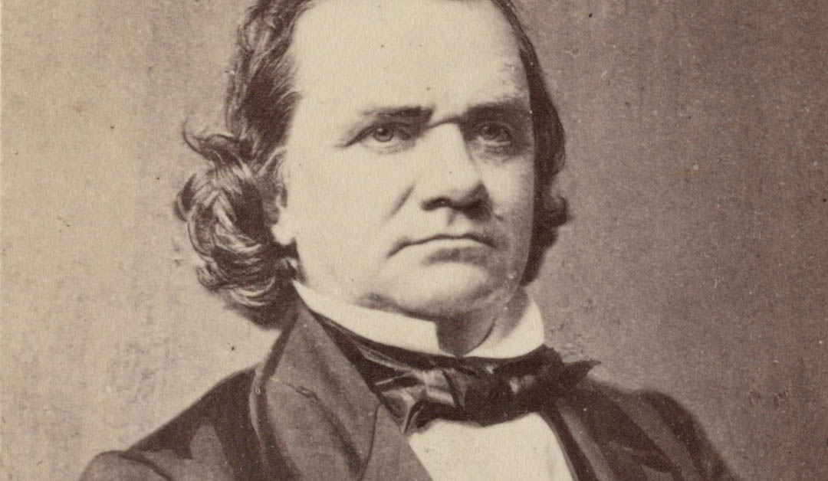

Slide 46
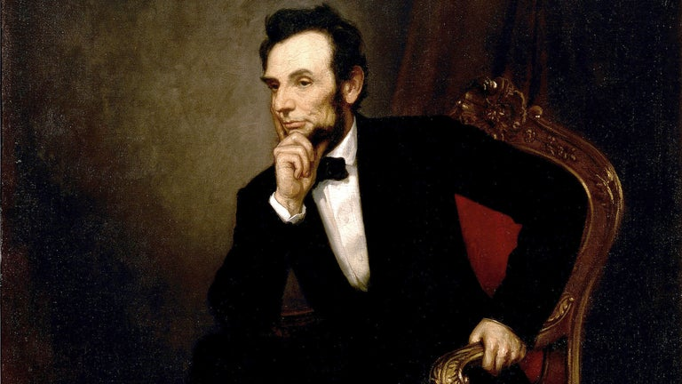

Slide 47
Significance of Lincoln-Douglas Debate (1857)

Slide 48
Causes of Civil War (1861-1865)
Devil Theory
Southern Accuses
Northern Accuses
2. Constitutional Theory
Southern Interpretation
Northern Interpretation
3. Economic Theory
Southern Labor System
Northern Labor System

Slide 49
4. Nationalism as a Factor
5. Struggle between Aristocracy and Democracy
6. Consequences of Civil War.

Slide 50
Diplomacy of American in Civil War
Introduction
Diplomacy in Civil War
Attitude of Britain
American Southern Beliefs
Britain own Attitude
British Decision to be Neutral
2. Attitude of France
3. Attitude of Russia
4. Lincoln’s Role

Slide 51
Factors Responsible for the Victory of North
Man Power
Increased Production
Finances
Superior Political Leadership
Able Military Leadership
Northern Superior Naval Force
Lack of Foreign Support to South

Slide 52
Significance of Civil War
Abolition of Slavery
Triumph of Nationalism over State Rights
Growing Big Enterprises
Transcontinental Railroads
Regulation of Banking System
Stimulus to Agriculture

Slide 53
Contributions of Abraham Lincoln
Abolition of Slavery
Preservation of Union
Extensive use of Presidential Powers
Foreign Affairs
Lincoln and his Cabinet
No Hatred Behavior Towards South

Slide 54
Problems Created by Civil War (1861-1865)
Physical Devastation
Financial Problems
Social Problems
The Negroes Problem
Dominance of Politics by Industrialists
Strong and United Nation

Slide 55
Reconstruction of South
Lincoln’s Plan
2. Johnson's Plan
3. Congressional Plan
4. Radicals Plan

Slide 56
Factors Responsible for the Economic Transformation of US in Post Civil War
Natural Resources
Scientific Inventions and Techniques
Good Transport System
Growth of Population & Foreign Market
Constant Labor Supply
Support of Government

Slide 57
Social Reforms Achieved by US during the period of 1860’s
Slum Accommodation
Prohibition of Alcohol & Liquor
Women Suffrage Act (1869)
Board of Charities
Prevention of Cruelty to Animals

Slide 58
Factors Responsible for the Rise of Imperialism in US (1880’s)
Introduction
Economic Factors
Doctrine of Racial Superiority
Religious Factors
Naval Policy
European Examples
Role of Leaders

Slide 59
Progressive Era (1890-1917)
Introduction
Two categories of progressives a. Western (Agrarian) b. Eastern How state should interfere to protect weaker.
Reforms:
a. At Local Level
b. At State Level
c. At National Level
4. Impacts of Movement

Slide 60
Open Door Policy (1899) and Relation with Japan
1. Open Door Policy (John Hay)
2. US-Japan Relations from 1890-1917
a. Open Door and Japan
b. America-Japan Relations under Roosevelt
3. American Relations with Japan under Wilson

Slide 61
Big Stick Democracy of Theodore Roosevelt and Dollar Diplomacy of Taft
Big Stick Diplomacy (1901) “Speak softly and carry a big stick, you will go far”.
Dollar Diplomacy

Slide 62
New Freedom Program/Legislative Record of Wilson
Introduction
Tariff Revision
Banking Reforms: Federal Reserve Act
Anti-Trust Legislation
Other Progressive Laws

Slide 63
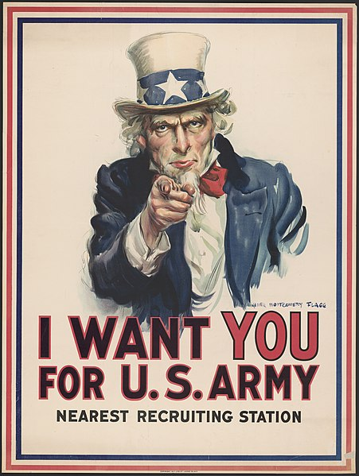

Slide 64
Factors Responsible for US entry into WW1 & Consequences of US entry into WW1.
Causes of US entry
a. Ethnic Factors
b. Economic Factors
c. Aggressive Diplomacy of Germany
d. Other Causes (eg. Zimmermann Note, Revolution in Russia)
e. Japan’s Violation of O.D.P.
2. Consequences of US entry
a. Supply of Men
b. Supply of Finances
c. Extension of Govt. Control
d. Labor in War Time

Slide 65
Fourteen Points of Woodrow Wilson
Abolishment of secret Treaties
Freedom of seas
Removal of Economic barriers and equality of trades
Reductions of Armaments
Adjustment of colonial claims
Evocation of Russian’s territory
Preservation of Belgium territory
Restoration of French territory
Readjustment of Italian frontiers
Division and Autonomous development of Austria-Hungry
Redrawing Balkan boundaries
Limitations on Turkey
Establishment of Independent Poland
League of Nations

Slide 66
Rejection of the Treaty of Versailles and League of Nation by US (1919)
Introduction: Submitted: July 1919 Henry Cabot Lodge was strongly against Wilson and dislike everything relating to Wilson. Lodge: For league not for Wilson’s league (number of reservations) The Senate was categorized in three group, while ratifying the treaty. 1. 40 Wilsonians, immediate ratification
2. 42 moderates, led by Lodge, who wanted ratification with the introduction of reservations
3. 14 irreconcilable, rejection of treaty.
On 6th Nov, 1919, Lodge presented 14 reservations
Reservations: US will assume no obligations to preserve the territorial integrity or political independence of any country without approval of Congress.
On 20th March 1920, the treaty with reservations was accepted in Senate by 49 members. 2/3 Majority (did not happened), Treaty didn’t get ratified.

Slide 67
Great Depression; Causes, Efforts & Impacts
Introduction In 1929, 78% of dividends went to 0.3% of the Population Stock Speculation in 1927-29
Causes of Depression Over Production of Agriculture Products Overproduction of Industrial Products Labor Saving Devices/Machines Concentration of Wealth in fewer hands Impacts of WW1 Decline in American Foreign Trade
Efforts made to cover Depression

Slide 68
New Deal; (Relief, Reforms & Recovery) of FDR
FDR: Franklin D. Roosevelt
Relief Reforms/Measures: Federal Emergency Relief Administration (FERA) Work Progress Administration (WPA) The Civilian Conservative Corps (CCC)
Recovery Measures: Reconstruction of Finance Commission National Recovery Act (NRA), Having Three Features: a. Public Works Administration (PWA) b. National Recovery Administration (NRA) c. National Labor Relation Board (NLRB) Encouragement to Trade Unions

Slide 69
New Deal; (Relief, Reforms & Recovery) of FDR
Continue… Agricultural Adjustment Administration Soil Conservation Act (SCA) New Agriculture Adjustment Act Banking and Finances Abandonment of Gold standard
3. Reform Measures: Social Security Act (1935) Tennessee Valley Authority (TVA) Housing Problems Coordination of Railroad

Slide 70
Failure of Neutrality Act or Circumstances of US entry in WW2
Amendment of Neutrality Acts
Panama Declaration of Oct. 1939
Act of Havana (1940)
Presidential Election of 1940
Lend Lease Act of 1941
Pearl Harbor Saga
Motives for Attack
Far East and US
Germany’s Aggressive Behavior and US entry in War

