Slide 1


Pak-Afghan Relations
Mohammad Ali Babakhel PSP

Slide 2
PRINCIPLES OF FOREIGN POLICY
National Security: National Security occupies first place in the foreign policy of Pakistan since its independence Pakistan’s national security is being threatened by the India
Economic Interest: Pakistan as a developing country is also needed to establish and maintain cordial relations with those states with whom it can maximize its trade relations or from whom it can obtain maximum economic aid

Slide 3
PRINCIPLES OF FOREIGN POLICY
Islamic Solidarity: Pakistan would pursue its ideological objective and would like to achieve the objective of Islamic Solidarity by promoting its relations with Islamic world
Peaceful Co-existence: Pakistan would believe in peaceful co-existence and would respect the other countries territorial integrity
Non Alignment: Pakistan had followed the policy of neutrality and had not aligned it self with any block. When non-aligned movement was formed it joined it and remained active member of it.

Slide 4
PRINCIPLES OF FOREIGN POLICY
Bilateralism: Pakistan has tried to settle its differences with neighboring countries including India through bilateral negotiations
United Nations: Pakistan has faith in the United Nations and has extended full support to the United Nations actions by contributing
troops

Slide 5
ISSUES
Growing influence of India
Defense Cooperation & Intelligence Sharing
Afghan Transit Trade
Withdrawal of US troops
Cross border militancy
Presence of refugees
Illegal crossing of border
Prisoners
Construction of 12 dams over River Kabul
Notes:
Shahtoot Dam+ Salama Dam + India with 2 Billion $ is the largest donor in the region

Slide 6
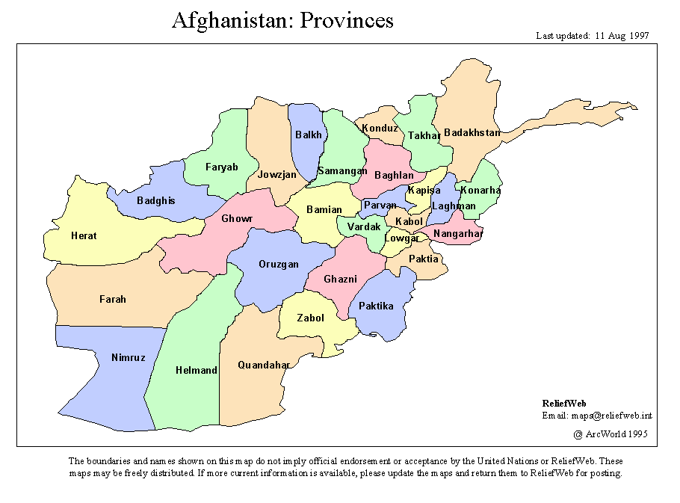
AFGHANISTAN

Slide 7
Statistical View
 | AFGHANISTAN | PAKISTAN
Area | 652,230 km² | 796,095 km²
Provinces | 34 | 4
Population | 31,108,077 | 182,490,721
Independence | First Afghan State 1709 | 1947
 | Afghan Empire 1747
 | Recognized State 1919
Bordering Countries | China, Iran, Pakistan, Tajikistan, Turkmenistan, and Uzbekistan.

Slide 8
INTRODUCTION
2240 km common border Durand Line.
Durand Line remained source of tension
Both Islamic republics
Afghanistan a landlocked country
Pashto speaking population (historically Ethnic Afghan)
Members of SAARC & ECO
Afghanistan observers status in SCO , Pakistan member

Slide 9
Durand Line
The border was established after the 1893 Durand Line Agreement between Durand & Amir Abdur Rahman Khan
The single-page agreement, which contains seven short articles, was signed by Durand and Khan, agreeing not to exercise political interference beyond the frontier line between Afghanistan and what was then colonial British India
Pakistan inherited this agreement but there has never been a formal agreement or ratification between Islamabad and Kabul.

Slide 10
Pakistan ‘s Policy on Durand Line
“The Durand Line between Pakistan and Afghanistan is the internally recognized border between Pakistan and Afghanistan and it is a closed and settled issue,”
( Foreign Office Spokesman Mozzam Ahmed Khan)

Slide 11
Relations
Despite shared geography, ethnicity and faith, relations with Afghanistan have never been smooth.
With the Indian threat looming from the East,
Afghanistan’s hostile attitude has added further in the fragile security environment
With the sole exception of Taliban rule (1997-2001) over Afghanistan, Kabul displayed varying degrees of disaffection towards Islamabad.

Slide 12
Relations
A cardinal feature of ideology of Pakistan is to make Muslim brotherhood a living reality.
But proximity with Afghanistan did not pay positive dividends
Pakistan succeeded in cherishing cordial relations with Muslim countries baring Afghanistan.
Geographical location of Afghanistan acted more negatively than the binding role

Slide 13
Relations
Afghanistan maintained an attitude of hostile neighbor
Pakistan has to live with it because neighbors can not be changed.

Slide 14
1947-1963
Claims on Pakistan’s territory
Indian claim on Kashmir
Allegation Pakistan extended mal treatment to Pashtoons

Slide 15
Pakhtunistan
Claims on Pashtoon areas
Referendum results held for the future of NWFP, 289244 votes in favor & 2874 against
Afghanistan was the only country that opposed Pakistan’s entry in UN
Notes:
2nd July 1947

Slide 16
Afghan Transit Trade
PAKISTAN is losing its share in Afghan transit trade to Iran and India, as both countries are developing infrastructure in and around the Iranian ports of Chabahar and Bandar Abbas.
Afghan transit trade dropped by over 54 per cent in fiscal year 2012, as the number of imported commercial containers fell to 28,813 from 60,338 a year earlier.

Slide 17
ATT
Decline in transit cargo is attributed to revised transit trade agreement, insufficient infrastructure, additional taxation/extortion, poor law and order situation & high freight charges
Pak-Afghan region is a trade specific region rather than a production hub. Therefore, Pakistan must liberalize its policy and shall tap the enormous potential of its trade route.

Slide 18
Economic
Last year Pakistan announced 20 $ million aid for Afghanistan
MoU for the construction of rail tracks in Afghanistan to connect with Pakistan Railways (PR)
In October 2010, the landmark APTTA agreement signed. The APTTA allows Afghan trucks to drive inside Pakistan to the Wagah border with India, including to the port cities, Karachi and Gwadar.[

Slide 19
Economic
In 2010 a joint chamber of commerce was formed
PAJCCI is targeting $5 to $6 billion bilateral trade in the next couple of years from the present level of $1.5 billion.
In July 2012, Afghanistan and Pakistan agreed to extend APTTA to Tajikistan in what will be the first step for the establishment of a North-South trade corridor.
The proposed agreement will provide facilities to Tajikistan to use Pakistan’s Gwadar and Karachi ports for its imports and exports while Pakistan will enjoy trade with Tajikistan under terms similar to the transit arrangement with Afghanistan.
Trade between Pakistan and Afghanistan was expected to reach $5 billion by 2015.
The volume dropped from $ 2.5 billion to $ 500 million.(SCCI-23 Jan 2018)

Slide 20
Refugees
2.5 million refugees
Pakistan extended refugee status
Since the fall of the Taliban regime in 2001, over 5.7 million Afghan refugees returned
Around 900,000 in Iran

Slide 21
Increasing Indian Influence
Salma dam project will meet energy & irrigation requirement of Western Afghanistan, with a capacity of producing 42Mw of power and irrigating 75,000 hectares of land.
India has invested US$ 10.8 billion in Afghanistan as of 2012
Afghan Parliament Building
The Indian government is investing more than US$100 million in the expansion of the Chabahar port in south-eastern Iran which will serve as a hub for the transportation of transit goods
India and Iran are set to ink a transit agreement on transporting goods to landlocked Afghanistan.

Slide 22
Increasing Indian Influence
Consulates in Herat, Jalalabad,Mazari Sharif & Kandhar (Pakistan’s Presence)

Slide 23
Afghanistan–Pakistan skirmishes
Cross-border shellings occurred since 1949
cross-border shellings intensified in 2011 and 2012
Upper Dir, Chitral & bordering areas of FATA

Slide 24
After Withdrawal
Pakistan shall evolve a proactive Afghan foreign policy rather than reactionary one.
Pakistan should continue convincing the US and Afghan regime into limiting India’s role in Afghanistan and increasing its volume of investment and reconstruction
This effort will also help Pakistan compete with other contenders and make a strong place for itself.
• Islamabad shall peruse two Ds policy in FATA: Development and dialogue. However, the government must involve the elders and Maliks in the development and dialogue process.
Administrative reforms shall be introduced in FATA which can make the system more transparent and responsive.

Slide 25
After Withdrawal
Recently, Pakistan’s foreign office is more assertive with regard to Afghan foreign policy.
Pakistan must understand that Afghanistan is her growth engine. The savor of Pakistani goods has already been developed in Afghan population and the former shall take advantage of this association.
Pakistan can serve as energy corridor and this will help the region in two ways. Firstly, it will promote interdependence, peace, and tranquility; and secondly it will help Pakistan exploit its industrial potential.

Slide 26
Border Fencing
150 kms of the frontier has been fenced
Target is to fence 832 kms of the border with Afghanistan in the next two years
In 1st phase, 432 kms of the border would be fenced
Project would cost Rs10 billion
Fencing of one km would cost Rs14 million

Slide 27
Afghan Peace
China is employing soft approaches
China & US both think the road to peace in Afghanistan goes through Pakistan
US expects Pakistan should facilitate talks with Afghan Talibans
Pak can help both militarily & politically to bring peace but what irritates it are the disproportionate expectations of the global community
Notes:
China-Af border length 74 kms

Slide 28
Afghan peace
The Afghan Peace Council was created to initiate peace process but failed to do so
Quadrilateral Coordination Group ,comprising Afghanistan,China,Pakistan & the US- almost non –functional
Trilateral Forum initiated by China having Pakistan and Afghanistan

