Slide 1
Political Ideologies

Slide 2


Slide 3


Slide 4


Slide 5
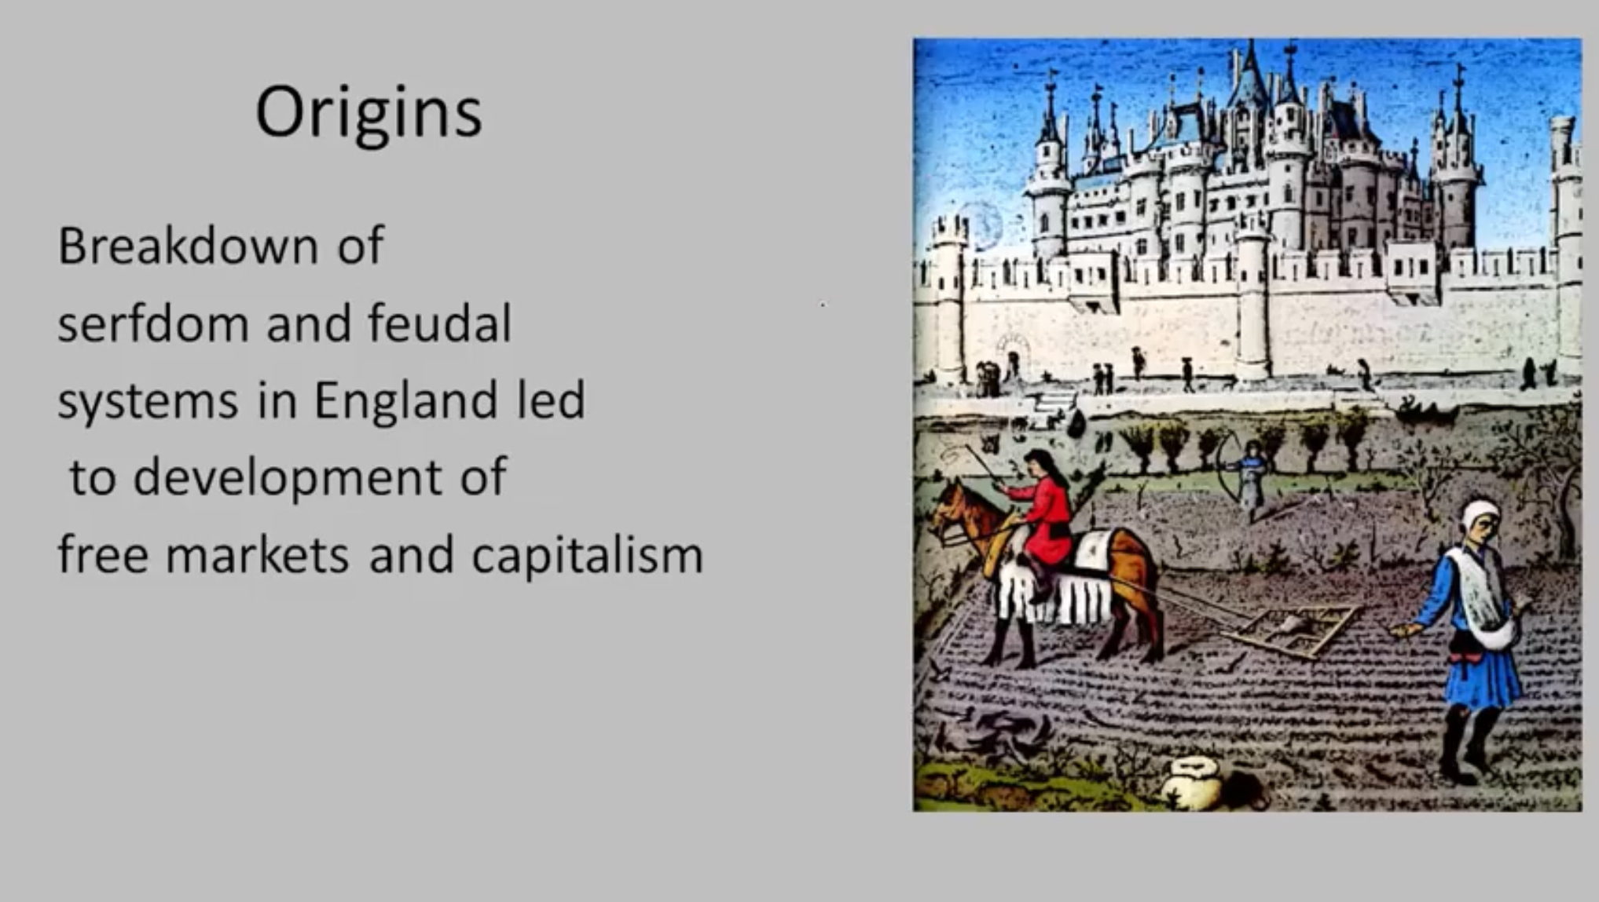

Slide 6
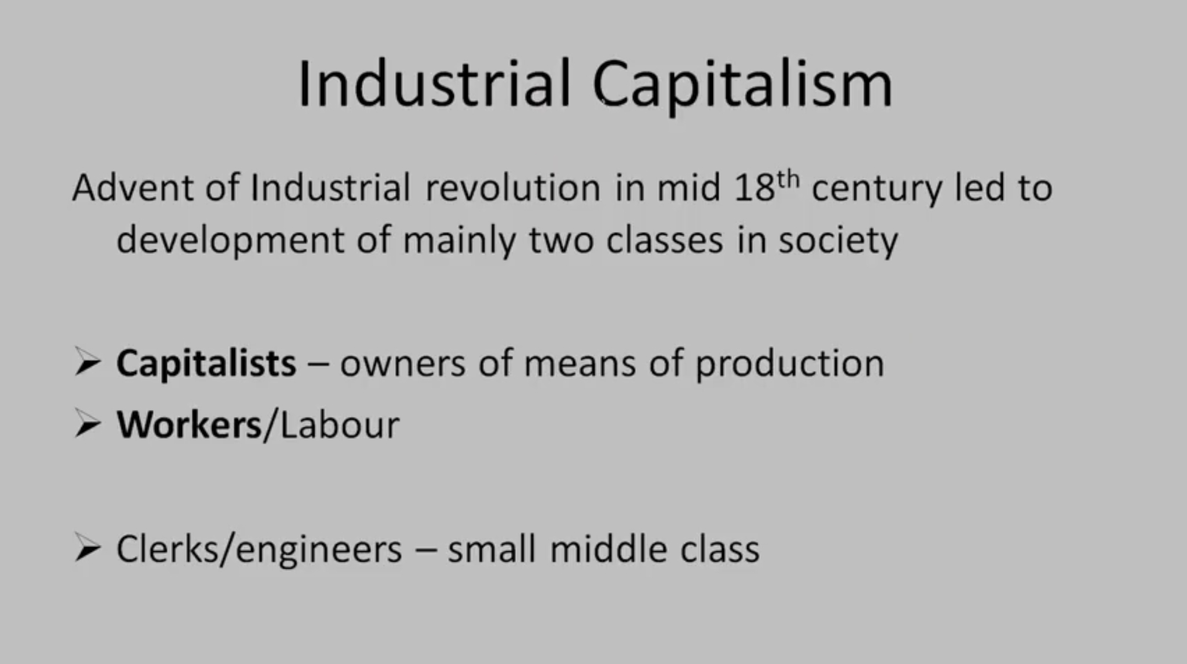

Slide 7


Slide 8
Consequences of capitalism
Increasing materialism in society
Increasing individualism in society
Stress on natural habitat
Inequality
Massive urbanization
Domestic and global competition
Consumer society

Slide 9


Slide 10
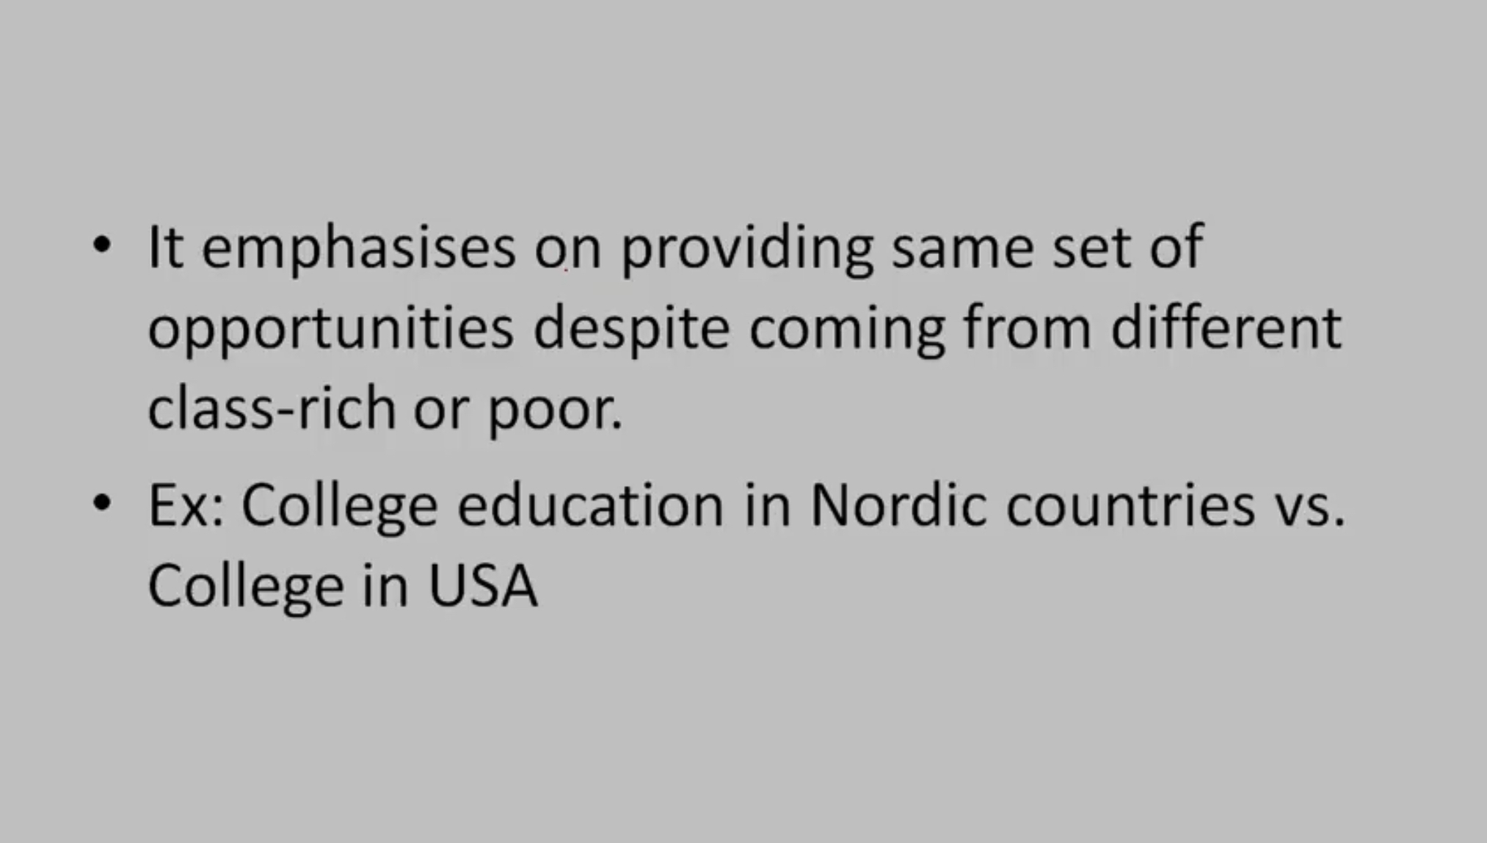

Slide 11


Slide 12
Principles of socialism
Public ownership
economic planning
egalitarian society
provision of basic needs
no competition
Price control
Social welfare

Slide 13
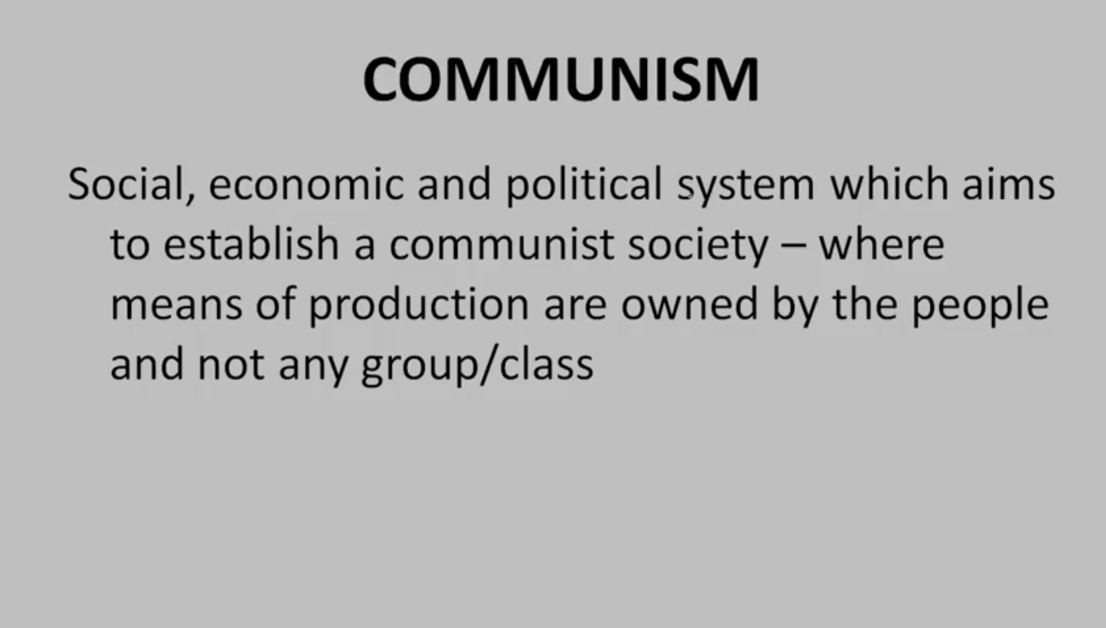

Slide 14
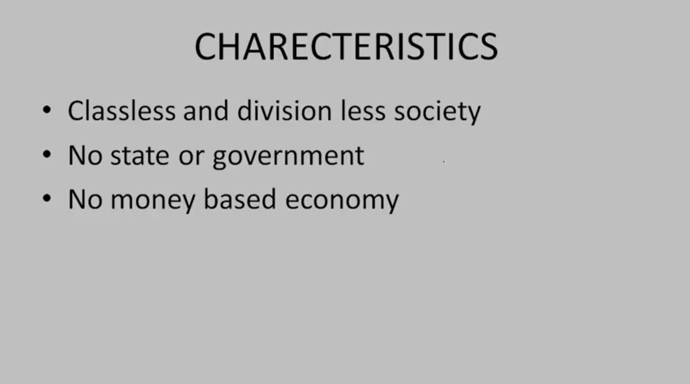

Slide 15
Difference between socialism and communism
Dictatorship of proletariat
Division of mental and manual labor
Bourgeoisie right

Slide 16
Positive consequences of communism
Equality
No competition
Low individualism
No alienation

Slide 17
Negative consequences of communism
No innovation and creativity
No wealth generation
Controlled freedom
Massive human rights violations

Slide 18
Some more characteristics
Opposition to Marxism
Opposition to liberalism
Conservative economic programs
Corporatism
Imperialism
Military virtues
Volksgemienschaft
Principle of absolute leader
New man

Slide 19
Totalitarianism

Slide 20
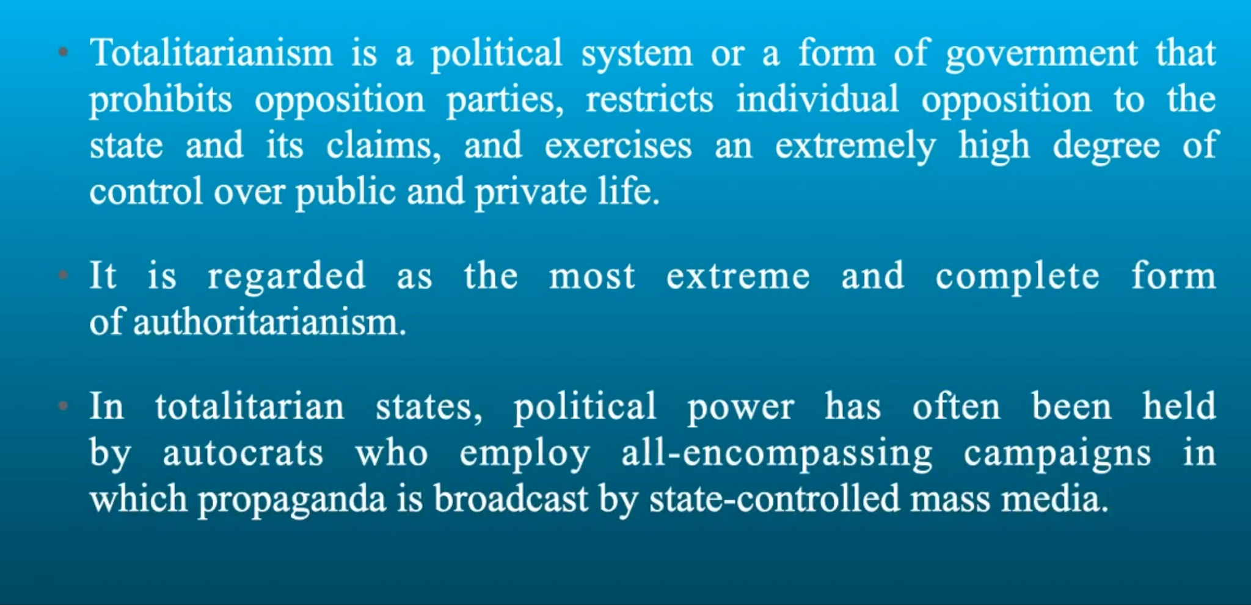

Slide 21


Slide 22

Characteristics

Slide 23


Slide 24


Slide 25
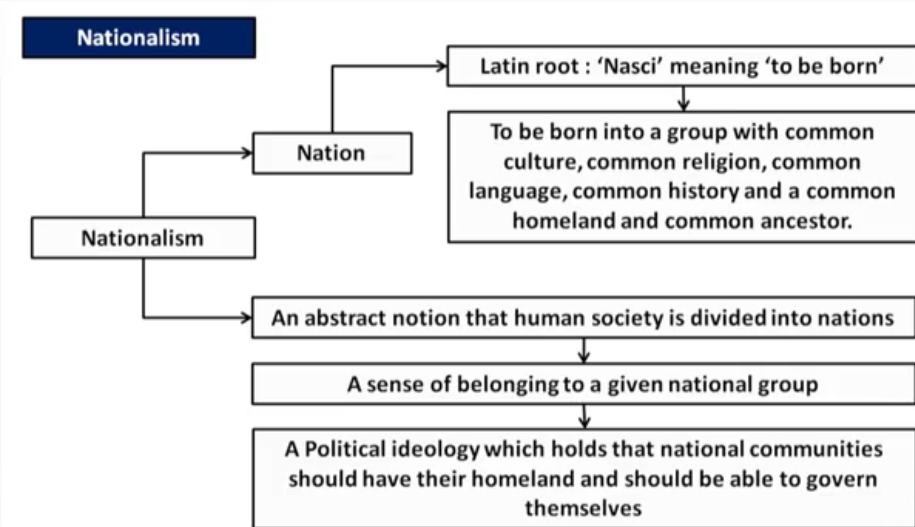

Slide 26


Slide 27
Merits of nationalism
Identity
Sense of belongingness
Source of integration
Provides inspiration for progress

Slide 28
Demerits of nationalism
Ethnocentrism
National conflicts
Protectionism
Populism

