Slide 1
Current Affairs
By
Zahid Mehmood Zahid (PhD - IR)
Assistant Professor

Slide 2
Syllabus of CA
Lecture 1
Key concepts
  Sovereignty, National Interest, Balance of Power
Foreign Policy
  Determinants, Decision Making and Analysis
  Pakistan’s National Interests, Challenges to the sovereignty
Afghanistan and Pak-Afghan Relations
  Afghanistan in Cold War theater, Soviets invasion, Mujahedeen, Geneva Accord, Post Cold War Situation, Rise of Taliban, Al, Qaeda, 9/11, Operation Enduring Freedom, Bonn Conference, US engagement, and Withdrawal.

Slide 3
Lecture 2
  Pak-India relations,
  Peace-making and Peace-Building in South Asia: Analytical overview of peace processes between/among the states of South Asia especially between India and Pakistan.
Lecture 3
  Russian Foreign Policy and Pak-Russia Relations,
Lecture 4
  Pak-Iran & Pak-Saudia Relations
  Pak-UK and Pak-EU relations

Slide 4
Sovereignty
‘Right’ & ‘power’ of a state to govern itself without any internal or external interference.
Supreme authority to use force within a territory to ensure ..
control over its territory, make laws, and independently manage its Int/Ext affairs.
Historical roots: Westphalia 1648, ended ‘thirty years war’, and established principles of sovereignty:
  Territorial Integrity, Political Independence, & Non-interference.
It is indivisible, permanent, & non-transferable. Rousseau
“Legitimate monopoly over the use of force” Max Weber

Slide 5
Sovereignty
Realism: Sovereignty is absolute, states prioritize their national interest and security in an anarchic system.
Liberalism: Sovereignty is flexible, states cooperate through int. institutions – sharing sovereignty to address global challenges.
Constructivism: Sovereignty is socially constructed, shaped by states through int. norms, identities, and practices.

Slide 6
National Interest
Aspirations or goals of a state in maintaining its sovereignty, security, and economic well-being In its interaction with other states/actors in Int. arena.
It represents the priorities and aspirations of a state.
In can be defined in multiple ways, let’s discuss USA, China, Russia, Ukraine, India, Pakistan, Afghanistan, etc.
Types of National Interests
Core/vital (territorial integrity, sovereignty, and national security)
Secondary (Economy, ideology, political system, etc.)
Variable (short-term stance over certain issues)

Slide 7
Balance of Power

Slide 8
Balance of Power (an even distribution of power)
Power: ability to influence others. J. Nye
BOP refers to the distribution of power among states in the system (regional or international).
It is significant in maintaining stability and preventing domination by any single power. H. Morgenthau
“Tendency of states to balance against potential threats to their security or power.” Kenneth Waltz
“States are power-seekers and strive to maximize their relative power to prevent any other state from achieving hegemony. J. Mearsheimer

Slide 9
Principles of BOP
Distribution of power (power is distributed to avoid domination)
Self-Help (states act for their interests and seek to enhance their security by balancing against the powerful states)
Equilibrium & alliances (through military buildups and alliances states maintain the balance)

Slide 10
How balancing is done
Internal balancing (economy, weapons, etc.)
External balancing (Alliances and Partnerships)
Soft balancing (attempts at restraining a threatening power through institutional delegitimization – Diplomatic & institutional)
Divide and Rule (Germany after WWII)
Armament & Disarmament (increasing or decreasing military capabilities for BOP)

Slide 11
Foreign Policy: Determinants, decision making and analysis

Slide 12
Questions to Ponder!
What is the purpose of the state?

Slide 13
Definitions of Foreign Policy
FP is "the art of establishing priorities among objectives and finding the means to achieve them." Kissinger
“the totality of interactions by which a state pursues its objectives with actors in other states." James Rosenau
FP is the establishment and development of relations with other states to promote and protect national interests by taking appropriate steps at the international level.

Slide 14
Stages in FP DM (Initiation, Formulation, implementation)
Problem/Need for a decision/Assessment of the Int. & domestic political environment.
Setting priorities.
Determination of FP Options.
Decision-making process/calculation.
Implementation of a selected option – resource allocation.

Slide 15
Permanent and Variables in FP DM
Permanent Factors:
Geographical Factors
Historical and Cultural Factors
Ideology …….
Variable Factors:
Global Power Dynamics (Power Distribution)
Economic Interests
Security Concerns and Threat Perceptions
Leadership and Domestic Politics
Int. Institutions.

Slide 16
FP Decision Making structure
PM/President
National Security Council/Committee/Commission
Parliament/Congress
Cabinet
Foreign Ministry
Defence & Intelligence Community
  Interest Groups
  Public opinion

Slide 17
Foreign Policy Decision-Making Models
Rational Actor Model (RAM)
Assumes the main actor in decision making is rational, and can be relied on to make informed and calculated decisions.
Assumes to have complete information for optimized decision-making.
Steps in Decision Making:
1- Identify the problem, 2 - Define desired objectives, 3 - Evaluate the options and consequences, 4 - Make the most rational decision with maximum benefits and least cost.
Examples: Putin’s decisions and WoT entry

Slide 18
Organizational Process Model (OPM)
Views Govt as a mix of powerful organizations working in concert.
SOPs, (authority and command structure) are followed.
Explains the decentralization of responsibilities & Power.
Decisions are made by qualified and professional individuals.
Example: Detonation: PM, PAEC, KRL, GHQ, PIA, PAF, NLC.

Slide 19
Bureaucratic Politics Model/Govt Bargain Model
Decision-making is done by a number of competing entities (organizations).
Each brings input to the DM process, with its own view of personal, organizational, and national interests.
Collective decision is contingent upon successful negotiation, bargaining, and compromises among entities.
Players’ positions and priorities matter.
Example: Pakistan’s detonation, Iraq War 2003

Slide 20
Implementation of Foreign Policy
Foreign policy is implemented through:
Diplomacy
  Political/Diplomatic (public dip, bilateral or multilateral agreements – JCPOA, NATO, EU)
  Economic (trade, tariffs, aid, sanctions)
  Military power & interventions (alliances & threats)
  Media narratives (promotion of perspectives, Saddam, Bashar, Taliban)
  Non-Government engagement (NGOs & Human Rights)

Slide 21
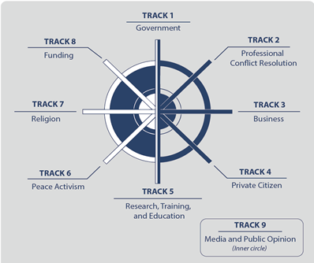
Tracks of Diplomacy

Slide 22
Before we discuss the national interests of Pakistan ….?

Slide 23
Pakistan’s FP Objectives
Promotion of Pakistan as a dynamic, progressive, moderate, and democratic Islamic country.
  Image, Identity problem, a normal rational state
Friendly relations with all/especially major powers, & immediate neighbors.
  Zero conflict approach, regional connectivity for regional development.
Safeguarding national security & geostrategic interests, including Kashmir. (FP starts at home)
  Citizen-centric economy, unemployment, food security, sectarianism, terrorism, societal harmony, climate, cyber, etc. (NSP 2022).

Slide 24
4. Consolidating commercial & economic cooperation with int. community.
  Trade & development, attracting FDI, economic diplomacy, innovation, and integration – ASEAN BRICS like.
5. Safeguarding the interests of Pakistanis abroad.
  Economic & politico-legal rights protection
6. Ensuring optimal utilization of national resources for regional & int. cooperation.
  CPEC, Looking to CA, Afghanistan, Human & natural Resources

Slide 25
Pak’s National Interests
Territorial integrity and security (India, Afghanistan)
Counter terrorism and Internal stability
Development and Prosperity (Economic growth, infra, energy security)
Political stability (demo and good gov)
Human Development (education and Human dev)
Identity and cultural values (cultural and religious harmony)
Access to resources (water, energy, and climate security)
Tech advancement (cyber and innovation)

Slide 26
Challenges to the Sovereignty
India
Cross Border terrorism (Afghan)
Terrorism and Extremism
Insurgency and Separatism
Economic Dependence (Addiction)
Political instability
Climate vulnerability
State (Hard)
Non-State (Soft)

Slide 27
Afghanistan in the Cold War Theater
Cold War geopolitics
Rise of PDPA (Leninist-Marxist Party)under Dawood and rise of resistance.
Refugees started entering Pakistan, 1975 abortive coup attempt.
Sur Inqilab (Red Revolution) April 1978
Comrade kills the comrade in October 1979
Soviets enter Afghanistan Dec 1979
Rise of Mujahedeen – a fusion of religion and geopolitics.
Pakistan becomes the front-line state in the last phase of the Cold War.

Slide 28
Geneva Accord 1988,
Rise of Taliban (Appeal? .. Promise?),
Al-Qaeda Enters into Afghan Theater
9/11 and Operation Enduring Freedom and the Taliban govt is toppled,
Bonn Conference 2001, and US/NATO in Afghanistan till 2021.
Doha Process 2018 - 2021
Return of Taliban 2.O (resilience and failure of Int effort)

Slide 29
Pak-Afghan Relations

Slide 30
Pak-Afghan Relations: An outline
Initial Phase: 1947 to 1979 (Afghan assertion and Pakistan’s vulnerabilities)
2nd Phase: 1979 to 1989 (Soviets in Afghanistan: the later stage of Cold War and Global Jihad against Communism)
3rd Phase: 1989 to 1994 (Civil War: infighting among Afghans)
4th Phase: 1996 to 2001 (Afghanistan under Taliban)
5th Phase: 2001 to 2021 (War on Terrorism: Global engagement in Afghanistan)
Latest Phase 2021 till date (Afghanistan under Taliban 2.O)

Slide 31
Introduction
Afghanistan and Pakistan share more than 2600 KMs border (Durand Line).
Afghanistan has always maintained a hostile posture/attitude towards Pakistan.
Despite common culture, ethnicity, faith, history & geo-political dilemmas, relations have been troublesome. WHY?
Primarily because of ‘Durand Line’ issue.
Afghanistan opposed Pakistan’s entry into UNO.
July 26, 1949 – terminated all agreements with British including ‘Durand Agreement’

Slide 32
Initial Stage: 1947 to 1979
Conflict over “Durand Line” & Pashtunistan formed the basis of relations b/w Afghanistan and Pakistan.
Afghans don’t recognize ‘Durand Line’ as an International border.
Agreement was signed in 1893 between Afghan King Amir Abdul Rehman and Sir Mortimer Durand.
However, Afghans claim, though misplaced:
  It was signed under duress,
  The language was English – Afghan Amir couldn’t understand,
  It was signed with British – not with Pakistan,
  Was not ratified,
  Afghan Amir was a weak ruler; hence, didn't represent Afghans,
  It was for 100 years.

Slide 33
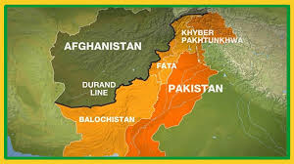
Afghan claims:

Slide 34
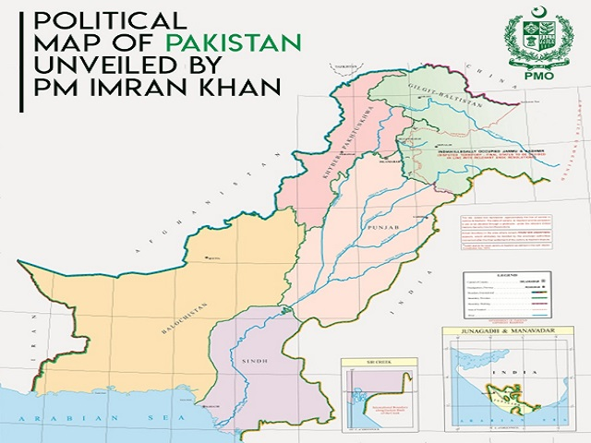

Slide 35
September 1950 Afghans raid in Balochistan.
In 1955, Pak embassy in Kabul, Jalalabad & Qandahar consulates were mob attacked over ONE UNIT. Severance of diplomatic relations.
Afghan invasion of Pakistan Sep. 1960-61 (Batmalai - Bajaour)
Afghan infiltration into Dir 1960.
Khyber pass skirmish 1961.

Slide 36
Second Phase: 1979 to 1989
Military Support: Pakistan helped Afghans in their war of liberation against the Soviet Union.
Funneled Arms and cash to the resistance forces.
Economic Support: Welcomed 4 million refugees,
Diplomatic Support: Denounced Soviet occupation and helped generate international response against Soviet invasion.
Geneva Accords April1988 (Pakistan sidelined)

Slide 37
Third Phase 1989-1994
Diplomatic Support to Afghanistan: Peshawar Accord April 1992 for the stability in Afghanistan.
Accord led to interim govt of Sibghatullah Mujad’di & Burhanuddin Rabbani.
However, this power sharing didn’t work and civil war broke out.
Afghan infighting gave way to the emergence of the ‘Taliban Movement’.

Slide 38
Fourth Phase: 1996 to 2001
Taliban took over Afghanistan after defeating a coalition force called “Northern Alliance”.
Northern Alliance was supported by India, Russia, and Iran.
Diplomatic Recognition to Taliban.
The Taliban introduced the orthodox Deobandi version of Islam.
Durand question remained the same. (public belief – Taliban/Durand Line)
Afghanistan becomes the host of Al-Qaeda.

Slide 39
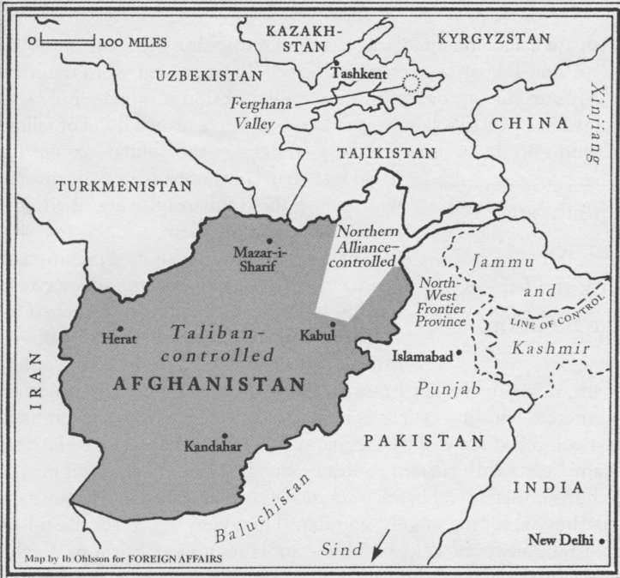
Taliban controlled Afghanistan in 1997-2001

Slide 40
Fifth Phase: 2001 to 2021
After 9/11, Pakistan was asked, “either with us or against us” by the USA.
Pakistan joined global WoT and became ‘non-NATO ally’ of the coalition.
Taliban govt was toppled and Pakistan supported the ‘Bonn Process’.
Pakistan supported Afghanistan politically, economically (1.5 billion US$), security, health, education.
Pakistan has always supported Afghan-led, Afghan-owned, Afghan-controlled solution of Afghanistan.

Slide 41
Latest Phase: Afghanistan under Taliban 2.O
Taliban took over Kabul on August 15, 2021 & consolidated their control.
Optimism turned into gloom.
  Terrorism - attacks rose to 28% in 2022 and 79% in 2023.
  Refugees
  Border management
  Trade to Central Asia increased since Taliban in Power
  Pakistan’s exports increased 75% in 2024, and imports decreased 8%.

Slide 42
Why is there no peace & stability in Afghanistan?
Realism:
Lack of strong central authority (Int. & in Afghanistan),
Power struggles - security dilemmas,
Strategic location – attracted regional and global powers.
Liberalism:
Weak institutions, Lack of economic development, and limited int. cooperation.
Constructivism:
Identity (ethnic, religious) exploited by external actors, culture, and historical narratives in shaping Afghanistan's conflict.

Slide 43
Pak-Afghan relations: complicating factors
Afghanistan is a toxic mix of state collapse, civil conflict, ethnic disintegration, and multisided intervention that has locked it in a self-perpetuation cycle that is beyond outside solution.
Turbulent/subjective history (ontologically historical)
Terrorism and sovereignty (cross-border, TTP, IS).
Regional competition (Indian question).
Recognition.
Refugees (Pak should not spoil its goodwill)
Lack of Shared economic vision (bilateral trade and connectivity to CARs).

Slide 44
Solution!
Forget, learn, and move into the future.
Track I & II dialogue – religious diplomacy.
Political Recognition (conditional) with meaningful action against TTP, inclusive government & women’s rights.
Pakistan should find ways to engage Afghanistan.
Trilateral mechanism (Pak-Afghan-China)
Refugee and border management
Dispute resolution mechanism for shared destiny.
Intelligence sharing for counter-terrorism.
Connectivity – shared economic vision (CASA & TAPI).
Engaging friends (guarantors).

