Slide 1
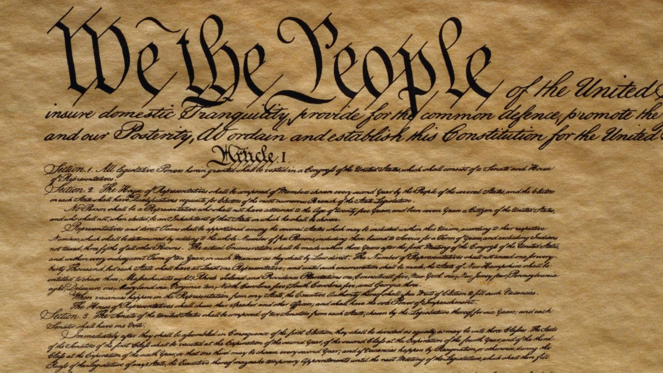
Constitution of the USA

Slide 2
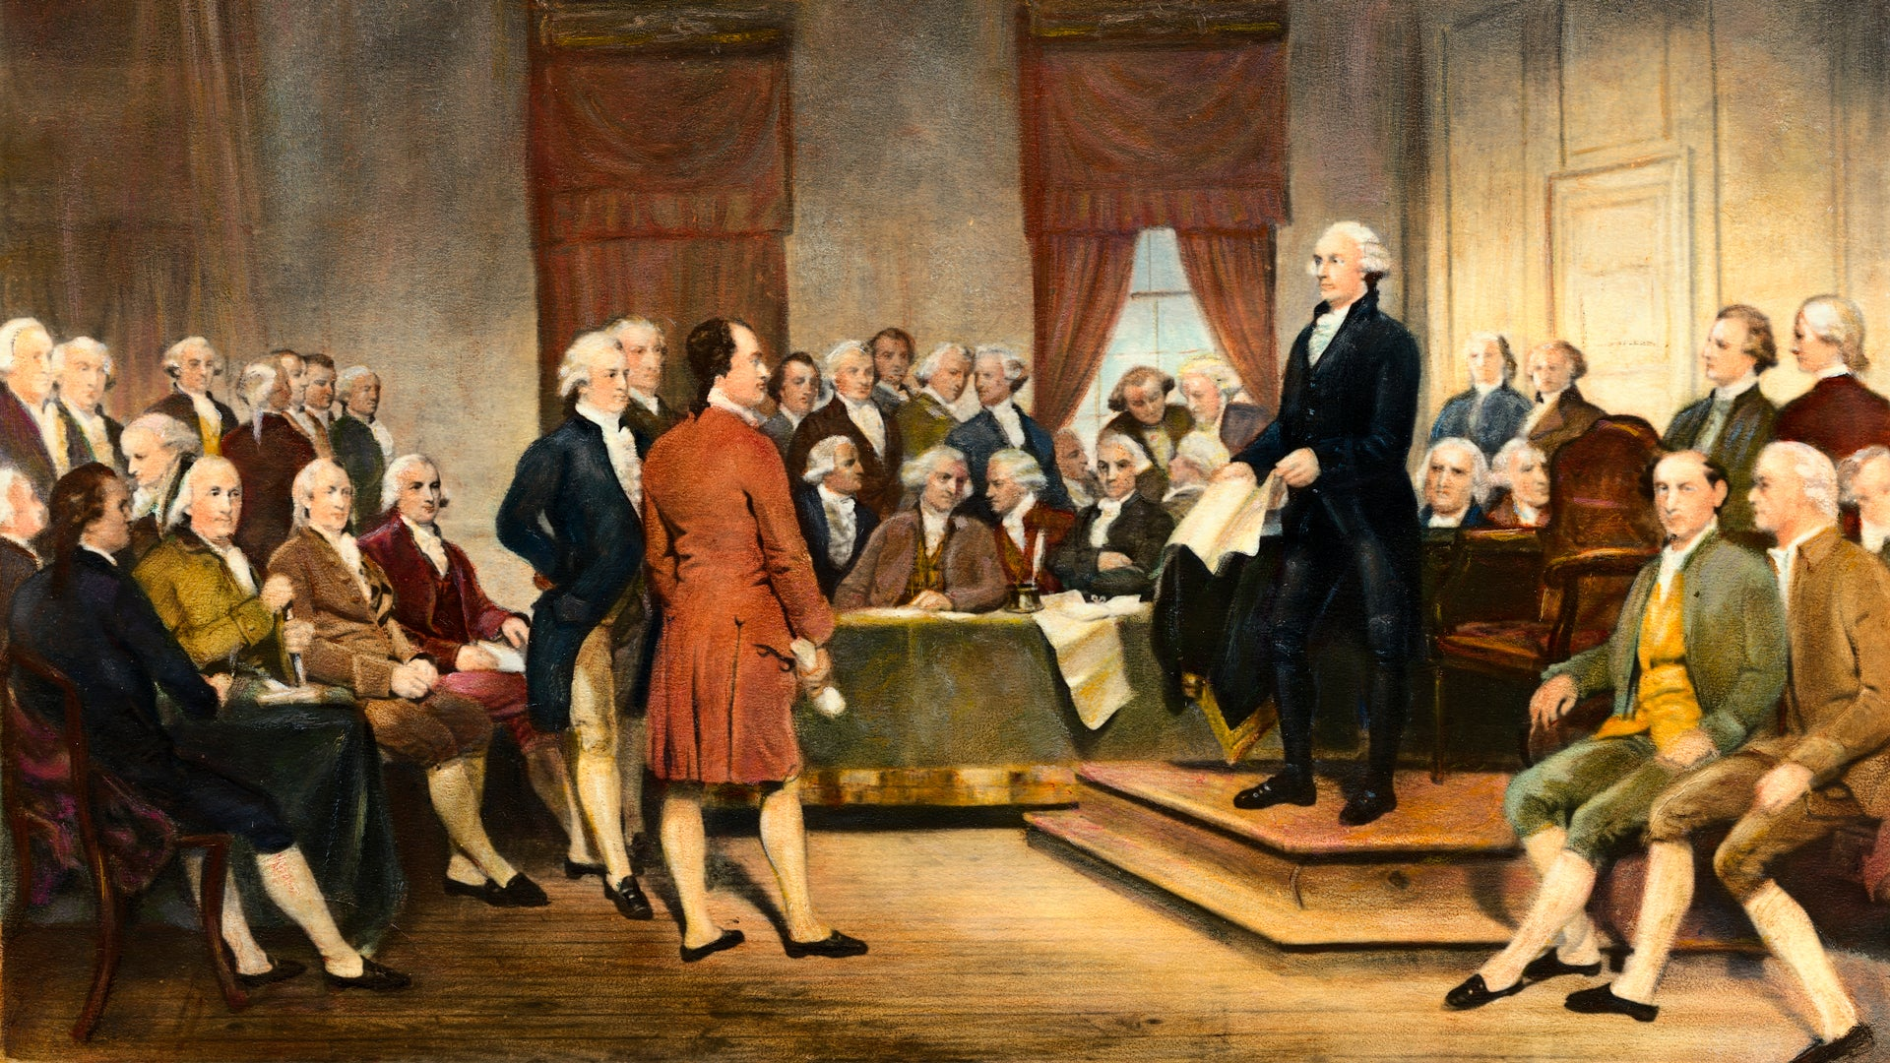

Slide 3
Issues during constitution making
Federalists vs. Anti-federalists
North States vs. South States
Virginia Plan Vs. New Jersey Plan
Nature of Govt.
Representation in Congress
Commercial and Agriculture States

Slide 4
Articles of Constitution
Article 1: Legislative Branch
Article 2: Executive Branch
Article 3: Judicial Branch
Article 4: States
Article 5: Amendment
Article 6: Debt, Supremacy, Oath
Article 7: Ratification of Constitution

Slide 5
Salient Features of the Constitution

Slide 6
Written Constitution
Brief and Simple (7 articles, 10 sections, 27 amendments
Liberal Constitution
Supremacy of Constitution
Rigid Constitution
Secular Constitution
Popular Sovereignty
Bicameralism
Independence of Judiciary
Presidential form of govt.
Presidential Veto
Spoil System
Federalism
Universal Suffrage
Dual Citizenship
Separation of Power
Checks and Balances
Bill of Rights

Slide 7
System of Checks and Balances

Slide 8
Legislative
Executive
Judiciary

Slide 9
Executive Branch Check and Balances the Legislative Branch
President has the power to Veto laws passed by Congress
President can propose new laws to Congress
Submits the Federal Budget to the House of Representatives
Appoints Federal Officials, who carried out and enforce laws

Slide 10
Executive Branch Checks and Balances the Judicial Branch
Nominates judges to the supreme Court
Nominates judges to the federal court system
President has the power to pardon or grant amnesty to persons convicted of crimes

Slide 11
Legislative Branch Checks and Balances the Executive Branch
Congress can override presidential vetoes with a two-thirds vote from both chambers
Senate can reject proposed treaties with a two-thirds vote
Senate can reject presidential nominations of federal officials or judges
Congress can impeach and remove the presidential (House serves as prosecution, Senate serves as jury)

Slide 12
Legislative Branch Checks and Balances the Judicial Branch
Congress can create lower courts
Senate can reject nominees to the federal courts and supreme court
Congress can amend the Constitution to overturn decisions of the Supreme Court
Congress can remove judges of the lower federal courts

Slide 13
Judicial Branch Checks and Balances the Executive Branch
Supreme Court can use the power of judicial review to rule laws unconstitutional
Supreme Court can use the power of judicial review to rule the presidential actions unconstitutional

Slide 14
Judicial Branch Checks and Balances the Legislative Branch
Supreme Court can use the power of judicial review to rule treaties unconstitutional

Slide 15
A candidate has won the popular vote but lost the election four times in our nation’s history:
1824 – Andrew Jackson won the popular vote, but received less than 50 percent of the electoral votes. John Quincy Adams won the presidency.
1876 – Samuel Tilden won the popular vote, but Rutherford B. Hayes received 185 electoral votes to Tilden’s 184.
1888 – Grover Cleveland won the popular vote, but received 168 electoral votes to Benjamin Harris’ 233.
2000 – Al Gore won the popular vote, but lost the election to George W. Bush. In one of the most contested elections in modern history, the U.S. Supreme Court stopped the Florida recount of ballots and gave Bush the state’s 25 electoral votes, giving him a total 271 compared to Gore’s 255.

Slide 16
Eight presidents have died in office
William Henry Harrison (pneumonia), 9th in line, 1841
Zachary Taylor (gastroenteritis), 12th in line, 1850
Abraham Lincoln (assassination), 16th in line, 1865
James Garfield (assassination), 20th in line, 1881
William McKinley (assassination), 25th, 1901
Warren Harding (heart attack), 29th, 1923
Franklin D. Roosevelt (cerebral hemorrhage), 32nd, 1945
John F. Kennedy (assassination), 35th, 1963

Slide 17
Interesting Facts
George Washington is the only president ever elected unanimously.
Victoria Woodhull was the first woman to run for president in 1872.
Hillary Clinton was the first woman to be nominated for president by a major party ticket in 2016
Martin Van Buren was the first natural-born American to become president in 1837. Each of the seven previous presidents were born as British subjects
Grover Cleveland was elected president in 1884, lost his re-election campaign in 1888, and won the presidency for a second time in 1892

Slide 18
THE PRESIDENT OF UNITED STATES OF AMERICA

Slide 19
Qualifications
Must be at least 35 years old
Have lived in the United States at least 14 years
Be a natural-born citizen.
Tenure and Removal
Elected for 4 years
The President cannot be removed except by an impeachment
He can be impeached for treason, bribery or high crimes
Originally, the constitution was silent about presidential re-election
The charges are framed by the HOR
The Senate presided over by Chief Justice of the Supreme Court
A 2/3rd vote of the Senate is necessary for conviction (none Removed)
Notes:
There are only three requirements to be president, according to Article II, Section 1, Clause 5 of the U.S. Constitution:

Slide 20
His Election (in Theory)
Elected for 4 years term
Elected indirectly by an Electoral College
The electors meet in each state on fix dates and vote for the President and Vice-President
A candidate who secures a majority of the electoral votes, declared elected.
To win, a candidate must obtain 270 electoral votes
If no candidate secure a clear majority of votes, the HOR of representatives chooses the President from among the first three

Slide 21
Primaries and Caucuses
National Conventions
General Elections
Electoral College
Election in Practice:

Slide 22
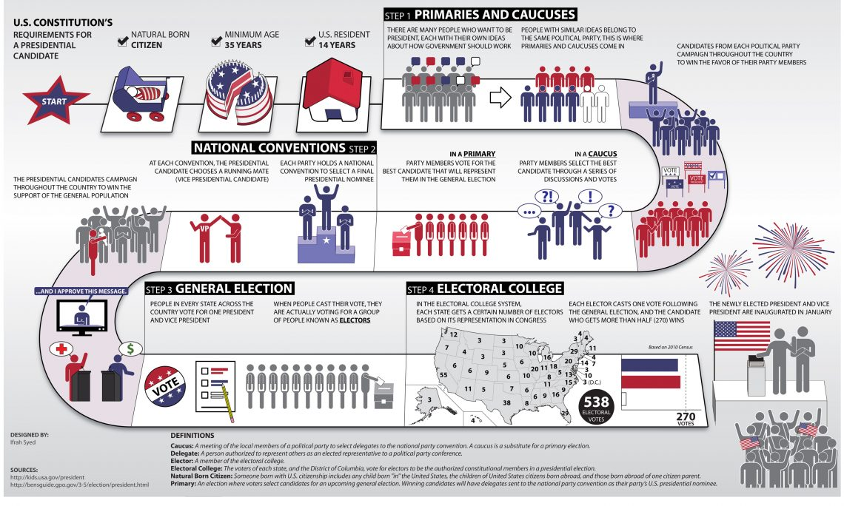

Slide 23
STEP 1: PRIMARIES AND CAUCUSES
There are many people who want to be President, each with their own ideas about how the government should work. People with similar ideas belong to the same political party. This is where primaries and caucuses come in. Candidates from each political party campaign through the country to win the favor of their party members.
Beginning in February the main voting events Primaries and Caucuses will lead to a selection of delegates who will represent the people at the upcoming conventions.
In a Caucus
Party members select the best candidate through a series of discussions and votes.
In a Primary
Party members vote for the best candidate that will represent them in the general election.

Slide 24
STEP 2: NATIONAL CONVENTIONS
Each party holds a national convention to select a final presidential nominee. State delegates from the primaries and caucuses selected to represent the people will now “endorse” their favorite candidates and the final presidential nominee from each party will be officially announced at the end of the conventions. The presidential candidate also chooses a running mate (Vice Presidential candidate). The presidential candidates campaign throughout the country to win the support of the general population.

Slide 25
STEP 3: GENERAL ELECTION
People in every state across the country vote for one President and Vice President. When Americans go to the polls in November they will select their favorite presidential candidate and their running mate.
When people cast their vote, they are actually voting for a group of people called electors. Except in the states of Maine and Nebraska, if a candidate receives the majority of the votes from the people of a state then the candidate will receive all electoral votes of that state.
The presidential nominee with the most electoral votes becomes the President of the United States.

Slide 26
STEP 4: ELECTORAL COLLEGE
The Electoral college is a process in which electors or representatives from each state in number proportional to the state’s population cast their vote and determine who will be president.
Each state gets a certain number of electors based on its representation in Congress. There are a total of 538 electors selected according to each state’s policy. Each elector casts one vote following the general election, and the candidate who gets more than half (270) wins.
The newly elected President and Vice President are inaugurated in January.

Slide 27
POWER AND FUNCTIONS OF THE US-PRESIDENT
Executive Powers:
1) Head of National Administration
2) Appointments
3) Dictator in Foreign Relations: Appoints all Ambassadors/Diplomats
4) C-in-C/Powers of Defense: American forces were ordered to undertake ‘police action’ in Korea in 1951 without a declaration of war
Legislative Powers:
1) Messages: The president is required by the constitution to send messages to Congress giving it information regarding the state of the Union
2) Veto: Influence Congress by the use of ‘Veto’
3) Extraordinary Sessions: can call special sessions of Congress
4) Ordinances

Slide 28
Continues…
Patronage: Member of Congress want jobs for their relatives, friends and supporters. He makes bargains with members to seek their support for legislative measures
Personal Conferences: In recent times, the President have used the device of taking Congressional leaders into confidence by holding personal conferences with them
Financial Powers: The budget is prepared under the guidance and supervision of the President
Judicial Powers: Power to grant pardon and reprieve to all offenders against federal laws, except those who have been impeached or those who have offended against the state

Slide 29
Parliamentary Form of Govt.
Exists an intimate relationship b/w the executive and legislative dept. and the stability and efficiency of the executive dept. depends on the legislature
Legislative supremacy is now replaced by cabinet supremacy (also called cabinet govt.)
The executive branch derives its democratic legitimacy from parliament, and held accountable to the parliament (inter-connected)
Elections, Political Parties Formation of govt. on the basis of majority wins.

Slide 30
Continue…
U.K const. as a mother const.
Legislature and executive are closely related and share powers with each other
Organs: The king/President, PM, Cabinet, Senate, Parliament Example: Britain, India, Canada, Pakistan
Cabinet is formed by the parliament and parliament is the superior organ
Two executives i.e. the elected president or king and the prime minister. President represents state and PM represents govt.
Cabinet responsible to legislature

Slide 31
Features
Existence of a Constitutional Ruler: Legally the administration of all the affairs of the state is conducted by the head of the state (Council of ministers)
Absence of Separation of Power: Shared functions and powers
Main Role of the Lower House(LH) in Ministry-Formation: Majority wins, leader of the party appointed as the PM
Responsibility to the Legislature: Cabinet and ministry
Collective Responsibility: Individual and collective (head of dept. and part of cabinet)

Slide 32
Features
Intimate Relationship b/w the Legislature and Executive: Control each other, PM from the Majority (Alliance) The programs and policies of the cabinet are backed by the majority in the parliament
Leadership of the PM: The success of parliamentary democracy depends, to a great extent, on the personality, efficiency and charisma of the PM
Existence of a Strong Opposition: Life force of Parliamentary democracy
Cabinet Dictatorship: Policies formulation (National and International issues) Passing laws Prepares the budget draft in Consultation with PM Formulates economic policies The Keystone of Political Arch
Notes:
Cabinet Dictatorship: Policies formulation (National and International issues) Arrangements for passing laws to implement the policies Determines the matters to be included in the national agenda Controls and directs the admin. Depts. Co-ordinates the activities of diff. govt. dpt. Prepares the budget draft in consultation with PM Formulates economic policies Advise the Constitutional head to take necessary action during emergency or unforeseen situation etc. Cabinet acts as the keystone of political arch, or has become the steering wheel of the ship.

Slide 33
Presidential Form of Govt.
A system of govt. where an executive branch is led by a president who serves both head of the state and head of govt.
A system is which president is constitutionally independent of the legislature
A system of govt. where the executive branch exists separately from a legislature
Characteristics: President is the Real Head Separation and checks and balances Ministers are accountable to President

Slide 34
Merits
More Democratic: Because of the twin principle of separation of powers and checks and balances, (concentration of powers)
Stability and Continuity: As both the president and legislature enjoy fixed terms of office, continuation of policies..
People’s President: Elected by direct election Enjoys more of people’s confidence and support
More efficient and take prompt and Bold Decisions: Free to chose his ministers. The senate may or may not ratify such appointments but it cannot impose its choice on the president

Slide 35
Continue..
Best suited to Deal with Emergencies: More effective in tackling emergences as there is unity of control and concentration of executive powers
More Suited for Multi-Party System: Multiparty system is prone to political instability. Political parties with different interests pull the political system in different directions. In order to check this, there is need of strong executive and presidential form of govt.
Symbol of National Unity and Integrity: Forging unity in the nation consisting of diverse regions, communities and cult, as President is directly elected by people. They took upon him as the symbol of unity

Slide 36
Demerits…
Dictatorial Role: All executive powers are concentrated in the hands of the president Not accountable to legislature
Conflict and Deadlock: As the president and his cabinet are not members of legislature, they find it difficult to persuade the legislature to accept proposal
Absence of Accountability: President directly elected by people
Rigid System of Govt. During crisis, the president cannot be replaced during tenure..
Foreign Policy Formulation with in Consensus with Congress: President handicaps According to Gamer, the presidential system is autocratic, irresponsible, and dangerous.

Slide 37
THE AMERICAN PRESIDENT V/S THE BRITISH PRIME MINISTER
(A CASE STUDY OF COMPARISON REGARDING THEIR POWERS AND FUNCTIONS)

Slide 38
U.S. President
Elected for 4 years
Constitutionally secured (Impeachment)
U.K. Prime Minister
Elected for 5 years
Vote of no Confidence
Directly Elected
Appointed by Monarch
Head of the Govt.
Head of the Govt. and State
Not Responsible to the Legislature
Answerable and accountable to the House of Commons
Head of his cabinet
The boss and the cabinet members are his subordinate
Powers of making appointments and conclusion of treaties
Derives all his powers from the constitution
The American President is helpless if the Majority in the Congress is against him
All appointments under the signature of Monarch
Derives his powers from constitutional conventions
The U.K. PM is always the leader of the majority party and can get the necessary legislations.

