Slide 1
Lecture 2
Pak-India Relations
Peace-making and Peace-Building in South Asia

Slide 2
How do you see the creation of India and Pakistan?
Is peace possible, if YES how; if NOT why?

Slide 3
Pak-India Relations
The Context: A Troubling Legacy
Phenomenon that can be approached from different perspectives (political, historical, religious, economic, etc.)
Relationship have been characterized by conflict & lack of trust.
Familiar obstacles on both sides – Terrorism and Kashmir, shrinking the far-sightedness on both sides because of domestic politics.

Slide 4
Despite strategic asymmetry & overall growing gap, Pakistan looms large on the Indian horizon.
Leadership on both sides cannot separate progress in one field from differences in other areas – which has turned it difficult to develop and sustain cooperation.
Both place nationalism above everything – nonstarter, making the relationship a ‘Zero-Sum.’

Slide 5
History of occasional optimism & often gloom
Pre-Partition (Opposing Ideologies)
Partition and Aftermath (identity)
Communalism 1.2 Million killings, Disputes over territories and assets.
Global Geopolitics and Indo-Pak Relations
Conflict (Kashmir) and cooperation with Cold War geopolitics (SEATO & CENTO).
1948, 1965 (Tashkent Agreement 1966), 1971 (Shimla Agreement), Indian nuclearization 1974, Siachen, Kashmir Intifada 1989, post cold war loss of significance.

Slide 6
Nuclearization, Balance of Terror, and Regional Stability
1998 N. Tests, Lahore Process (Bus Yatra), Kargil 1999 (Koh Paima), MAD, and Balance of Threat.
21st Century and Renewed Rivalry
Agra Summit 2001 (Musharraf 4 Point Formula), Indian Parliament Attack, Military Standoff 2001-2002, Diplomacy crisis management (Golden Handshake 2002), SAARC Summit Islamabad 2004.
Composite Dialogue Process 2004
Samjhouta Express Blast 2007, Mumbai Attacks 2008
Sharm-El-Sheikh Gelani-Singh meeting 2009.

Slide 7
Eight Agenda Items of CDP
Peace and Security including confidence-building measures (CBMs)
Jammu and Kashmir (J&K)
Siachen
Wullar Barrage (Jehlum river)
Sir Creek (96 KM – Gujrat and Sindh, Thalweg principle)
Economic and commercial cooperation
Terrorism and drug trafficking
Promotion of friendly exchanges in various fields

Slide 8
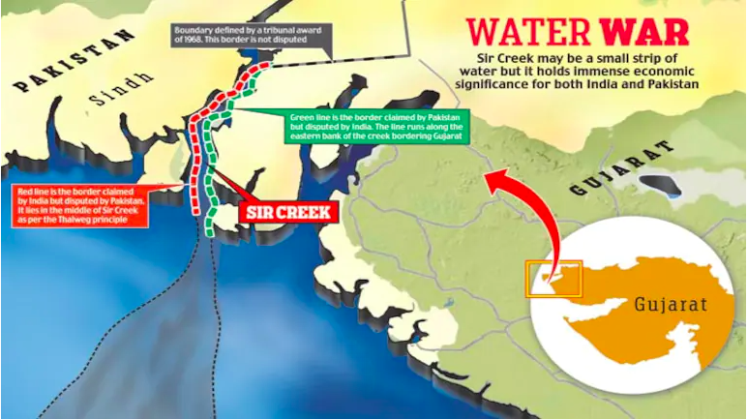

Slide 9
Musharraf’s Four Point Kashmir Formula (2001)
Demilitarization (Kashmir)
Self-governance (autonomy and self-rule)
Joint Mechanisms (bilateral institutions)
Soft Borders (free movement, people to people) .

Slide 10
Pakistan and Modi’s India since 2014
Modi’s FP is guided by Panchamrit
1 Samman = Dignity, 2 Samvad = Dialogue, 3 Samriddhi = Shared prosperity, 4 Suraksha = Security, 5 Sanskriti evam sabhayata = Cultural & Civilizational links.
Relations have been the worst since 2014.
India propagates cross-border terrorism – a tool to reduce issues to their advantage.

Slide 11
Great power ambitions (Realism, Hindu nationalism, Vishwa guru).
Economy Diplomacy, ‘5 Trillion’ economy ambition.
“Act East” with multipolar vision in Asia in the Asian century.
Calculated risk-taking (Doklam, Balakot, Urri, Russia oil & S400, and Energy from Iran, Article 370 & 35 A, Modi in Moscow on NATO’s 75 Years).

Slide 12
Indian regional and global profile is rising.
Internally: Hindufication of India.
Externally: Hegemonic aspirations with assertive FP
Status quo suits India more than Pakistan.
Peace will pay Pakistan more … crisis is used by India to demonize Pakistan.

Slide 13
Genesis of the Relationship
Historically: Muslim nationalism & identity – a majority/minority issue (after 1947 - big India and Small Pakistan).
Zero-Sum Nature of Relationship: powerful India and weaker Pakistan – hence zero-sum relationship & continuation of rivalry.
India sees its security on a continental way, not as a state, (Khyber to Lahore to Delhi)
Structures of Political, Security, and Administrative Institutions: designed & institutionalized on suspicions on both sides.
Solution:
Strong leadership can defy and generate popular consensus by and momentum within institutions politically and in security terms.

Slide 14
Way out/Suggestion
Forget and learn ….
Political will & intent is the pre-requisite.
Election 2024 results are a positive sign ….. How?
Both should take baby steps … towards peace.
Track I and II, what is doable and what is desirable
People-to-people contacts
Relaxing visa regime
Bilateral trade (Pak-India business forum)
Integration and connectivity – SAARC (Webinars etc.)
International and regional friends to be brought in.
Demilitarization of certain zones – Siachen

Slide 15
India cannot isolate Pakistan and will continue to be on the Indian horizon (non-contact warfare failed).
Religious tourism (Kartarpura, Hassan Abdal, Nankana),
Medical visas,
Military CBMs (DG MOs flag meetings, frequent use of hotline),
Role of Media
Dialogue on Kashmir (taking Kashmiris as well)
Consensus is necessary to prevent any conflict and spoilers’ intervention.
Resumption of composite dialogue…. Will India?
Economic interdependence can help normalize relations.

Slide 16
Peacemaking
Agreeing to end active conflict/war through negotiations.
It is short-term process.
It Involves:
Immediate focus (ceasefire through peace agreement)
Negotiation & Mediation:
It involves direct negotiation between conflicting parties, often facilitated by third-party mediators.
Solution through addressing the ‘immediate’ cause.
Diplomacy (all the stakeholders and guarantors)

Slide 17
Peacebuilding
Creating the conditions for sustainable peace by addressing the root causes of conflict.
It is long-term process.
It Involves:
Reconciliation
Social Cohesion
Economic Development
Through – Community Engagement and sustainable institutions (prevention)

Slide 18
Q/A
Discussion

