Slide 1
SAARC + SCO

Slide 2

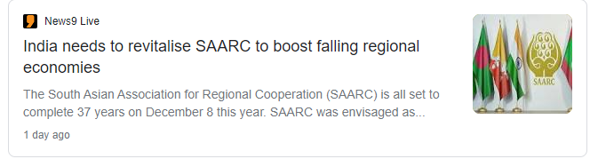

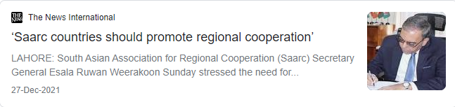

Slide 3
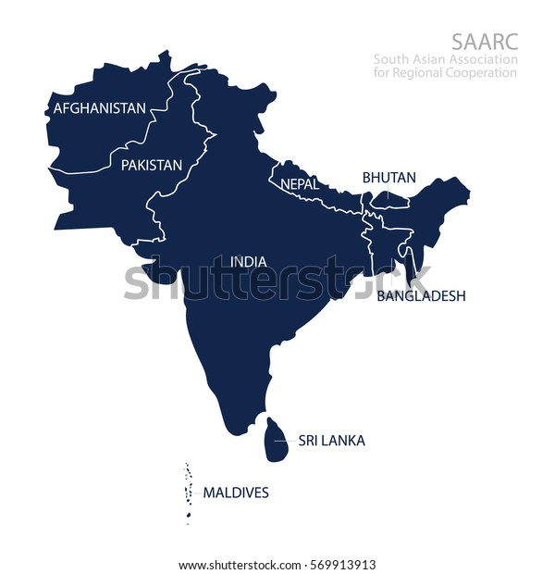
SAARC (South Asian Association for Regional Cooperation)
Introduction
Member Structure
Functions

Slide 4
SAARC
Institutional Framework
Chamber of Commerce and Industry (SCCI)
SAARC Arbitration Council
South Asian Regional Standards Organization

Slide 5
SAARC
Achievements of SAARC
SAFTA
SAARC Food Bank
SAARC Development Fund
South Asian University

Slide 6
SAARC
Reasons for Failure of SAARC
Bilateral Conflicts
Indian Question
Security Element of South Asia
Economic/Social Conditions
Political Lockdown
Sir Lankan Economic Crisis
Hegemonic aims
03 Tiers of Security concerns
Water Disputes
Attempts to cripple SAARC
Afghanistan Economic Crisis

Slide 7
SAARC
Recommendations for SAARC
Political Solutions
Economic Solutions
Institutional Changes
-Role of India
-Conflict Conciliation Groups
- Resolution of Bilateral Disputes

Slide 8
ASEAN (Association of South East Asian Nations )
Introduction
Fundamental Principles

Slide 9
ASEAN (Association of South East Asian Nations )
Economic Integration
Phase-I
Phase-II
Phase-III

Slide 10
ASEAN
Prevailing Issues of ASEAN
ASEAN, China and the South China Sea
Human Rights Violation
-What is the South Chine Sea issue?
-Rohingya Crisis, Myanmar.
Myanmar Coup
Philippines war on Drugs

Slide 11
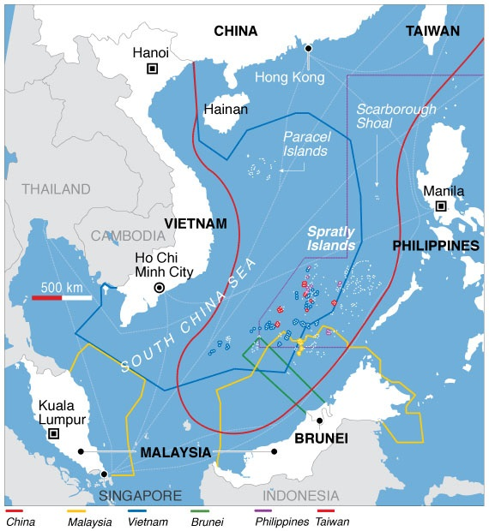

Slide 12
ASEAN
ASEAN and Pakistan
-As member
-Common areas of Collaboration

Slide 13
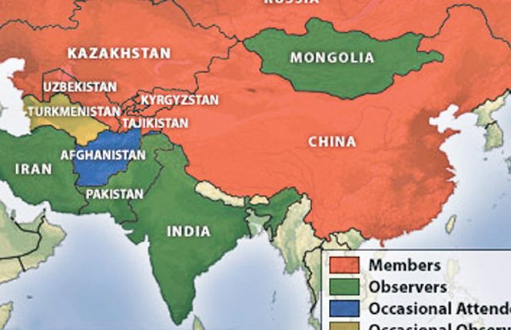
SCO (Shanghai Cooperation Organization)
Introduction
Structure
Aims of SCO

Slide 14
SCO
Structure of SCO
The Heads of State Council (HSC)
The Heads of Government Council (HGC)
Regional Anti-Terrorist Structure (RATS)
SCO Secretariat

Slide 15
SCO
SCO and Pakistan
(Common Points of Benefits)
-Geo-economic win-win situation for both.
Energy Crisis
The fight against the 3 Evils
Opportunity for enhancing Diplomatic Relations:

Slide 16
SCO
Challenges faced by SCO
Offsetting USA and NATO in the region
The 3 Evils and Security Issues
Political Relations
China vs Russia Leadership
Pakistan and India

