Slide 1
Lec#03

Slide 2
Two Schools of thoughts
Radicals
Always look to estrange the relations with British
Charles Thomson, George and Thomas Jefferson
Less in number
Boston Tea Party 1773
Conservatives
Always interested in restoring of good relations and forgetting what happened.
Professionals politicians, Royal merchants & Officials
More in Numbers
Colonial protests and Massachusetts formation of committee of correspondence in Boston in 1772
By 1773, committee of correspondence were established in all states excepting Pennsylvania and North Carolina

Slide 3
B. American Colonists Preparation for War
First Continental Congress Meeting(Sept. 5,1774)
Suffolk Resolves
Declaration of Rights and Grievances
Second Continental Congress Meeting (May 10, 1775), Philadelphia
a. Battle of Bunker Hill (June, 1775)

Slide 4
Background year 1774
March 31 - Boston Port Act— Parliament closes the city’s port in response to the Tea Party.
May 20 - Administration of Justice Act and Massachusetts Government Act, two of the so-called Intolerable Acts, further anger colonists
June 2 - Quartering Act is amended
September 5–October 26 - First Continental Congress—Carpenter’s Hall, Philadelphia

Slide 5
First continental congress

Slide 6
Message: All the colonies met at Philadelphia

Slide 7
………..

Slide 8
Presided by Peyton Randolph
Prominent Figures: Samuel Adams, John Adams, George Washington
Georgia?
Total 56 delegates

Slide 9
Facing a war with neighboring Native American tribes, the colony did not want to jeopardize British assistance.

Slide 10
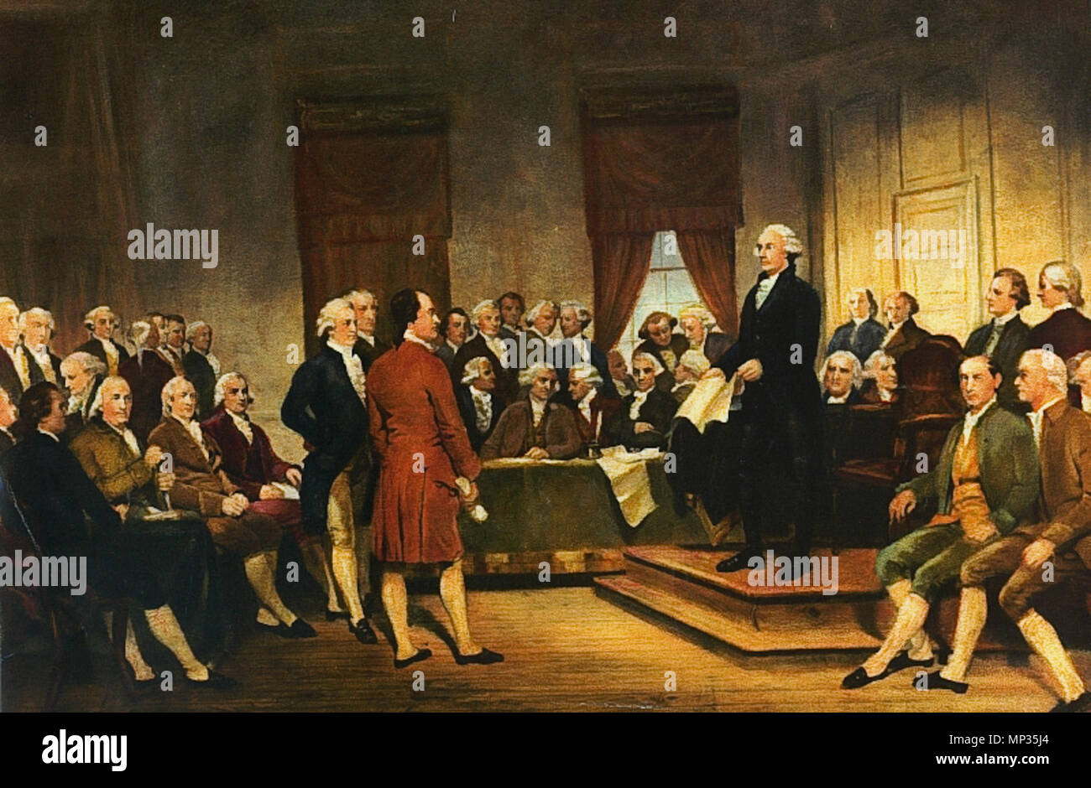

Slide 11
The Suffolk Resolve Presented by Joseph Warren (6th Sept. 1774)

Slide 12
1. Boycott British imports, curtail exports, and refuse to use British products
Notes:
boycott British imports, curtail exports, and refuse to use British products;
pay "no obedience" to the Massachusetts Government Act or the Boston Port Bill;
demand resignations from those appointed to positions under the Massachusetts Government Act;
refuse payment of taxes until the Massachusetts Government Act was repealed;
support a colonial government in Massachusetts free of royal authority until the Intolerable Acts were repealed;
urge the colonies to raise militia of their own people.

Slide 13
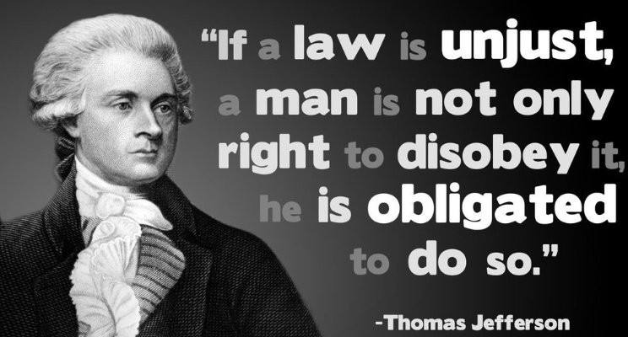
2. Pay "no obedience" to the Massachusetts Government Act or the Boston Port Bill
Notes:
1. Massachusetts Govt. Act: passed by the Parliament of Great Britain, gave its royally-appointed governor wide-ranging powers.
https://en.wikipedia.org/wiki/Massachusetts_Government_Act 2. The Boston Port Act, passed in March 1774 closed the Port from all commerce and ordered the citizens of Boston to pay a large fine to compensate for the tea thrown into the river during the Boston Tea Party.

Slide 14
3. Refuse payment of taxes until the Massachusetts Government Act was repealed.
4. Support a colonial government in Massachusetts free of royal authority until the Intolerable Acts were repealed.

Slide 15
5. Urge the colonies to raise militia of their own people

Slide 16
Entitled to life, liberty and property
French and Indian war(1756-63)
Set territorial limits on where European colonists could settle in America
Proclamation of 1763
Congress dispersed to meet again on 10th May 1775

Slide 17
Second Continental Congress (10th May, 1775)

Slide 18
Second Continental Congress Established May 10, 1775 Disbanded March 1, 1781
Agenda To review possible changes made by British Parliament and King To Prepare for War

Slide 19
Background Year 1775
March 23 - Patrick Henry’s “Liberty or Death” speech, Richmond, VA
April 19 - Battles of Lexington and Concord, MA
May 10 - Ethan Allen and Green Mountain Boys seize Fort Ticonderoga, Second Continental Congress meets

Slide 20
Year 1775
June 15 - George Washington appointed commander-in-chief
July 5 - Congress approves the Olive Branch Petition, a final attempt to avoid war with Britain
October 13 - The U.S. Navy is established

Slide 21
Year 1776
April 12 - Halifax Resolves, NC—First colony to authorize its delegates to vote for independence
June 7, 1776 - Lee Resolution: Richard Henry Lee proposes independence to the Second Continental Congress
July 4 - Congress adopts the Declaration of Independence

Slide 22
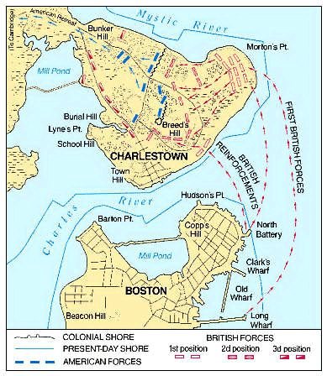
Notes:
Battle of Bunker Hill

Slide 23
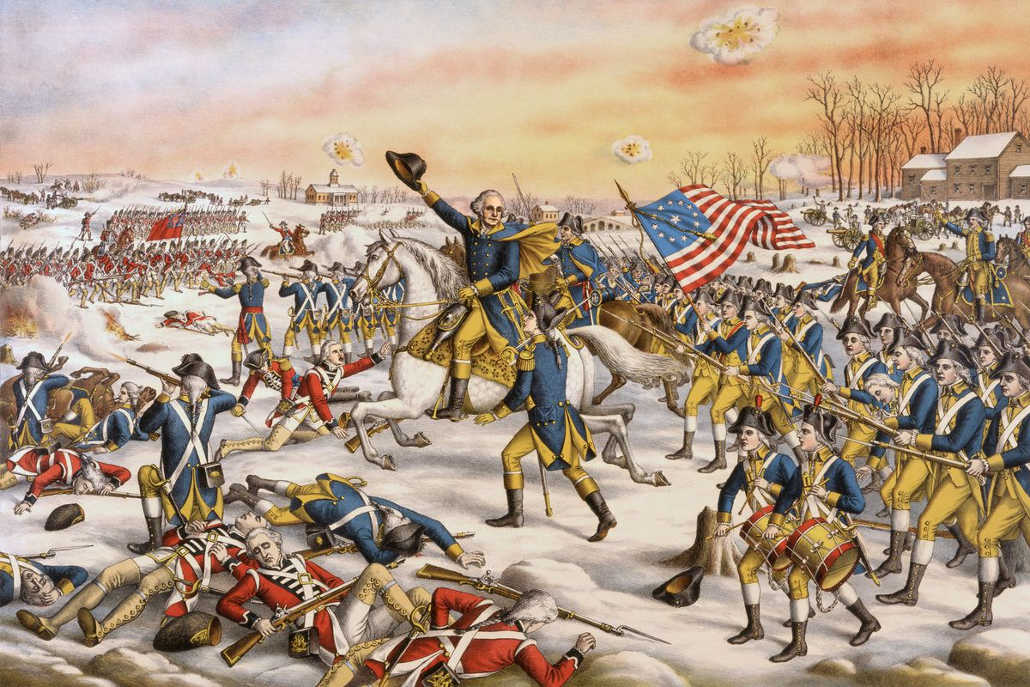

Slide 24
C. American War of Independence
First Phase (1775-77)
Second Phase (1777)
Third Phase (1778-81)
Peace Treaty of Paris (1783)
Notes:
https://www.battlefields.org/learn/articles/american-revolution-timeline

Slide 25
Year 1775
April 19 - Battles of Lexington and Concord, MA
May 10 - Ethan Allen and Green Mountain Boys fort Ticonderoga: NY
June 17 - Battle of Bunker Hill
December 30-Jan 1 - Battle of Quebec
Notes:
encourage common people in the Colonies to fight for egalitarian government.
Published in 1776, Common Sense challenged the authority of the British government and the royal monarchy

Slide 26
The Siege of Boston
The battle is named after Bunker Hill in Charlestown, Massachusetts
Notes:
17th June 1775, General Gage controlled Boston after defeating Gen. Joseph Warren

Slide 27
Battle Of Quebec December 31, 1775
Notes:
American/colonial Forces attack on Canada

Slide 28
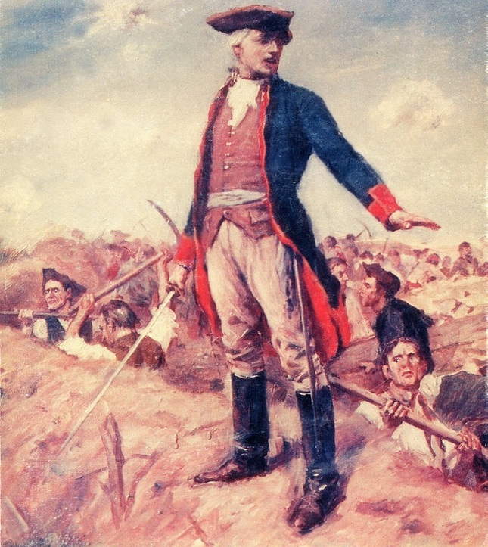
Gen. William Howe
Gen. George Washington

Slide 29
1777, 2nd Phase of WOI

Slide 30
Battles
Battle of Princeton
Battle at Ridgefield, CT
British capture Fort Ticonderoga
Battle of Brandywine, PA
Battle of Saratoga, NY
British take Philadelphia, Congress shift to York
British surrender at Saratoga, NY
December 19 - Washington and his army winter in Valley Forge

Slide 31
June 14 - Flag Resolution- Congress declared “That the flag of the thirteen United States be thirteen stripes, alternate red and white; that the union be thirteen stars, white in a blue field”
Political Development

Slide 32
3rd Phase, WOI

Slide 33
Feb 6, 1778 - The United States and France become allies
France

Slide 34
Change in British Command
General Sir Henry Clinton (CnC)

Slide 35
June 21, 1779- Spain declares war on Great Britain

Slide 36
Battles in 3rd Phase
Battle of Monmouth, NJ
British capture Savannah, GA
Battle of Port Royal Island, SC
Battle of Kings Mountain, SC
October 19 - General Cornwallis officially surrenders at Yorktown, VA

Slide 37
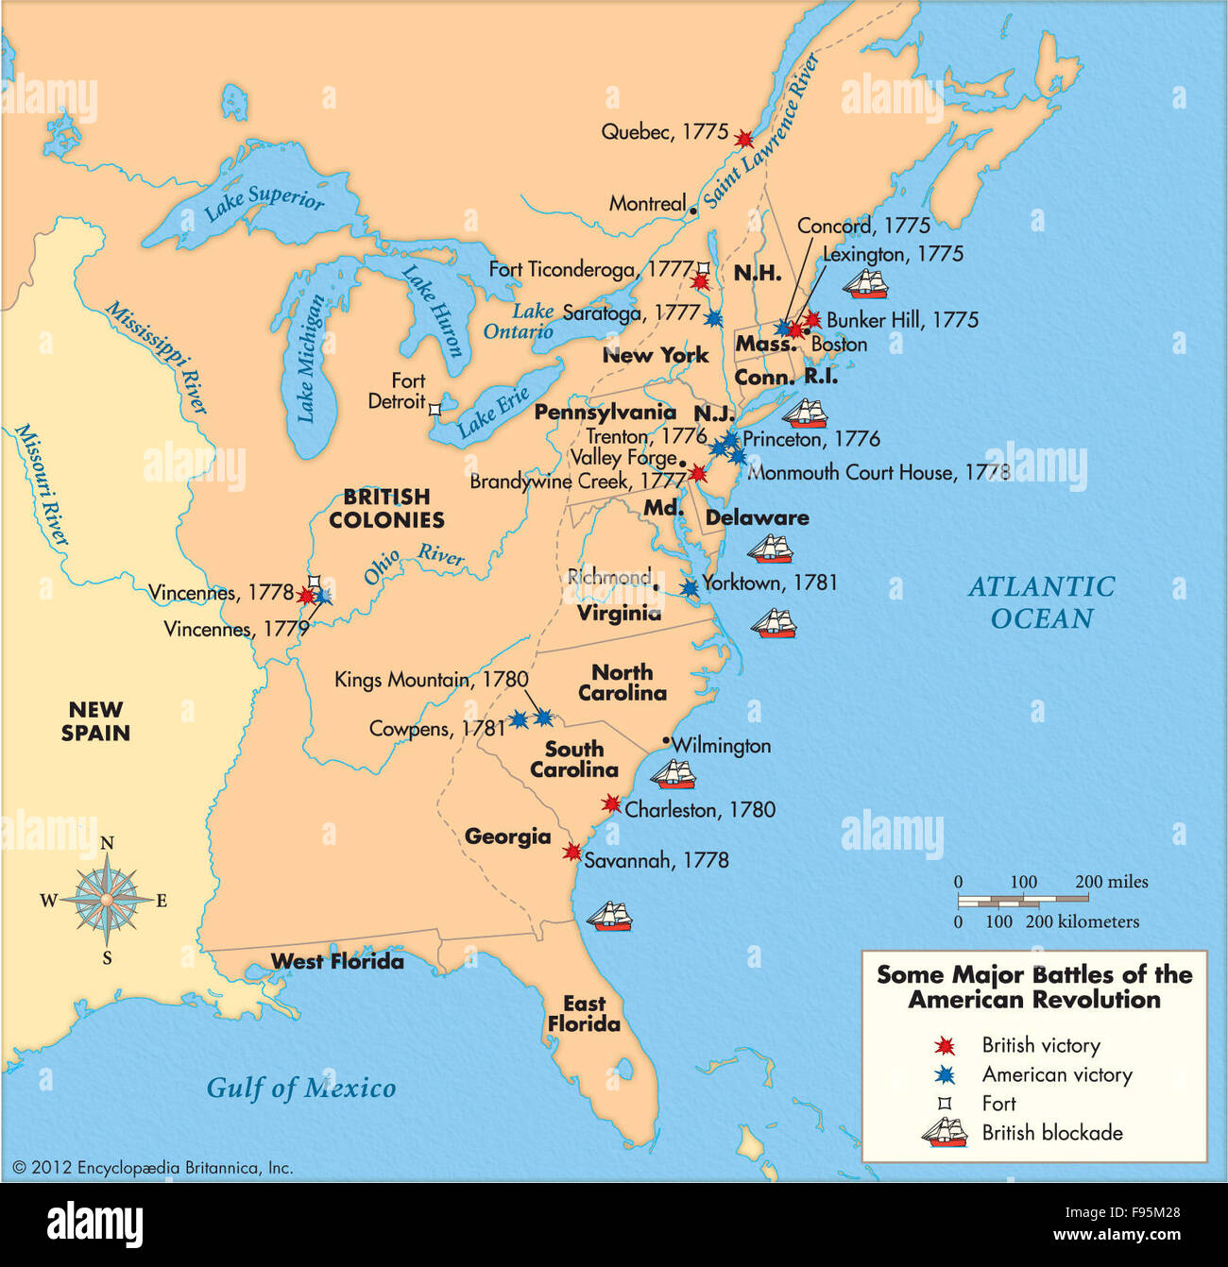

Slide 38
Articles of Confederation adopted 1781, March 2.

Slide 39
Peace Treaty of Paris 1783
War ended with the British surrender at Yorktown on 19th Oct 1781
British were controlling Charles town and some other regions for some time
On Sept 3, 1783, Peace treaty of Paris b/w America, British and France was signed

Slide 40
Impacts of American War of Independence (OR) Problems created after American Revolution

Slide 41
D. Impacts of American War of Independence
Constitutional Problems
Article of confederation (15 Nov, 1777)
No Bill of Rights
Lack of Central Government
2. Economic Problems
Decline of Commerce
National Debt
Absence of Satisfactory System of Currency
3. Political Problems
Western Land
Foreign Relations (a. With Britain b. With Spain)

Slide 42
John Dickinson Draft “The United States of America”
Adopted by the second continental congress (15th Nov, 1777)

Slide 43
Articles of Confederation 15th Nov, 1777
Article 1: Created the name of the combined 13 states as The United States of America.
Article 2: State governments still had their own powers that were not listed in the Articles of Confederation.
Article 3: The combined states were responsible for helping to protect each other from attacks.

Slide 44
Articles of Confederation
Under the Articles, the states, not Congress, had the power to tax.
The Articles of Confederation did not include a president.
The Articles of Confederation created a very weak central government.

Slide 45
This document served as the United States' first constitution. It was in force from March 1, 1781, until 1789 when the present-day Constitution went into effect.
The last sheet bears the signatures of delegates from all 13 states.

Slide 46
James Madison
Initially no BORs
First 10 amendment in 2 years

Slide 47
Inspiration
It was strongly influenced by the Virginia Declaration of Rights, written by George Mason as well as English documents such as the Magna Carta, the Petition of Right, the English Bill of Rights, and the Massachusetts Body of Liberties.

Slide 49
Freedoms, Petitions, Assembly
Right to bear arms, State army
Quartering of soldiers
Search and arrest
Rights in criminal cases
Right to a fair trial
Rights in civil cases
Bail, fines, punishment
Rights retained by the People
States' rights

Slide 50
Lack of Central Government
No constitution until 1789
New combined Federal constitution was necessary
Ratified: June 21, 1788
Congress status: Regulatory Body (Before), Central Authority (After)

Slide 51
Economic Problems
Decline of Commerce
Imposition of heavy taxes by British on American Ships
All the struggles of congress went fruitless
National Debt
Higher debts due to non payment of interest taken from foreign
Congress tried to solve the problem by selling the cheap land in Western region & raising revenue by export/import
Absence of satisfactory system of currency
There was no common currency
National Bank establishment was resisted by the people and merchants
Later on economic trade relation with Baltic areas recovered the set back
States were asked to fund but they couldn’t
Later on a bill was passed by congress for establishment of National Bank
Mint Act: To establish a mint at Philadelphia for minting Silver/Gold coins

Slide 52
Political Problems
Western Land
Foreign Relations (British, Spain)

Slide 53
Western Land
The problem of North-West Territory
This Territory lay b/w Appalachian and Mississippi River
It was handed over to Congress by New York in 1780, but couldn’t came into force
It was resolved again under the Famous North West Ordinance of 1787
1. Put the territory under the governor
2. A male resident owning at least 50 acre of land were to elect a legislature

Slide 56
British
Good trade relations with British but Rejected
Pre-revolutionary private debts for which American were not ready to pay Then Paid $600,000

Slide 57
Spain
Spain encouraged the Indians to harass American
Spain refused to hand over port of Natchez, which it had captured from British in 1779
Spain also encouraged the westerners to secede from US to Spanish Empire
Finally an agreement was signed

Slide 58
D. Impacts of American War of Independence
Constitutional Problems
Article of confederation (15 Nov, 1777)
No Bill of Rights
Lack of Central Government
2. Economic Problems
Decline of Commerce
National Debt
Absence of Satisfactory System of Currency
3. Political Problems
Western Land
Foreign Relations (a. With Britain b. With Spain)

Slide 59
Process of Framing American Constitution (Philadelphia Convention Process in Framing Constitution)
1. Introduction
Convention of Philadelphia
Committee: Examined various proposal
2. Proposed Plans
Virginia plan
New Jersey plan
3. Controversies/Contradiction between the plans on the basis of:
Nature of Government

Slide 60
Continue…
Representation in congress
Slave state and free state
Commercial and Agriculture states
4. Need of compromise
5. Connecticut Compromise
6. Ratification of the constitution

Slide 61
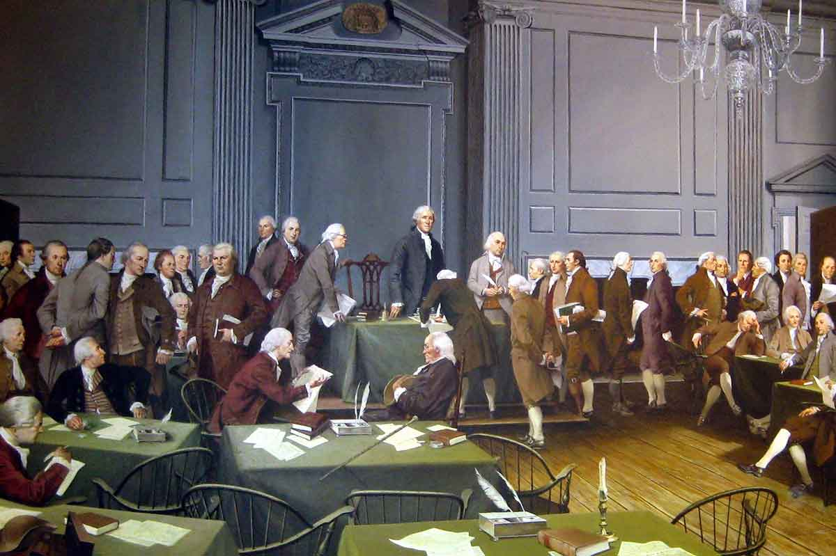

Slide 62
Introduction;
Convention of Philadelphia
Examined/amended articles of confederation
Constitution of United states
Assemblies delegates realized that it would not be ratified those defects in the amendments in the articles of confederation
Responsibility of framing new constitution
Committee to examined various Proposals

Slide 63
Proposed Plans
1. Virginia Plan
2. New Jersey Plan

Slide 64
Virginia Plan Offered: Edmund Randolph Prepared: James Madison
A bicameral Legislature
Representation to states on the basis of population
Lower House: Directly elected
Upper House: Indirectly elected by the nominees of states legislatures

Slide 65
Continue…
Supreme and inferior courts
Council for revision of the legislative acts
Power to veto
This plan was debated for fortnight

Slide 66
New Jersey Plan Submitted: William Paterson
Unicameral
Insisted on equal representation in both houses
Emphasized on retention of confederation
Conferment (right) of power on congress to tax, regulate foreign and interstate trade
Plural executive without power to veto
Supreme court
Laws of congress to be treated as supreme laws in states
Right with state government of interstate business

Slide 67
Controversies Contradictions
Nature of Government
Representation in congress
Slave and Free states
Commercial and Agriculture states

Slide 68
Nature of government
Big states (Virginia) favored strong federal government
Hamilton’s Plan:….
Small states (New Jersey) favored confederation, where states enjoys power

Slide 69
Hamilton’s Plan
Central government with extensive powers
Subordination of states to center
People choose both houses
President and senate should be elected for life
Governors of states to be appointed by congress

Slide 70
Representation in congress
Large States: Proportion of population
Small States: Equal representation for all
Virginia: 16, Delaware: 1

Slide 71
Slave state and Free states
South demanded for slave representation
North: Slave as a property

Slide 72
Need of compromise
These issues were to be resolved
Therefore, these opposite resolutions were brought in debates several times
Benjamin Franklin emphasized

Slide 73
Connecticut Compromise
The plan was accepted by the convention for compromise
The plan was containing 23 fundamental resolution
A committee of 5 members was established to verify and modify these resolution
The committee and convention debated the draft from 6th to 10th August, 1787
Finally, on Sept 20, 1787 the congress received the proposed draft for ratification by various states

Slide 74
Terms of the Compromise
The Central government neither too powerful nor too weak , i.e. Coordinate govt. not supreme govt.
Upper House: On equal basis
Lower house: Proportion basis
3/5 compromise regarding slave population
Slave trade was permitted till 1808

Slide 75
Ratification of the Constitution
Signed by 39 delegates
Gerry, Madison, Randolph refused it
13 states were absent to sign it
The document was immediately transmitted to various states for ratification by congress
To allay the fear of people regarding the constitution, the framers of constitution started educating them
Alexander Hamilton, James Madison and John Jay wrote about 85 articles
These 85 articles were later compiled and published as “The Feudalist”

Slide 76
The Process of Ratification
Delaware on Dec 7, 1787
Pennsylvania on Dec 12, 1787
New Jersey on Dec 18, 1787
Georgia on Jan 2, 1788
Connecticut on Jan 8, 1788
Massachusetts on Feb 8, 1788
Maryland on April 28, 1788
South Carolina on May, 1788
New Hampshire on June 21, 1788
Virginia on June 26, 1788
New York on June 26, 1788
North Carolina on Nov 21, 1789
Rhode Islands on May 29, 1790

