Slide 1
Syllabus
1. Introduction:- a. From ancient times to 1492 b. Advent of the Europeans to British supremacy (1492-1606) 2. USA as a British Colony (1606-1783). 3. USA as an Independent Country (1783 - 1819) 4. Expansion of USA: From 13 to 50 States (1820 - 1949) 5. Constitution of the USA: Salient Features a. US Presidential Election b. The US Congress: Role and Functions c. Separation of Powers: Check and Balances 6. Civil War between the North and the East (1850 - 1869) 7. Industrialization and its emergence as one of the world powers (1870 -1916) 8. USA’s role in the Two World Wars (1914 – 1918 & 1939 - 1945) 9. Post 1945 world scenario and emergence of USA and USSR as the Two World Powers. 10. American Role in patronizing UNO and International Organizations 1945 - 2012 11. American Role in Cold War and its emergence as the Sole Super Power (1945 - 1990). 12. International Concerns of USA: An Overview. 13. The War on Terror: The Role of Pakistan and USA (2001 - 2012) 14. Global perceptions of the USA. 15. Progressive Era: Reforms of Theodore Roosevelt and Woodrow Wilson, 16. The Great Depression and the New Deal 17. Civil Rights Movement 18. United States’ role in International Conflicts
Notes:
Distribute print of the syllabus..

Slide 2
Lecture Plan
1. Introduction:- a. From ancient times to 1492 b. Advent of the Europeans to British supremacy (1492-1606)
2. USA as a British Colony (1606-1783). 3. USA as an Independent Country (1783 - 1819)
4. Constitution of the USA: Salient Features a. US Presidential Election b. The US Congress: Role and Functions c. Separation of Powers: Check and Balances 5. Expansion of USA: From 13 to 50 States (1820 - 1949) 6. Civil War between the North and the East (1850 - 1869) 7. Industrialization and its emergence as one of the world powers (1870 -1916) 8. USA’s role in the Two World Wars (1914 – 1918 & 1939 - 1945)
9. Progressive Era: Reforms of Theodore Roosevelt and Woodrow Wilson, 10. The Great Depression and the New Deal 11. Post 1945 world scenario and emergence of USA and USSR as the Two World Powers. 12. American Role in Cold War and its emergence as the Sole Super Power (1945 - 1990). 13. Civil Rights Movement
Notes:
Lecture Plan.

Slide 3
a. From ancient times to 1492 b. Advent of the Europeans to British supremacy (1492-1606)

Slide 4
Ancient Civilizations
Caral-Supe
Olmec
Maya
Zapotec
Nazca
Tiwanaku
Wari
Inca
Aztec
Mississippian
Iroquois Confederacy
Powhatan Confederacy

Slide 5
Caral-Supe Civilization (3000BC-2500BC)
Urban Community (Temple)
Quipu, Cotton Trade
Peru, Lima
Peaceful society based on commerce & pleasure
Musical Instruments (Bones)
Notes:
Agriculture based society (sweet potatos+Beans), Mixed Economy of fishing and farming. Caral City is the oldest in America. Caral's pyramids is Templo Mayor (Great Temple).

Slide 6
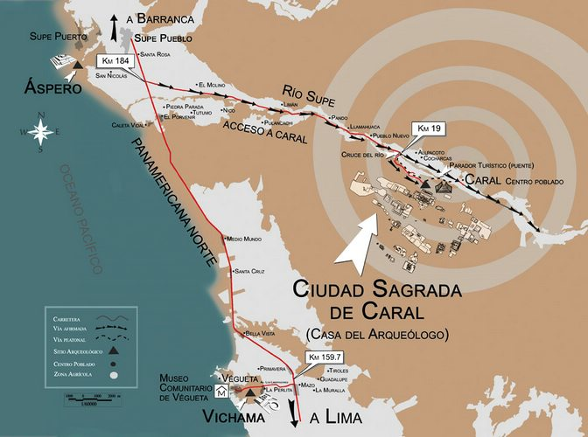
Notes:
https://www.google.com/maps/place/Ciudad+Sagrada+de+Caral/@-10.8922984,-82.79527,6z/data=!4m14!1m7!3m6!1s0x9107179b5f596655:0x1c3a27a54b2ec400!2sCiudad+Sagrada+de+Caral!8m2!3d-10.8922984!4d-77.5218329!16zL20vMDNtd2Jt!3m5!1s0x9107179b5f596655:0x1c3a27a54b2ec400!8m2!3d-10.8922984!4d-77.5218329!16zL20vMDNtd2Jt?hl=en&entry=ttu

Slide 7
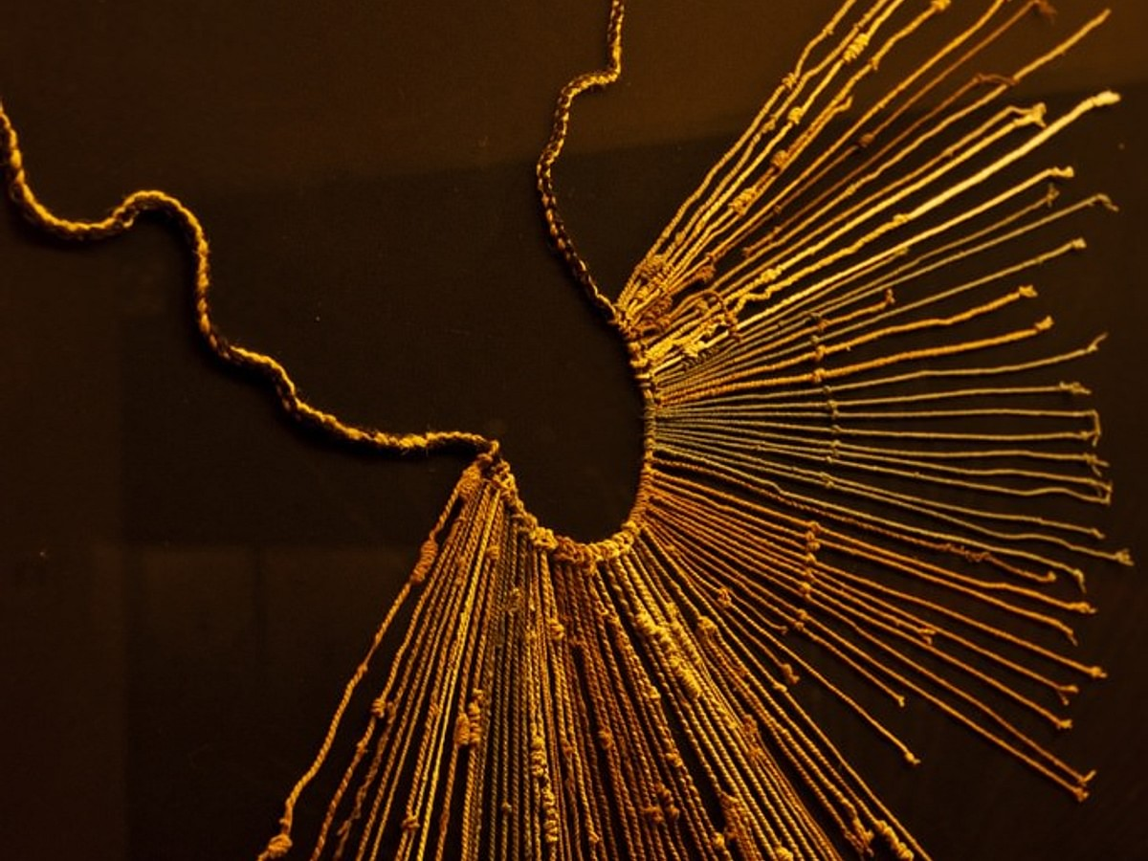
Notes:
Quipa, To keep track of all these statistics, a sophisticated assembly of knotted cords which was also highly transportable and could record decimals up to 10,000.

Slide 8
Olmec Civilization 1200BC-400BC
Kings
Arts, Writing
Crops(2), Chocolate
Gulf of Mexico (Veracruz)
Strategic Position

Slide 9
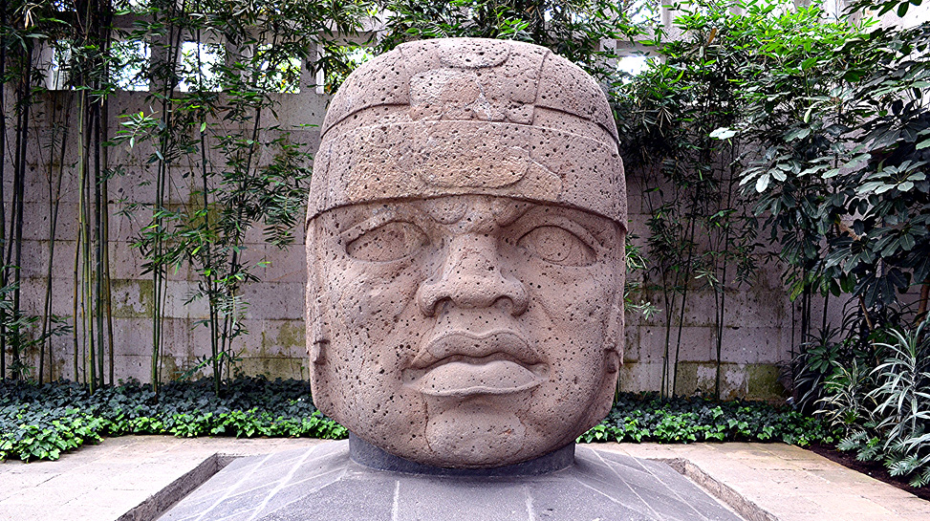

Slide 10
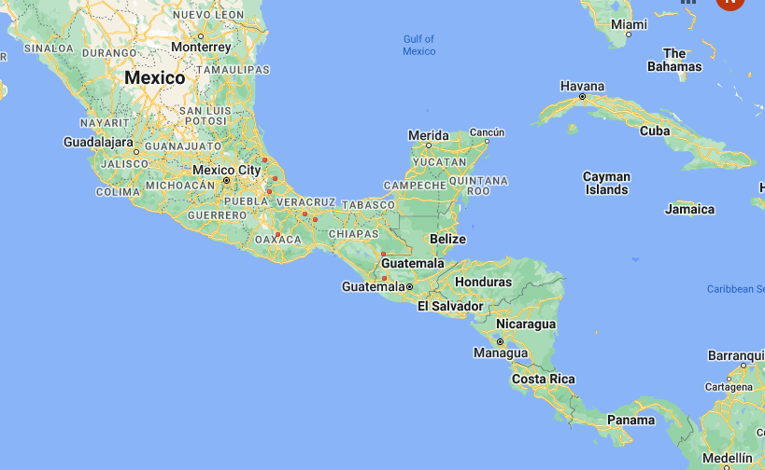
Notes:
https://www.google.com/maps/place/Heroica+Veracruz,+Ver.,+Mexico/@19.168576,-138.4109123,3z/data=!4m6!3m5!1s0x85c3414245ca78c5:0x18a4d642e936019b!8m2!3d19.173773!4d-96.1342241!16zL20vMDJfcnp0?hl=en&entry=ttu

Slide 11
Maya Civilization 500BC-800AD
City States, Cultural Identity
Mexico + Central America (Yucatan, Guatemala)
Pok a Tok
Cosmological views
Developed Calendar(365/18)
Notes:
https://www.google.com/maps/place/Yucatan,+Mexico/@21.0773871,-100.4777877,5z/data=!4m6!3m5!1s0x8f540ff8aad604ed:0xcccc217531083d0a!8m2!3d20.7098786!4d-89.0943377!16zL20vMDlna18?hl=en&entry=ttu

Slide 12
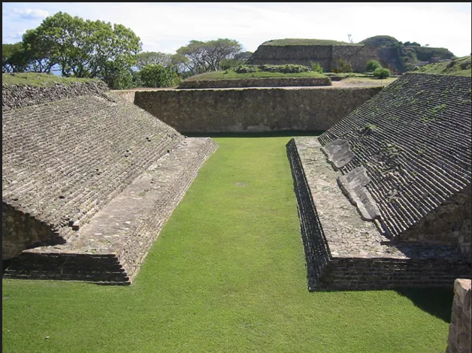
Notes:
Pok tok ball game, 2 teams, each 7 members, head, hand, feet not allowed

Slide 13
Zapotec Civilization 700BC-1500AD
Concept of capital City
Central Mexico
Mitla (700AD-1400AD)
Monte Alban (700BC-700AD)
Zaachila-Yoo (1400-1521)
Notes:
https://www.google.com/maps/place/Monte+Alb%C3%A1n,+Oaxaca,+Mexico/@17.0438756,-102.0406022,6z/data=!4m6!3m5!1s0x85c7187d793ab219:0xbec62ae73fc32413!8m2!3d17.0438035!4d-96.7681104!16s%2Fg%2F1tgz0y0r?hl=en&entry=ttu

Slide 14
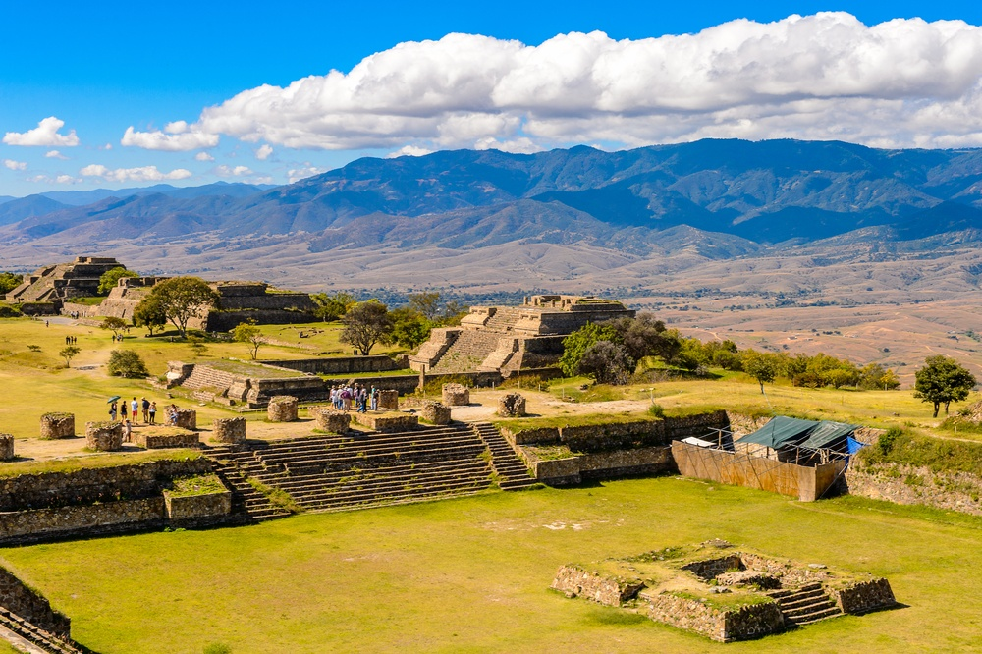
Notes:
Zapotec, Oasis hotel and resort

Slide 15
Nazca Civilization 1-700AD
Drawing, Master of making textile, Ceramic (Colors)
South coast of Peru (Rio de Grande)

Slide 16
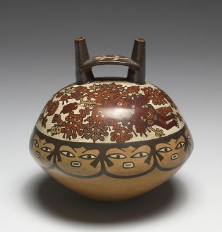
Notes:
Nazca, color pottery,

Slide 17
Tiwanaku Civilization 550AD-950AD
Concept of group work
Between Peru and Bolivia

Slide 18
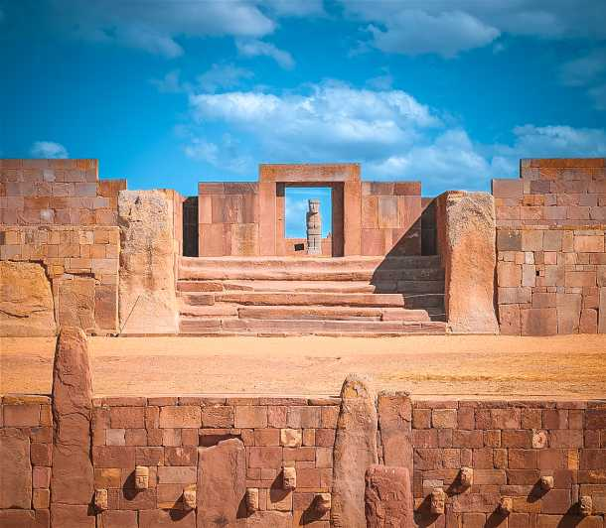
Notes:
Tiwanaku ruins.

Slide 19
Wari Civilization 750AD-1000AD
Master of Textile, Metals work
Large Road network, Canal System, Storage System.
Military might, State controlled by Elite
Andes mountains of Peru
Capital Huari

Slide 20
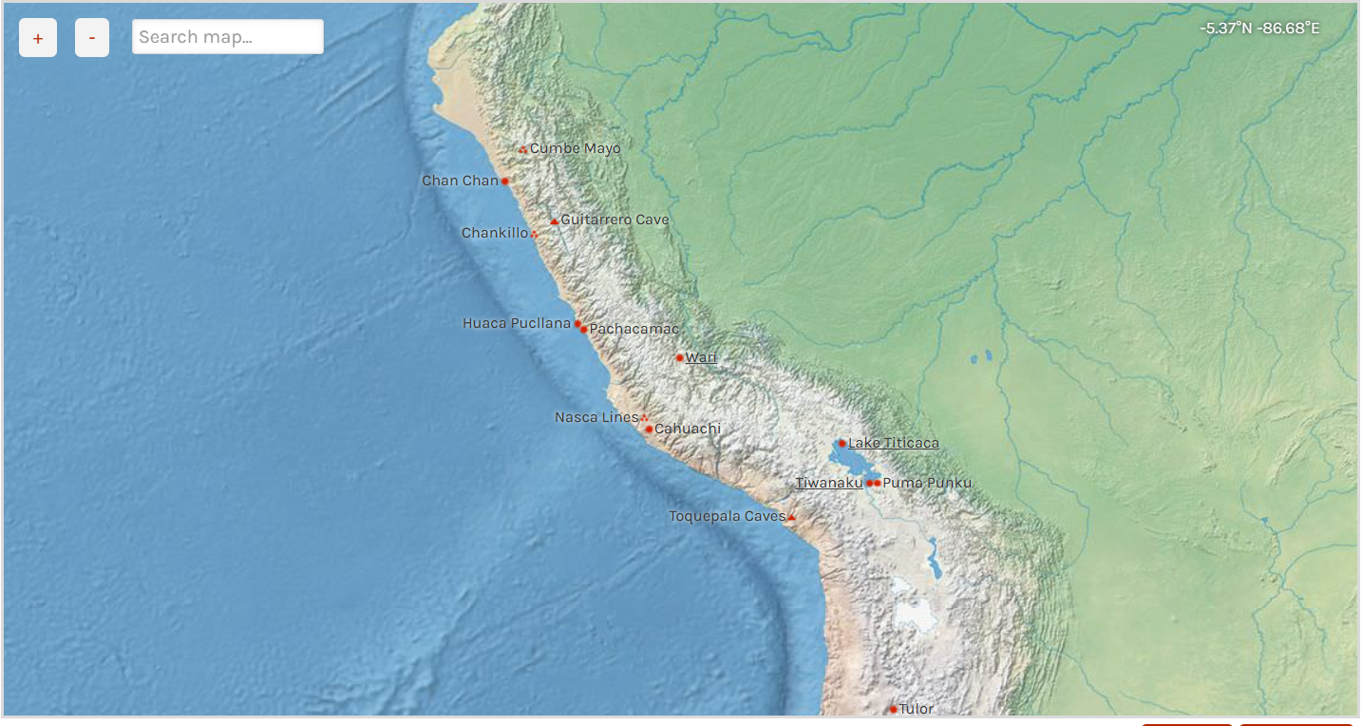

Slide 21
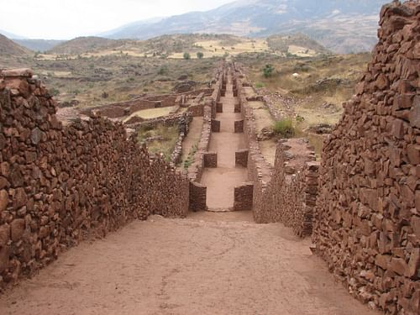
Notes:
Wari civilization,

Slide 22
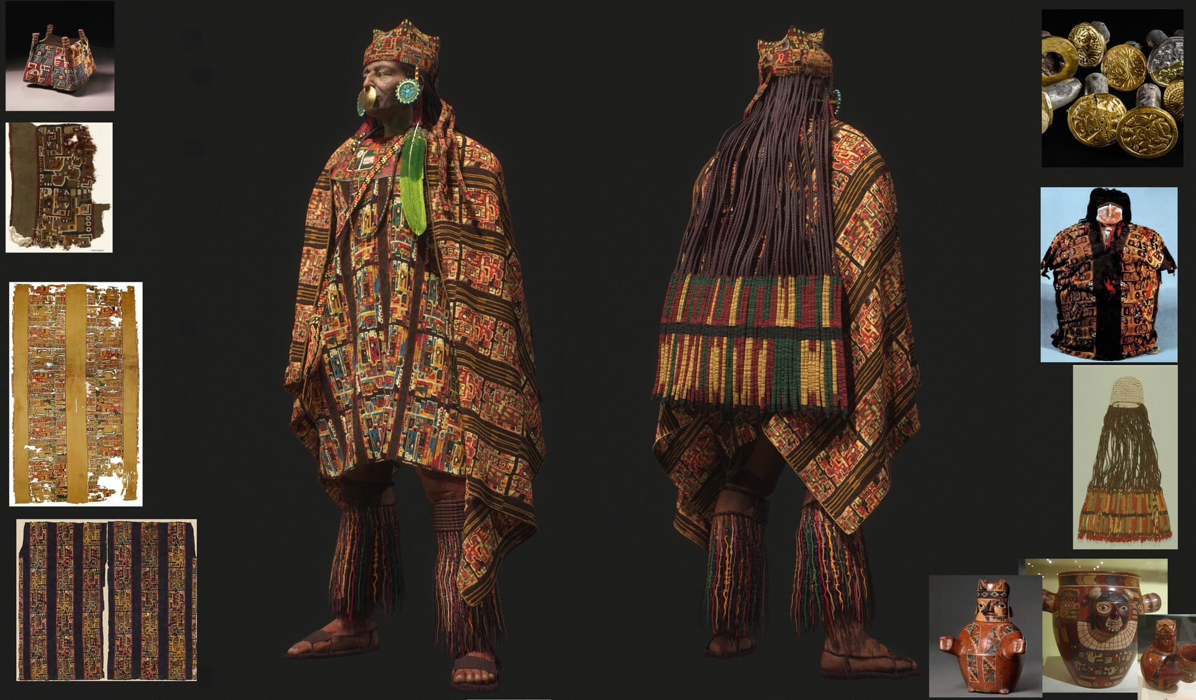
Notes:
Wari Civi, textile

Slide 23
Inca Civilization 1250AD-1532AD
Earthquake proof buildings, gold mines
Conquered people and exploited landscape
Largest empire, nationwide system of tax (Mit’a service), Quipu
10 million subjects, 30 Lang, 80 regional administration, Big ears (Orejones)
Peru, Ecuador, Bolivia
Downfall: Spanish invasion

Slide 24
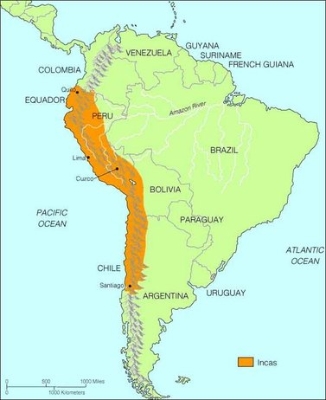

Slide 25
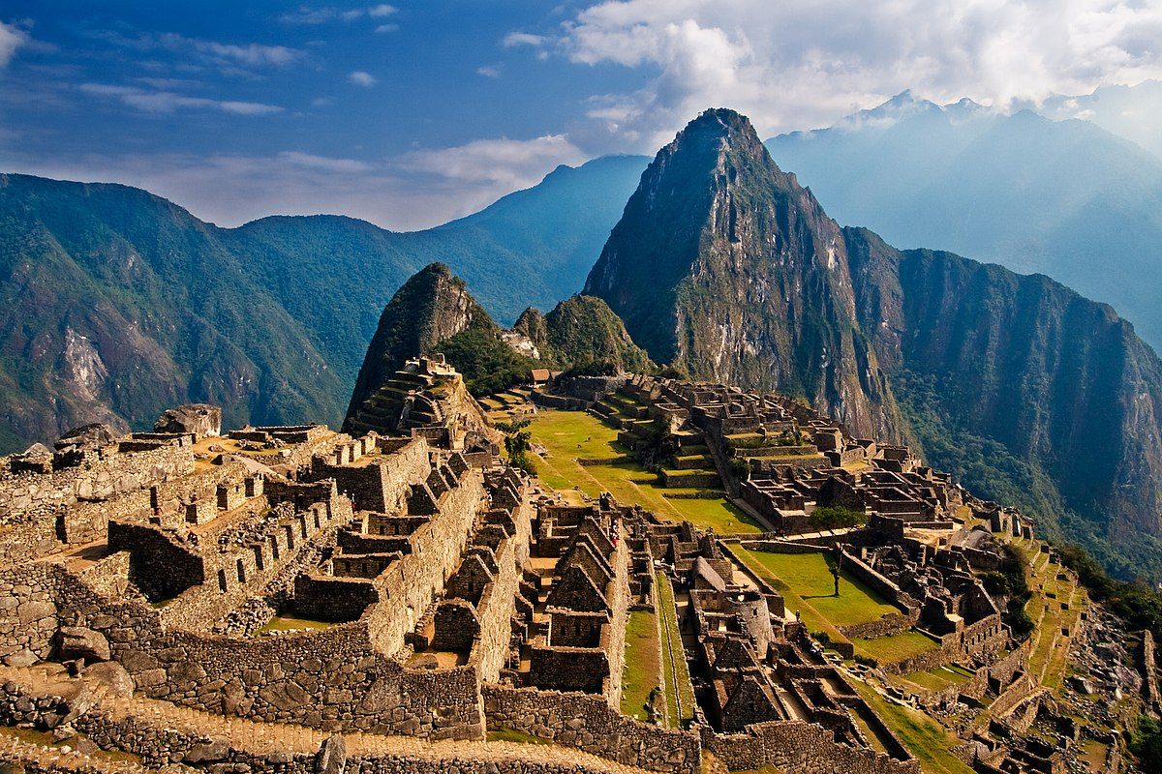
Notes:
Machu Picchu, Inca Civilization

Slide 26
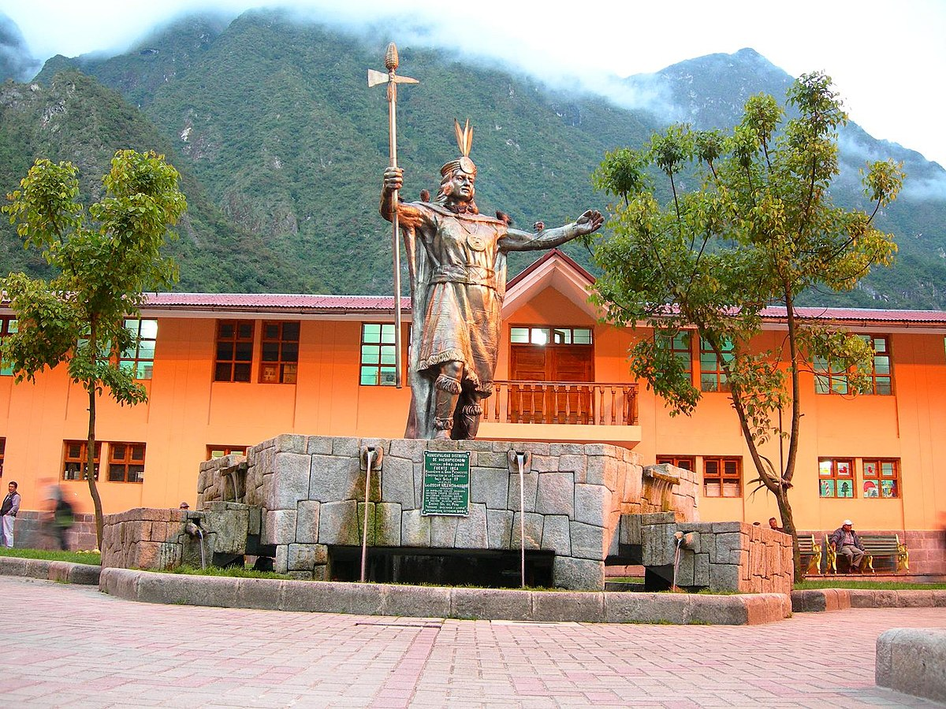

Slide 27
Aztec Civilization
13th Century
Capital: Tenochtitlan (1325) (Tenochca)
15million people, language: Nahuatl
Constructed Artificial Island, established a controlled water system to plant gardens.
Powerful military
1428, Formed a three-way alliance (Texcoco, Tlacopan)
Spanish Invasion: Hernan Cortes (1519), Small Pox

Slide 28
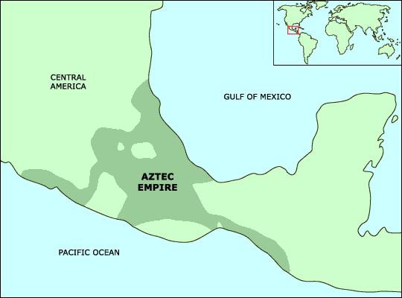

Slide 29
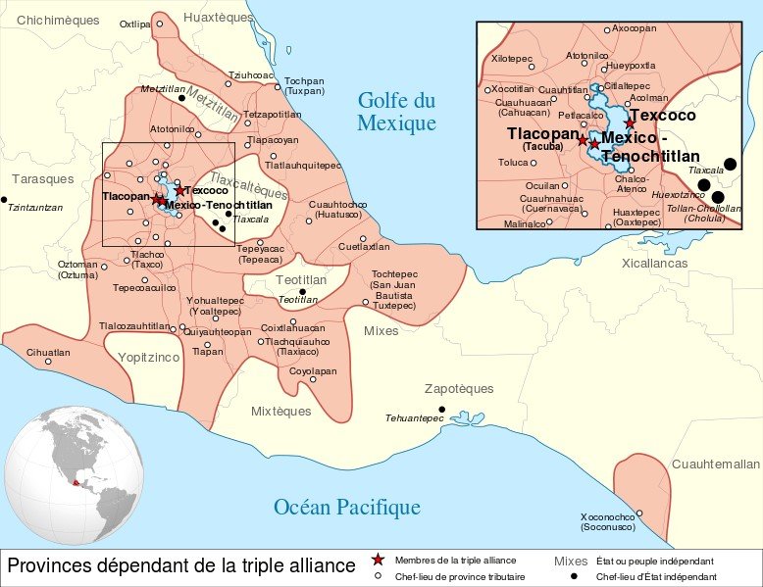

Slide 30
Mississippian Civilization 1000AD-1500AD
City population 10k to 30k
Women cultivated crops, men hunted, both took responsibility of raising children
Consist of different tribes: Iroquois, Powhatan, Cherokee
Cahokia: A trading center
Series of strain that led to collapse
Cahokia to Present day St. Louis, Illinois, Missouri

Slide 31
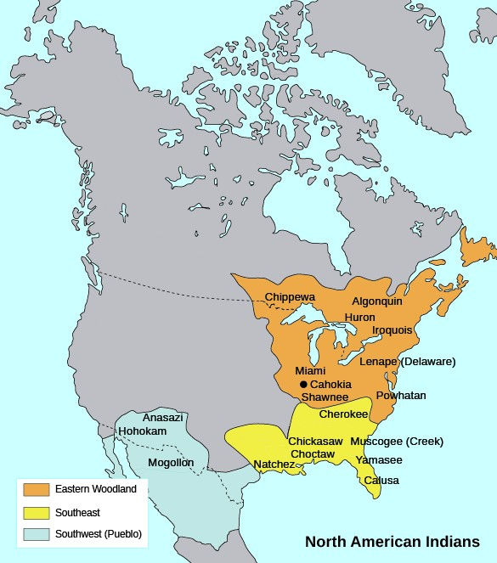

Slide 32
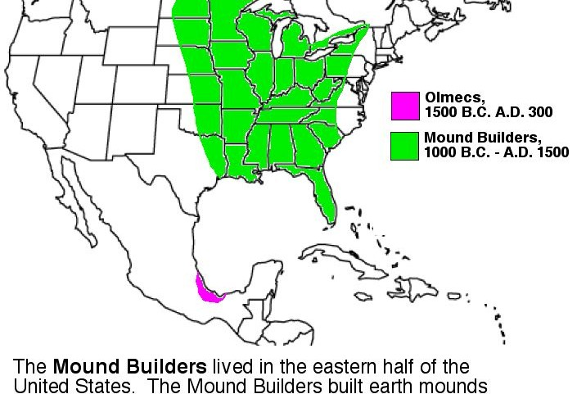
Notes:
Mississippian civilization,

Slide 33
Iroquois Confederacy
Haudenosaunee (people of longhouse)
Five Nations
Matriarchy (Clan Mother)
Political Appointees (Civil, War, Peace, Sachem)
Moieties (2)

Slide 34
Notes:
https://www.google.com/maps/place/Lake+Ontario/@39.2280676,-75.5575405,5z/data=!4m6!3m5!1s0x89d4320505bde167:0x18582a629b4927e8!8m2!3d43.6333482!4d-77.8270669!16zL20vMDRrYzQ?hl=en&entry=ttu

Slide 36
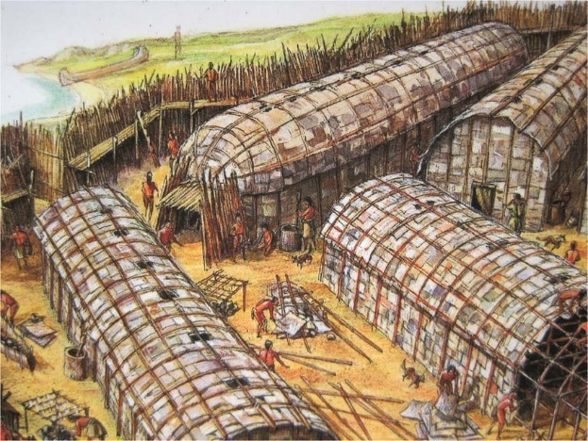
Notes:
Haudenosaunee, people of longhouse, Iroquois confederacy

Slide 37
Mohawk 9
Oneida 9
Seneca 8
Cayuga 10
Onondaga 14
Senior
Junior

Slide 38
Powhatan Confederacy 1570AD-1646/77AD
Wahunsenacah, Werowocomoco, Algonquian (language), +30 tribes, chiefs (F+M), Mother’s Bloodline.
Peace through common interest, ending intertribal warfare
James town (1607), Anglo-Powhatan wars 1610-1646, Diseases
Protection against other tribes, primarily the Iroquois Confederacy
Protection of the resources and land of Tsenacommacah
Ensuring an adequate food and clothing supply for all the people
Honoring the land and the deities who had provided them with a home
Notes:
Treaty of 1646 and the Treaty of Middle Plantation in 1677.

Slide 39
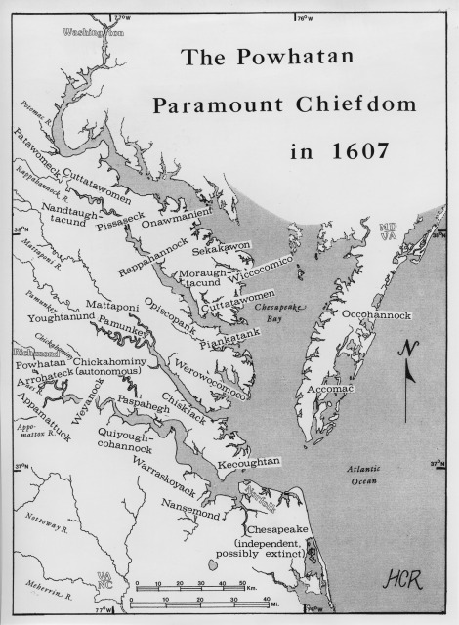

Slide 40
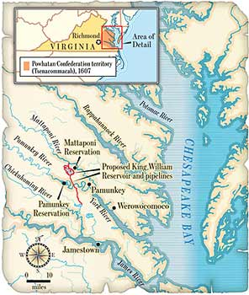

Slide 41
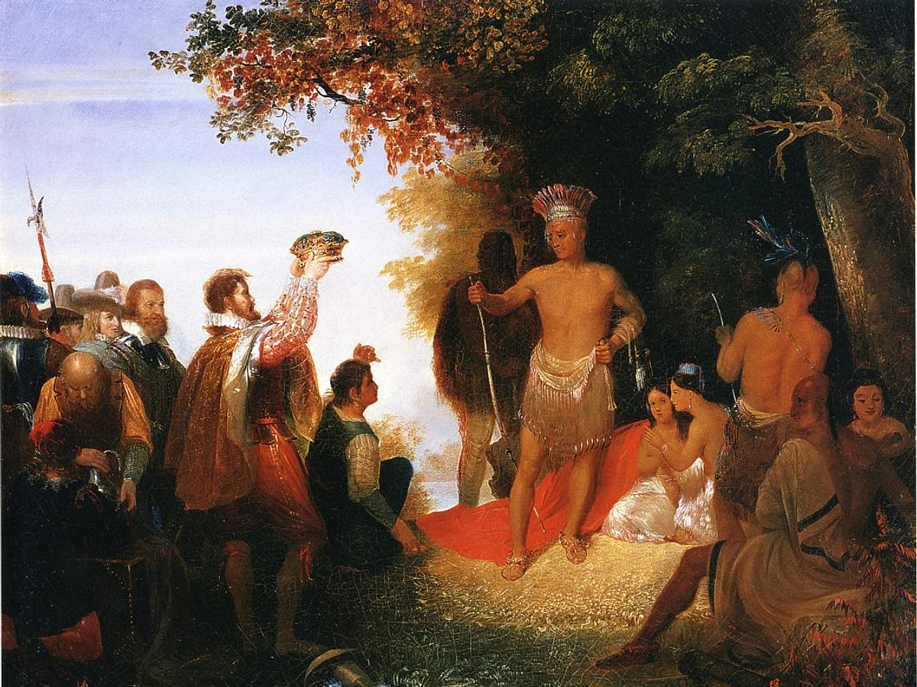

Slide 42
The Arrival of British colonizer
Notes:
Richard Hakluyt, Discourse on western planning (1584), English colonization of the new world would be not only to the benefit of England but furthermore to the benefit of God. Protestant England needs to rescue north America from catholic world. Also social and economic possibilities like jobs, agri, cultural freedom, etc

Slide 43
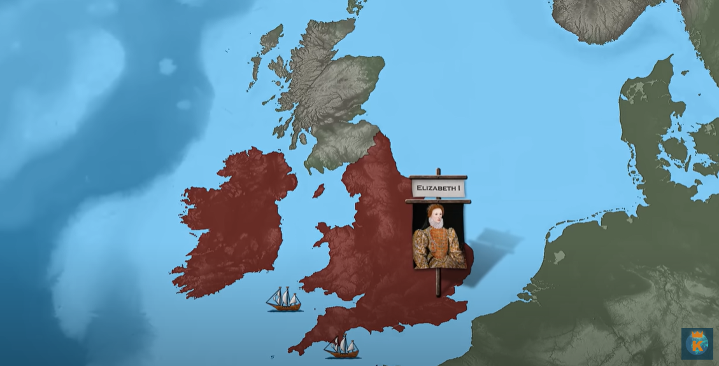
Notes:
Elizabeth 1, queen of England. Seadogs (John Hawkins, Francis Drake), Plundered Spanish ships to the coast of Peru.

Slide 44
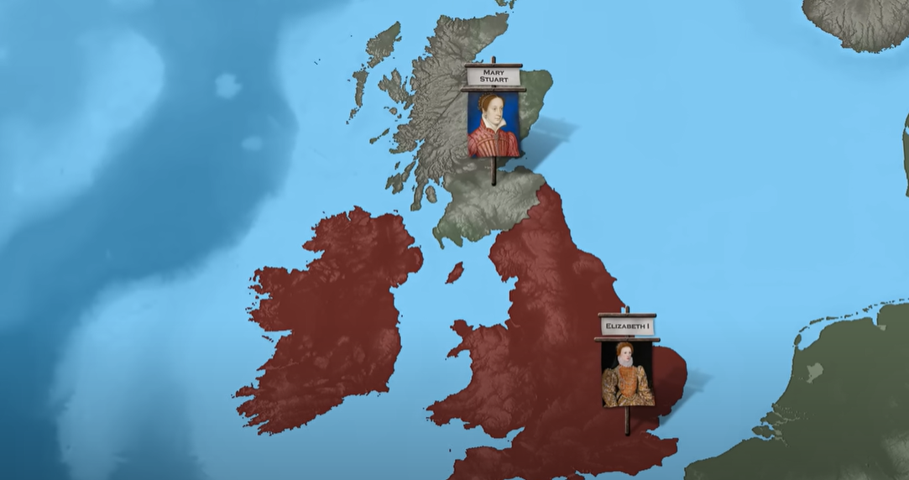
Notes:
Mary Stuart, the catholic queen of England (Scotland). Executed in 1587

Slide 45
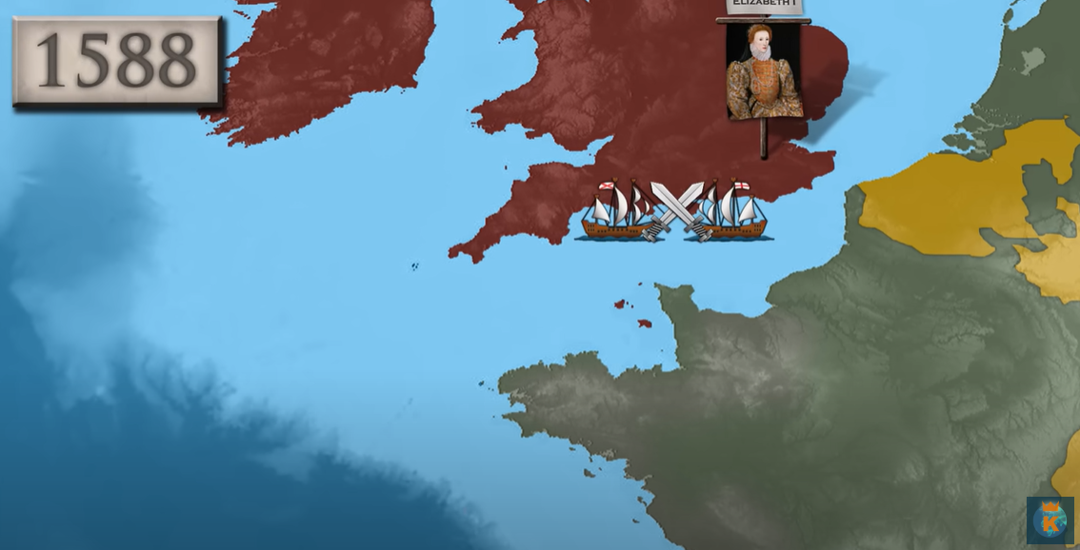
Notes:
Phillip 2 of Spain vs England. Neatherland. Nature favors the British.

Slide 46
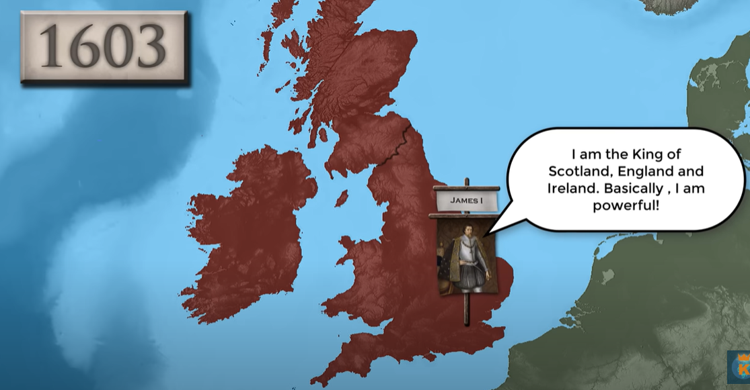
Notes:
Queen passes away in 1603. Following year peace made with Spain.

Slide 47
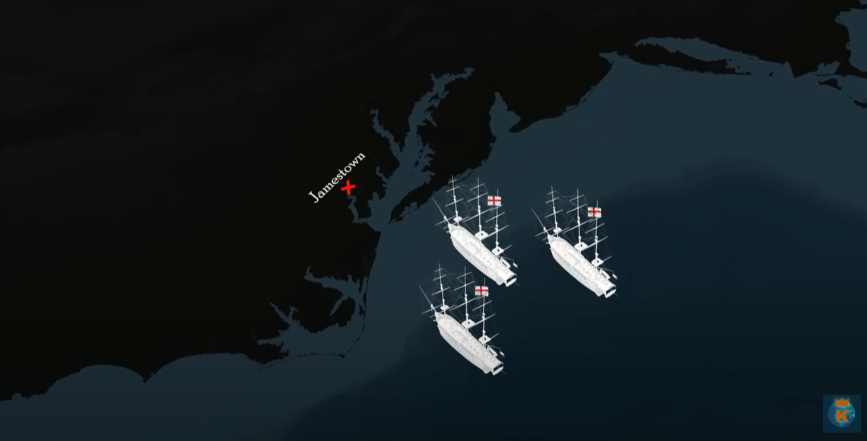
Notes:
The Discovery, the Suzan constant, the Godspeed. The British colonizes the Jamestown. The king also granted a charter to the playmouth company but their phopam colony short lived. By 1617, only 300/17000 lived(Battles with Powhatan), After 40 years first tobacco shipment of value (15m pounds).

Slide 48
Factors for Colonization in 16th and 17th Century
God, Gold and Glory
Pressure of Population
Trade with the East (Asian Countries)
Industrial Growth
Scientific and Technological Advancement
Desire for Fabulous wealth
Religious and Cultural Freedom
Royal Patronage
White Man’s Burden
Imperial Race
Strategic (Sea Power)

Slide 49
Factors for Colonization
Introduction:
A number of people who leave their country to settle down in a new country and make that place their permanent abode and remain under the protection of their mother country
Competition among European for colonization

Slide 50
Pressure of Population
100 million people lived in Europe
Chief profession was agriculture
Due to primitive methods, more land was needed
Discovery of America was a new ray of hope

Slide 51
Trade with the East
Ever increasing demand for Asian goods
Like spices, silk, cotton, precious stones etc.
Lure for orient and its goods encouraged European for finding new sea routes
So America was discovered and colonized

Slide 52
Industrial Growth
Discovery of machine in 16th AD
More production of goods
More market needed
Colonies of America provided a ready market

Slide 53
Scientific and Technological Advancement
Improved navigational methods and instruments in 15th century
Discovery of many new lands
So exploration and colonization was made

Slide 54
Desire for Fabulous Wealth
Spain and Portugal, 1st colonizers of America found rich stores of gold, silver and copper
Made other powers eager to go to America
French and English joined the race
They encouraged individuals as well as chartered companies to settle in the unclaimed portions of America

Slide 55
Religious Factor
Laws of persecution and religious intolerance compelled people to leave their mother lands
America: Freedom of religious worship
Puritans from England (pilgrims) left England and founded the colony of Massachusetts etc.

Slide 56
Royal Patronage
Colonization was not easy without state protection due to absence of int. laws and regulations
Early efforts of English failed because of lack of state patronage
They succeeded when English King extended patronage
Spanish, Portuguese and French were also given protection by their kings

Slide 57
Factors for Colonization
Introduction:
A number of people who leave their country to settle down in a new country and make that place their permanent abode and remain under the protection of their mother country
Competition among European for colonization

Slide 58
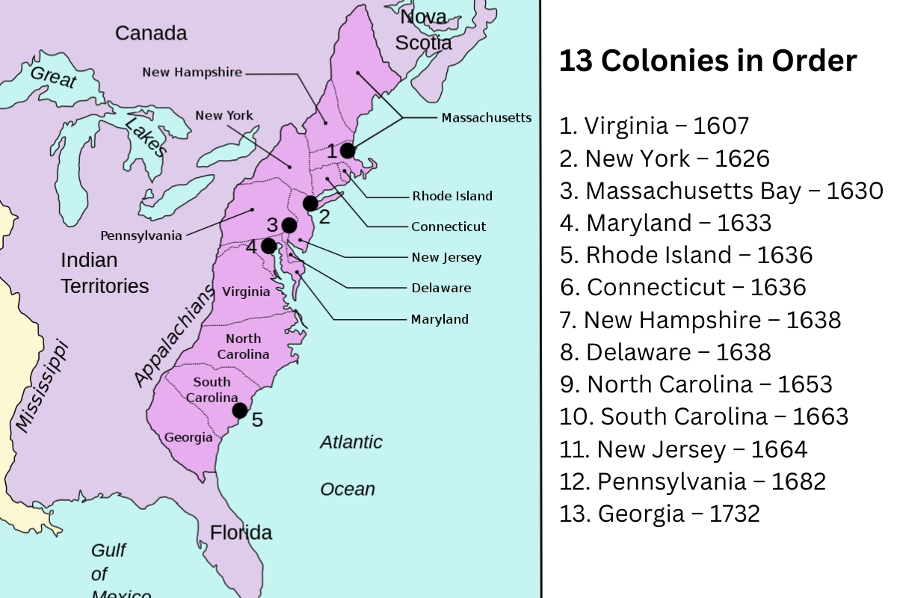

Slide 59
Original Thirteen Colonies

Slide 60
Q. American Revolution (1775-1783)
Causes of American Revolution
1. American Attitude:
Migrated people from England in 18th century to America were not the same.
America had been scaled dissenter and radicals (spirits of liberty) in 1750s.
America had became better home than Europe for the migrants.
2. British Attitude:
British government belief, that America is its colony and colonist will serve the motherland.
Colonies were brought under Royal control
British military commanders and governors over the colonies.
British kings were vetoing laws
While America were trying to take control over the colonies by themselves.
A contest bw imperialism and colonialism (home rule). 1703-1750

Slide 61
Mercantilism and Navigation acts Control on supply. Mercantilism vs home rule govt. It harmed the trade of other nations in America. Navigation Act of 1651: Goods entering England must be carried in ships owned by England. Enumerated Commodities Act of 1660: English colonies shall not export certain goods i.e. Sugar, tobacco, cotton and dyes to any other country. (the list was extended in 1706 and 1722. The Staple Act of 1663: Duty Act of 1673: Enforcement Act of 1696: (Check on smuggling) The Molasses Act of 1733: tax: 3 to 6 pence/gallon To stop the import from French and west Indian molasses. Till 1758, these acts were not strongly enforced and colonist didn’t feel the pinch but after its strict enforcement…

Slide 62
4. British Restrictions on Manufacture 5. Quartering Act of 1765 Passed to impose writ of English government. English forces to live in colonies. Passed to provide residence to English soldiers wherever they are in colonies. Soldiers are hated by people of colonies. 6. Currency Act of 1764 7. Policies of George Grenville Seven years left a heavy financial burden on British. Sugar Act 1764 Stamp Act 1765 (Official docs, newspaper, bonds) Colonial Protest (Merchants, lawyers, ministers and sailors joined hands Massachusetts: first one to begin formal protest and collect many people Stamp act was repealed in 1766. A great victory for Americans.

Slide 63
8. Townshend Program:
Grenville fell ill, Lord of Rockingham (New PM)
Charles Townshend (Chancellor of exchequer)
A series of British acts of parliament passed during 1767-68 (taxes and regulation to fund adm)
Colonists boycott
American radicals made Boston a HQ of NA
Townshend enforce the existing laws
9. Resistance to Townshend’s Program:
Colonial leaders, merchants and lawyers started putting economic pressure on English merchants and manufacturers.
First agreement was signed among colonists in Boston to refuse purchase of certain items from English merchants (1768)
In August 1768, a non imposition agreement was signed among the Boston merchants.
In Oct 1768, in NY. In March 1769 in Philadelphia.
By the end of 1769, agreements were signed among the colonists in almost all colonies.

Slide 64
10. Circular letter: Massachusetts Samuel Adams, wrote a letter to all the colonists “Townshend Acts are infringement of their natural and constitutional rights” This letter was sent to all colonial assemblies for endorsement Endorsed by the assemblies of Maryland, South Carolina , Georgia and Virginia King ordered to dismiss the assemblies of these states. 11. Boston Massacre: In 1768, British troops were sent to Boston to uphold authority of board of commissioners. On 5th March 1770, there had been a ding dong battle b/w Radicals of colonies and Troops. 3 were killed and 8 were injured This day was commemorated annually until 1780, as Boston Massacre The burning of Gaspe (a vessel of royal navy) by residents of Rhode islands in 1772. Finally the clashes started extending Lord North (PM of England)

Slide 65
Two Schools of thoughts
Radicals
Always look to estrange the relations with British
Charles Thomson, George and Thomas Jefferson
Less in number
Boston Tea Party 1773
Conservatives
Always interested in restoring of good relations and forgetting what happened.
Professionals politicians, Royal merchants & Officials
More in Numbers
Colonial protests and Massachusetts formation of committee of correspondence in Boston in 1772
By 1773, committee of correspondence were established in all states excepting Pennsylvania and North Carolina

Slide 66
American Colonists Preparation for War
1st Continental Congress Meeting (Sept 5, 1774)
Call of Massachusetts -> All the colonies met at Philadelphia
56 delegates from all colonies except Georgia
Peyton Randolph was the president of the congress
Resolutions of the congress
Suffolk Resolves:
American Radicals rejected the plan of union presented by Joseph of Pennsylvania
Urged people of Massachusetts to form a govt. to collect taxes.
Advised the people to form their military
Recommended stringent economics sanctions against Britain
b. Declaration of Rights and Grievances:
Congress declared that by English constitution they were entitled to life, liberty and property
They cannot submit to the grievous acts passed by British in 1763
Congress dispersed to meet again on 10th May 1775.

Slide 67
American Colonists Preparation for War
2nd Continental Congress Meeting (May 10, 1775)
Two main tasks
It had to review possible changes made by British
To prepare for war
Massachusetts forces seized the Fort of Ticonderoga from British
Prepared a military, George Washington was commander in chief
400,000 men were raised in the entire war
b. Battles
Battle of Bunker Hill (June, 1775)
Troops of colonies at Boston, Warren was commander
American took position on Bunker Hill
Gage’s attack were defended by American twice
3rd attack made a defeat of colonies and Warren was killed in action
George Washington and General Howe
Howe was directed to seize Dorchester Heights but he was failed by American (Feb 1776)
Later on American took Boston again from British
Notes:
https://www.google.com/maps/dir/Dorchester+Heights/Dorchester+Heights,+Boston,+MA+02127,+USA/@42.3334017,-71.1263401,12z/data=!3m1!4b1!4m13!4m12!1m5!1m1!1s0x89e37a8b80ed808f:0x514d125122817a8f!2m2!1d-71.0439392!2d42.3334312!1m5!1m1!1s0x89e37a8b80ed808f:0x514d125122817a8f!2m2!1d-71.0439392!2d42.3334312?hl=en&entry=ttu

Slide 68
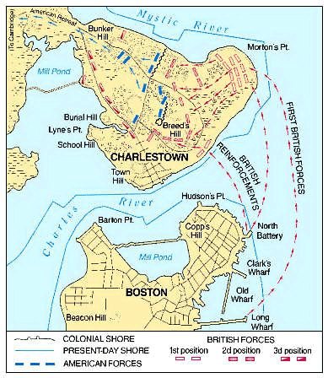
Notes:
Battle of Bunker Hill

Slide 69
AMERICAN REVOLTUION (1775-1783)
A. Causes
American Attitude (Migrated, better home)
British Attitude
Mercantilism and Navigation Acts
British Restrictions on Manufacture
Removal of French Danger
Policies of Grenville
Townshend Program

Slide 70
Continue…
Resistance to Townshend’s Program
Quartering Act of 1765: Anglo-French war
Circular Letter
Boston Massacre

Slide 71
Two School of Thoughts in American Colonies
Radicals
Always look to estrange the relation with British
Charles Thomson, George Washington, Thomas Jefferson
Less in number
Conservatives
Always interested in restoration of good relation and forgetting what happened
Professional politicians/Royal Merchants/Officials

Slide 72
B. American Colonists Preparation for War
First Continental Congress Meeting(Sept. 5,1774)
Suffolk Resolves
Declaration of Rights and Grievances
Second Continental Congress Meeting (May 10, 1775), Philadelphia
a. Battle of Bunker Hill (June, 1775)

Slide 73
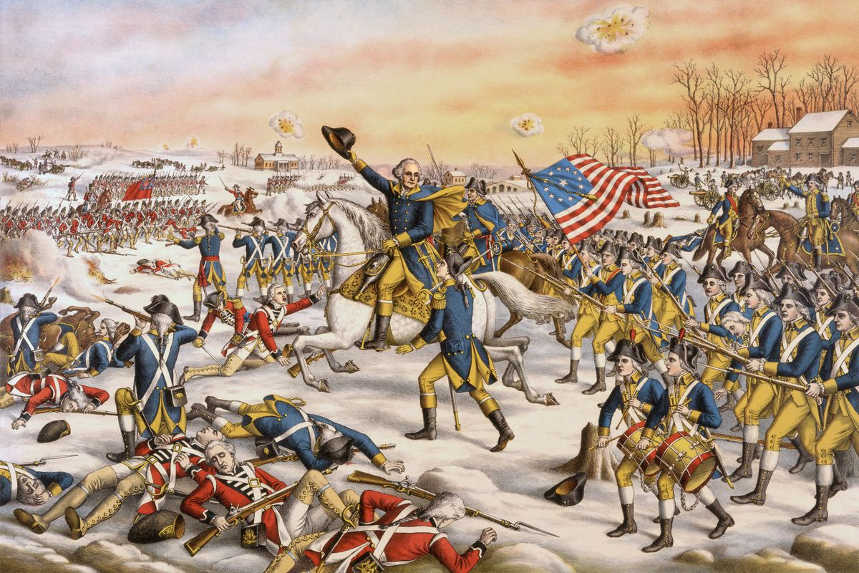

Slide 74
C. American War of Independence
First Phase (1775-77)
Second Phase (1777)
Third Phase (1778-81)
Peace Treaty of Paris (1783)

