Slide 1
Current Affairs
By
Zahid Mehmood Zahid (PhD - IR)
Assistant Professor

Slide 2
Syllabus of CA
Lecture 1
Key concepts
Sovereignty, National Interest, Balance of Power
Foreign Policy
Determinants, Decision Making and Analysis
Pakistan’s National Interests, Challenges to the sovereignty
Afghanistan and Pak-Afghan Relations
Afghanistan in Cold War theater, Soviets invasion, Mujahedeen, Geneva Accord, Post Cold War Situation, Rise of Taliban, Al, Qaeda, 9/11, Operation Enduring Freedom, Bonn Conference, US engagement, and Withdrawal.

Slide 3
Lecture 2
Pak-India relations,
Peace-making and Peace-Building in South Asia: Analytical overview of peace processes between/among the states of South Asia especially between India and Pakistan.
Lecture 3
Pak-Iran & Pak-Saudia Relations
Lecture 4
Russian Foreign Policy and Pak-Russia Relations,
Pak-UK and Pak-EU relations

Slide 4
Sovereignty
Supreme authority to use force within a territory
A state’s supreme authority to manage internal affairs and foreign relations.
Historical roots: Westphalia 1648, ended ‘thirty years war’, and established principles of:
Territorial Integrity
Political Independence
Non-interference and Legal equality among states.
It is internal (rule within borders) and external (FP)
It is indivisible, permanent, & non-transferable. Rousseau
“Legitimate monopoly over the use of force” Max Weber

Slide 5
National Interest
Fundamental goals and objectives that a state seeks to achieve in its interactions with other actors in the international arena.
It represents the priorities and aspirations of a state.
In can be defined in multiple ways, let’s discuss USA, India, Pakistan, Afghanistan, etc.
Types of National Interests
Core/Primary/vital (Survival against security threats)
Secondary (Economy, ideology promotion, tech development, and diaspora, etc.)
Variable (short-term stance over certain issues)

Slide 6
Balance of Power

Slide 7
Balance of Power (an even distribution of power)
Power: ability to influence other. J. Nye
highlighting its significance in maintaining stability and preventing domination by any single power.
“It is essential for maintaining stability and peace”
H. Morgenthau
“States are power-seekers and strive to maximize their relative power to prevent any other state from achieving hegemony. J. Mearsheimer
BOP refers to the distribution of power among states in the inter. system.
BOP theory asserts that a stable order is more likely when power is distributed among multiple states rather than concentrated into one.

Slide 8
B.O.P “An even distribution of power”
A state of stability between competing states.
It is equilibrium among states to prevent a single state from becoming too powerful to enforce its will upon other states.
It can be regional (Indo-Pak) and global (Soviet-US, Sino-US).

Slide 9
How balancing is done
Internal balancing (economy, weapons, etc.)
External balancing (Alliances and Partnerships)
Soft balancing (Diplomatic, economic, institutional)
Bandwagoning (align with the threat – Ukraine could go with Russia)

Slide 10
Foreign Policy: Determinants, decision making and analysis

Slide 11
Questions to Ponder!
What is the purpose of the state?

Slide 12
Definitions of Foreign Policy
FP is "the art of establishing priorities among objectives and finding the means to achieve them." Kissinger
“the totality of interactions by which a state pursues its objectives with actors in other states." James Rosenau
FP is the establishment and development of relations with other states to promote and protect national interests by taking appropriate steps at the international level.

Slide 13
Stages in FP DM (Initiation, Formulation, implementation)
Problem/Need for a decision/Assessment of the Int. & domestic political environment.
Setting priorities.
Determination of FP Options.
Decision-making process/calculation.
Implementation of a selected option – resource allocation.
Now use this process on Pakistan’s moving to China…!
Problem (regional BoP, global geopolitics, Indo-US relations)
Objectives (keeping BoP, Security)
Options (China, Russia, …..?)
Decision (rational calculation – playing objectives vis-à-vis options)
Implementation (China as most rational option)

Slide 14
Factors influencing the Foreign Policy
Domestic Factors: Geography, Political System, Leadership, Public opinion, interest groups, Economic interests (China Russia, Hitler, Pak-Israel & China).
Security: Military capability, National Security Concerns, Alliances, and Security Commitments (Pak WoT, SEATO/CENTO).
Historical & Cultural Factors: Historical experience, and ideology (US Europe, Pak-India, Pak-Muslim world).
International context: Power dynamics & Int structure, Int. institutions and norms (Polarity and geopolitics – Pak Us, Saudia-US).

Slide 15
Implementation of Foreign Policy
Foreign policy is implemented through:
Treaties & Agreements (bilateralism/multilateralism)
Economic tools,
Military and security measures,
Public diplomacy and soft power,
Media narrative/communication strategies.

Slide 16
Before we discuss the national interests of Pakistan ….?

Slide 17
FP Guiding Principle of Pakistan (QA M Ali Jinnah)
Friendship with all and Enmity with none,
Peace & Prosperity in the world.
Nutshell:
Respect for sovereignty & territorial integrity of all states,
Non-interference & Non-aggression,
Peaceful settlements of the disputes.

Slide 18
Pakistan’s FP Objectives
Promotion of Pakistan as a dynamic, progressive, moderate, and democratic Islamic country.
Image, Identity problem, a normal rational state
Friendly relations with all/especially major powers, & immediate neighbors.
Zero conflict approach, regional connectivity for regional development.
Safeguarding national security & geostrategic interests, including Kashmir.
Citizen-centric economy, unemployment, food security, sectarianism, terrorism, societal harmony (NSP 2022).

Slide 19
4. Consolidating commercial & economic cooperation with int. community.
Trade & development, attracting FDI, economic diplomacy, innovation, and integration – ASEAN BRICS like.
5. Safeguarding the interests of Pakistanis abroad.
Economic & politico-legal rights protection (state legitimacy)
6. Ensuring optimal utilization of national resources for regional & int. cooperation.
CPEC, Looking to CA, Afghanistan, Human Resource

Slide 20
Pak’s National Interests
National Security (against internal and external threats)
Economic Prosperity (through growth and development)
Socio-political Stability (Harmony, predictability, and governance)
Environmental Security (Sustainability and Mitigation)

Slide 21
Challenges to the Sovereignty
State (Hard)
Non-State (Soft)
India
Afghan Irredentism
Terrorism and Extremism
Insurgency and Separatism
Weak Economy
Political instability
Climate Change &
Resource Scarcity

Slide 22
Afghanistan in the Cold War Theater
Cold War geopolitics
Rise of PDPA (Leninist-Marxist Party)
Sur Inqilab (Red Revolution) April 1978
Soviets enter Afghanistan
Rise of Mujahedeen
Islam – in great power politics
Pakistan becomes the front-line state

Slide 23
Geneva Accord,
Rise of Taliban,
Al-Qaeda Enters into Afghan Theater
9/11 and Operation Enduring Freedom
Bonn Conference
US longest war in Afghanistan
Afghan resilience or US lack of coherent strategy
US decides to leave – Doha Process
US leaves and Taliban captures Kabul August 15, 2021
The return of Taliban

Slide 24
Pak-Afghan Relations

Slide 25
Pak-Afghan Relations: An outline
Initial Phase: 1947 to 1979 (Afghan assertion and Pakistan’s vulnerabilities)
2nd Phase: 1979 to 1989 (Soviets in Afghanistan: the later stage of Cold War and Global Jihad against Communism)
3rd Phase: 1989 to 1994 (Civil War: infighting among Afghans)
4th Phase: 1996 to 2001 (Afghanistan under Taliban)
5th Phase: 2001 to 2021 (War on Terrorism: Global engagement in Afghanistan)
Latest Phase 2021 till date (Afghanistan under Taliban 2.O)

Slide 26
Introduction
Afghanistan and Pakistan share more than 2600 KMs border (Durand Line).
Afghanistan has always maintained a hostile posture/attitude towards Pakistan.
Despite common culture, ethnicity, faith, history & geo-political dilemmas, relations have been troublesome. WHY?
Primarily because of ‘Durand Line’ issue.
Afghanistan opposed Pakistan’s entry into UNO.
July 26, 1949 – terminated all agreements with British including ‘Durand Agreement’

Slide 27
Initial Stage: 1947 to 1979
Conflict over “Durand Line” & Pashtunistan formed the basis of relations b/w Afghanistan and Pakistan.
Afghans don’t recognize ‘Durand Line’ as an International border.
Agreement was signed in 1893 between Afghan King Amir Abdul Rehman and Sir Mortimer Durand.
However, Afghans claim, though misplaced:
It was signed under duress,
The language was English – Afghan Amir couldn’t understand,
It was signed with British – not with Pakistan,
Was not ratified,
Afghan Amir was a weak ruler; hence, didn't represent Afghans,
It was for 100 years.

Slide 28
Afghan claims:

Slide 30
September 1950 Afghans raid in Balochistan.
In 1955, Pak embassy in Kabul, Jalalabad & Qandahar consulates were mob attacked over ONE UNIT. Severance of diplomatic relations.
Afghan invasion of Pakistan Sep. 1960-61 (Batmalai - Bajaour)
Afghan infiltration into Dir 1960.
Khyber pass skirmish 1961.

Slide 31
Second Phase: 1979 to 1989
Military Support: Pakistan helped Afghans in their war of liberation against the Soviet Union.
Funneled Arms and cash to the resistance forces.
Economic Support: Welcomed 4 million refugees,
Diplomatic Support: Denounced Soviet occupation and helped generate international response against Soviet invasion.
Geneva Accords April1988 (Pakistan sidelined)

Slide 32
Third Phase 1989-1994
Diplomatic Support to Afghanistan: Peshawar Accord April 1992 for the stability in Afghanistan.
Accord led to interim govt of Sibghatullah Mujad’di & Burhanuddin Rabbani.
However, this power sharing didn’t work and civil war broke out.
Afghan infighting gave way to the emergence of the ‘Taliban Movement’.

Slide 33
Fourth Phase: 1996 to 2001
Taliban took over Afghanistan after defeating a coalition force called “Northern Alliance”.
Northern Alliance was supported by India, Russia, and Iran.
Diplomatic Recognition to Taliban.
The Taliban introduced the orthodox Deobandi version of Islam.
Durand question remained the same. (public belief – Taliban/Durand Line)
Afghanistan becomes the host of Al-Qaeda.

Slide 34
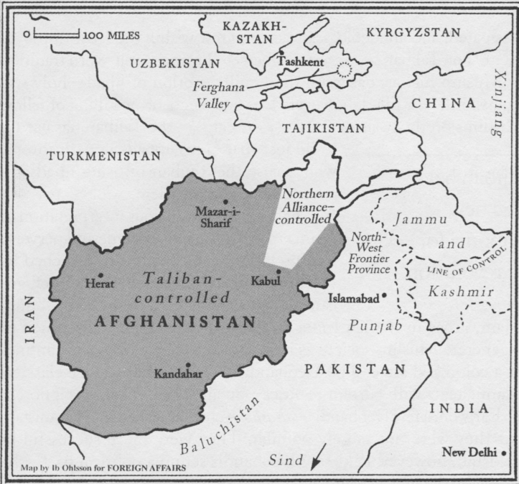
Taliban controlled Afghanistan in 1997-2001

Slide 35
Fifth Phase: 2001 to 2021
After 9/11, Pakistan was asked, “either with us or against us” by the USA.
Pakistan joined global WoT and became ‘non-NATO ally’ of the coalition.
Taliban govt was toppled and Pakistan supported the ‘Bonn Process’.
Pakistan supported Afghanistan politically, economically (1.5 billion US$), security, health, education.
Pakistan has always supported Afghan-led, Afghan-owned, Afghan-controlled solution of Afghanistan.

Slide 36
But, blamed for pursuing strategic depth in Afghanistan.
Karzai and Ghani frequently reiterated:
Afghan would never recognize Durand Line as international border
Indo-Afghan nexus during this phase and terrorism as a foreign policy tool.

Slide 37
Latest Phase: Afghanistan under Taliban 2.O
Taliban took over Kabul on August 15, 2021 & consolidated their control.
Optimism turned into gloom.
Terrorism (TTP & IS)
Refugees
Border management
Trade to Central Asia increased since Taliban in Power
Economic relations improved (coal, fruits, etc.)

Slide 38
Pak-Afghan relations: complicating factors
Afghanistan is a toxic mix of state collapse, civil conflict, ethnic disintegration, and multisided intervention that has locked it in a self-perpetuation cycle that is beyond outside solution.
Sovereignty & Irredentism.
Terrorism (TTP & IS).
Turbulent/subjective history (ontologically historical)
Regional competition (Indian question).
Recognition.
Refugees (Pak should not spoil its goodwill)
Lack of trade, connectivity, and absence of shared economic vision (CARs)

Slide 39
Solution!
Forget and learn ….
Track I & II dialogue (Trust Building)
Political Recognition (conditional) and diplomatic engagement for inclusive government.
Pakistan should find ways to engage Afghanistan.
Trilateral mechanism (Pak-Afghan-China)
Refugee and border management
Religious diplomacy
Dispute resolution mechanism for shared destiny.
Intelligence sharing for counter-terrorism.
Connectivity – shared economic vision (CASA & TAPI).
Engaging regional and global stakeholders.

