Slide 1
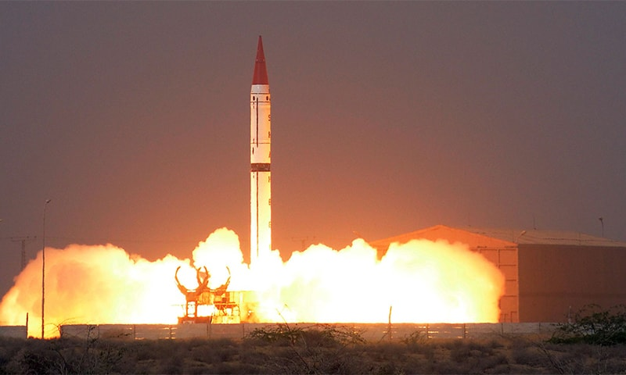
Nuclear issues
Lecture I
By Mohammad Shaaz
Notes:
NOTE:
To change the image on this slide, select the picture and delete it. Then click the Pictures icon in the placeholder to insert your own image.

Slide 2
Introduction of the course
Syllabus and Content

Slide 3
Syllabus
Current Affairs
Nuclear Proliferation and Nuclear Security
Pakistan Affairs
Nuclear Program of Pakistan, its Safety and Security; International Concerns
Nuclear Politics in South Asia

Slide 4
Syllabus
International Relations
Proliferation of Nuclear Weapons
Nuclear Weapon States- Programs and Postures: Indian-Pakistan Nuclear Doctrines
Nuclear Non –Proliferation Regime: International Atomic Energy Agency, Nuclear Non- Proliferation Treaty; Nuclear Supplier Group; Partial Test Ban Treaty; Comprehensive Test Ban Treaty; Fissile Material Cut-off Treaty
Challenges of Non-Proliferation, Cooperation for Nuclear Energy
Arms Control /Disarmament and Nuclear Non proliferation Regime
Deterrence: Theory and practice with special reference to India and Pakistan
The Missile Defense Systems and their impact on global strategic environment

Slide 5
Sources
Age of Deception by Muhammad El Baradei
Eating Grass by Feroz Hassan Khan
International Relations by Joshua Goldstein (WMD Chapter)
You can find all of these books in soft copy on my Google Drive folder: https://drive.google.com/drive/folders/1pY8u_ejoBOSpxAPgIOqkjjKtg7ZUIVt4?usp=sharing

Slide 6
Lecture one

Slide 7
Content
Lecture 1:
Brief Nuclear History, 1945 – Present
Baruch Plan
Atoms for Peace
International Atomic Energy Agency
Cuban Missile Crisis
Limited Test Ban Treaty
Nuclear Non-Proliferation Treaty
Nuclear Suppliers Group
Strategic Arms Reduction Treaty
Comprehensive Test Ban Treaty
Fissile Material Cut-off Treaty

Slide 8
History of nuclear proliferation
1945 - present

Slide 9
Brief History of Nuclear Proliferation
Manhattan Project
Hiroshima and Nagasaki
UK
Baruch Plan
USSR
6th and 9th August 1945
1942
1946
1949
1952
First Nuclear Age
Second Nuclear Age
Limited Test Ban Treaty
Cuban Missile Crises
France
IAEA
Atoms for Peace
  1963
  1962
  1960
  1957
  1953

Slide 10
Brief History of Nuclear Proliferation
China
Israel
NSG
NPT
India
1967
1964
1967
1974
1975
Second Nuclear Age
START
CTBT
North Korea
Pakistan
Indo-US
Open on 1996
1994
28th May 1998
2005
2006
Third Nuclear Age

Slide 11
First nuclear age
1901-1945

Slide 12
The Advent of Nuclear Weapons
Nuclear Fission by Otto Hahn and Fritz Strassman
Manhattan Project
Trinity Test
Hiroshima and Nagasaki
The Atomic Age

Slide 13
What Makes Nuclear Weapons So Frightening?
Destructive Power
Radioactivity
Radioactive Fallout
Nuclear Winter
Lingering Effect
Intergenerational Effects

Slide 14
Second nuclear age
1945-1991

Slide 15
Baruch Plan
UNAEC was formed by UNGA’s very first resolution
A proposal by the US government proposed to the United Nations Atomic Energy Commission during its first meeting in June 1946.
International Atomic Development Authority monopoly over Nuclear Technology
US agreed to decommission nuclear weapons
Condition that all other countries pledged to not develop nuclear weapons
Soviets rejected, UN dominated by US and allies, submitted counter proposal

Slide 16
Uses of Nuclear Technology
Nuclear technology is technology that involves the nuclear reactions of atomic nuclei.
Peaceful Uses
Military Uses
Energy
Health
Environment
Water
Food and agriculture
Industry
Nuclear Weapons
Nuclear-powered Submarines
Aircraft Carriers

Slide 17
The Two Sides of Nuclear Technology
Nuclear Weapons
Differences
Nuclear Energy
Chain Reaction
High Enrichment
Controlled Reaction
Low Enrichment
Similarities
Nuclear Fuel Cycle
Similar Enrichment Technology

Slide 18
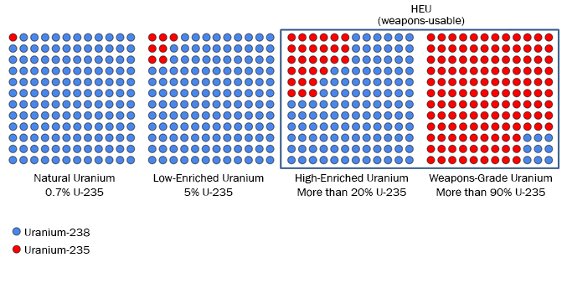
Enrichment

Slide 19
Atoms for Peace Program
Speech by D. Eisenhower in 1953
Cold war propaganda for containment, emotion management and ally reassurance
Pakistan’s first nuclear reactor Pakistan Atomic Research Reactor (PARR-1)—in 1962.
Achievements: Created the ideological background for the creation of the International Atomic Energy Agency and the Treaty on the Non-Proliferation of Nuclear Weapons
Shortfalls: Gave political cover for the U.S. nuclear weapons build-up
Under Atoms for Peace related programmes the U.S. exported over 25 tons of highly enriched uranium (HEU) to 30 countries, mostly to fuel research reactors, which is now regarded as a proliferation and terrorism risk

Slide 20
International Atomic Energy Agency (IAEA)
An autonomous organization formed in 1957
Established independently of the UN, through its own international treaty but submits reports to both the UNGA and the UNSC
Headquarter in Vienna, Austria
Missions
Peaceful use
Safeguards
Nuclear Safety and Security

Slide 21
Structure of IAEA
General Conference
Director General
Manage-ment
Board of Governors
Technical Co-operation
Nuclear Energy
Nuclear Safety and Security
Nuclear Sciences and Applica-tions
Safe-guards

Slide 22
Legal Framework for Safeguards
Three types:
  comprehensive safeguards agreements with non-nuclear-weapon State parties to the NPT;
  voluntary offer safeguards agreements with the nuclear-weapon State parties to the NPT; and
  item-specific safeguards agreements with non-NPT States.
Additional Protocols

Slide 23
Cuban Missile Crisis
1 month, 4 day (16 October – 20 November 1962) confrontation between the United States and the Soviet Union
In response to US missiles in Italy and Turkey and failed invasion of Bay of Pigs, Soviet N. Khrushchev accepted to Cuban secret request of installing nukes in Cuba
Rejecting other options, J. F. Kennedy decided to impose naval “quarantine” on Cuba
Several days of negotiations lead to agreement:
Publicly, Soviet would dismantle and return their nukes to Soviet Union in return for US public declaration and agreement to not invade Cuba again
Secretly, US would dismantle and remove their nukes from Turkey
Aftermath: realization of the nuclear threat, temporary easing of nuclear arms race, Washington-Moscow hotline,

Slide 24
Limited Test Ban Treaty (LTBT)
Also called Partial Test Ban Treaty or Nuclear Test Ban Treaty
Was signed in 1963
Due to public unease about radioactive fallout and thermonuclear bombs
Bans parties from conducting a nuclear test in the atmosphere, outer space, or underwater
China, France and North Korea have not signed
Reduced radioactive debris in atmosphere and slowed proliferation

Slide 25
Nuclear Non-Proliferation Treaty (NPT)
Came into force in 1970
Nuclear Weapon States, those who have made and
openly tested nuclear weapons before
1 January 1967
Pillars
Non-Proliferation
Peaceful Use
Disarmament

Slide 26
Nuclear Non-Proliferation Treaty - Pillars
Non-Proliferation
Art I - NWS cannot in any way “assist, encourage or induce” NNWS to nukes
Art II – NNWS vice versa
and not manufacture nukes
Art III – NNWS accept safeguards and IAEA’s role as a regulator
Peaceful Use
Art IV – Right of every member to nuclear tech for peace and promotes international cooperation in this regard
Art V – Non-discriminatory assistance to NNWS for peaceful tech
Disarmament
Art VI – NWS will “pursue negotiations in good faith” to disarm nuclear weapons “at an early date”
Notes:
https://treaties.unoda.org/t/npt

Slide 27
Nuclear Non-Proliferation Treaty – Strengths and Weaknesses
Strengths
Weaknesses
Non-signatories
Pakistan
South Sudan
India
Israel
North Korea
First treaty of its kind
191 states are signatories
Provides legal framework
Discriminatory
No work on Article VI
Non-signatories
Withdrawal, Art X
Intergovernmental pressure more effective than the treaty

Slide 28
Why States Want Nuclear Weapons—and Why They Don’t
Drivers
Barriers
Security
Prestige
Domestic Politics
Technology
Economics
Security
Prestige
Domestic Politics
Technology
Economics
Notes:
Bomb Scare: The History and Future of Nuclear Weapons by Joseph Cirincione (Pg. 47-83) https://pk1lib.org/book/765185/d48bf3

Slide 29
Nuclear Suppliers Group (NSG)
Founded in response to the Indian nuclear tests in 1974
48 Members
Also called London Club, London Group or London Suppliers Group
Control of exports nuclear technology that can readily be used for weapons development to non-nuclear weapons states
Zangger’s “Trigger List”
Listed items can only be supplied to non-nuclear weapon states if they have certain safeguards in place
India and Pakistan are not a member though India is backed by all except China, New Zealand, Ireland and Austria

Slide 30
Third nuclear age
1991-Present

Slide 31
Strategic Arms Reduction Treaty (START)
Bilateral treaty between the United States and the Soviet Union on the reduction and the limitation of strategic offensive arms
Signed on 31 July 1991 and entered into force on 5 December 1994
Barred its signatories from deploying more than 6,000 nuclear warheads and a total of 1,600 intercontinental ballistic missiles (ICBMs)
Implemented in 2001 removed 80% of all strategic nuclear weapons in existence
Treaty expired in 2009 and was replaced by New START which will expire in 2026, having extended in 2021

Slide 32
Comprehensive Test Ban Treaty (CTBT)
A multilateral treaty that bans all nuclear tests, for both civilian and military purposes, in all environments
Signed by 185, ratified by 170
Not in force as 8 of the 44 Annex 2 states, including Pakistan, India, US and China, have not ratified it
Annex 2 states are states that participated in the CTBT's negotiations between 1994 and 1996 and possessed nuclear power reactors or research reactors at that time

Slide 33
Fissile Material Cut-off Treaty
A proposed international agreements that would prohibit production of High Enriched Uranium and Plutonium
UN resolution passed in 1993 introduced the treaty in UN Conference on Disarmament
UN Conference on Disarmament took up the Shannon Mandate in 1995
Pakistan has opposed consensus in the CD on the treaty, all 65 member should accept the treaty for it to pass to the UNGA
Pakistan’s reason is the existing disparity between the existing fissile stockpile between India and Pakistan
Later, countries including Egypt, Indonesia, Iran, North Korea, Sri Lanka, and Syria have joined the Pakistani position while others, like Israel, are remaining silent about their opposition to the treaty and taking advantage of Pakistani position
Pakistan’s stance is that cut-off must be accompanied by programme for the elimination of asymmetries in existing stockpiles

