Slide 1
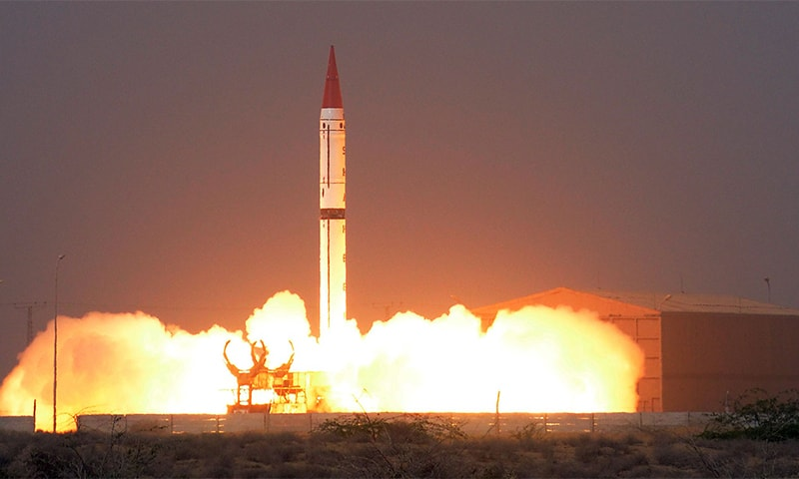
Nuclear issues
By Mohammad Shaaz
Notes:
NOTE:
To change the image on this slide, select the picture and delete it. Then click the Pictures icon in the placeholder to insert your own image.

Slide 2
Content
Lecture 2:
A Brief History of Pakistan’s Nuclear Programme pre-1998
Dr. Abdul Qadeer Khan Episode
Current Nuclear Regime of Pakistan
Pakistan’s Nuclear Doctrine
International Concerns on Pakistan’s Nuclear Prog

Slide 3
Pakistan’s nuclear programme
A brief history

Slide 4
Brief History of Pakistan’s Nuclear Programme
PAEC
PARR - I
Multan Meeting
MA Khan – A Khan Meeting
KANUPP
1965
1956
1965
1972
1972
TPG
A Q Khan
First Cold Test
Youm-e-Takbeer
1974
1972
1983
28th May 1998
1974
India’s Nuclear Test

Slide 5
Pakistan’s Nuclear Programme – Pre-1971
Pakistan initially wanted to have a peaceful nuclear programme:
In 1953, Foreign minister Muhammad Zafarullah Khan publicly stated that "Pakistan does not have a policy towards the atom bombs".
Pakistan became an active part of Atoms for Peace Program and received PARR-I
Pakistan Atomic Energy Commission was formed for overseeing peaceful nuclear technology in 1956
Uranium deposits were discovered near Dera Ghazi Khan
Pakistan Institute of Nuclear Science and Technology (PINSTECH) was also formed under Dr. Abdus Salam
First civil-purpose nuclear power plant, built by Canada, based on the CANDU reactor, was constructed near Karachi
Called KANUPP-I, this plant was completed in 1972

Slide 6
The Need for Nuclear Weapons
A lesson from the fall of Dhaka 1971 was that Pakistan could not rely on allies such as United States or China to protect it against the much bigger and aggressive India
India was economically, militarily, geographically and demographically bigger than Pakistan and growing; Pakistan would not be able to deter it conventionally
India was already in the process of developing nuclear weapons, as Munir Ahmed Khan had already notified; a nuclear India against a non-nuclear Pakistan would have tilted the strategic balance in South Asia dangerously against Pakistan
Pakistan had great scientists and engineers, such as A.Q Khan, Abdus Salam, Munir Ahmed Khan, Raziuddin Siddiqui, Tufail Naseem, etc., who could help her develop nuclear weapons

Slide 7
Developing Nuclear Weapons
Pakistan started its development of nuclear weapons in 1972
Zulfiqar Ali Bhutto, Munir Ahmed Khan, and Abdus Salam gathered premier Pakistani scientists and engineers working around the world for the programme
Initially, the less technologically advanced plutonium based gun-type fission weapon was planned but later on uranium based implosion type weapon was worked upon
AQ Khan, having worked at Urenco Group in Netherlands, had technical expertise of gaseous centrifuges which were then developed and used by PAEC for uranium enrichment
The first cold test was successfully carried out in 1983 and finally nuclear tests were done on 28th May 1998 and 30th May 1998
On the first day 5 uranium based devices were successfully tested while on the second day a plutonium based device was tested successfully

Slide 8
Nuclear Proliferation Episode
In 2003, Bush administration shared intelligence with Musharraf administration that P-1 type, centrifuges similar to ones designed by Pakistan were found in Iran by IAEA
It was alleged that a network in Pakistan had sold nuclear technology to Iran, Libra and North Korea with AQ Khan as its head
AQ Khan was serving as Advisor on Science and Technology to President Musharraf
He was fired from his post and on 4 February 2004 publicly apologized on National TV, saying that he had sold the secrets out of greed without government authorization
The reaction by US was subdued due to popularity of AQ Khan in Pakistan and the need of US for Musharraf and Pakistan as an ally in Afghanistan War
Later allegations were levelled by US, AQ Khan and some countries in Europe that past top army generals were a part of the proliferation, but never proven

Slide 9
Nuclear Security
“Nuclear security is the prevention of, detection of, and response to, criminal or intentional unauthorized acts involving or directed at nuclear material, other radioactive material, associated facilities, or associated activities.”
The responsibility for nuclear security within a State rests entirely with the State, which has to ensure the security of nuclear material, other radioactive material, associated facilities and activities under its jurisdiction.
The three pillars of Pakistan’s nuclear security are:
Legislative and Regulatory
Institutions and Organizations
Systems and Measures

Slide 10
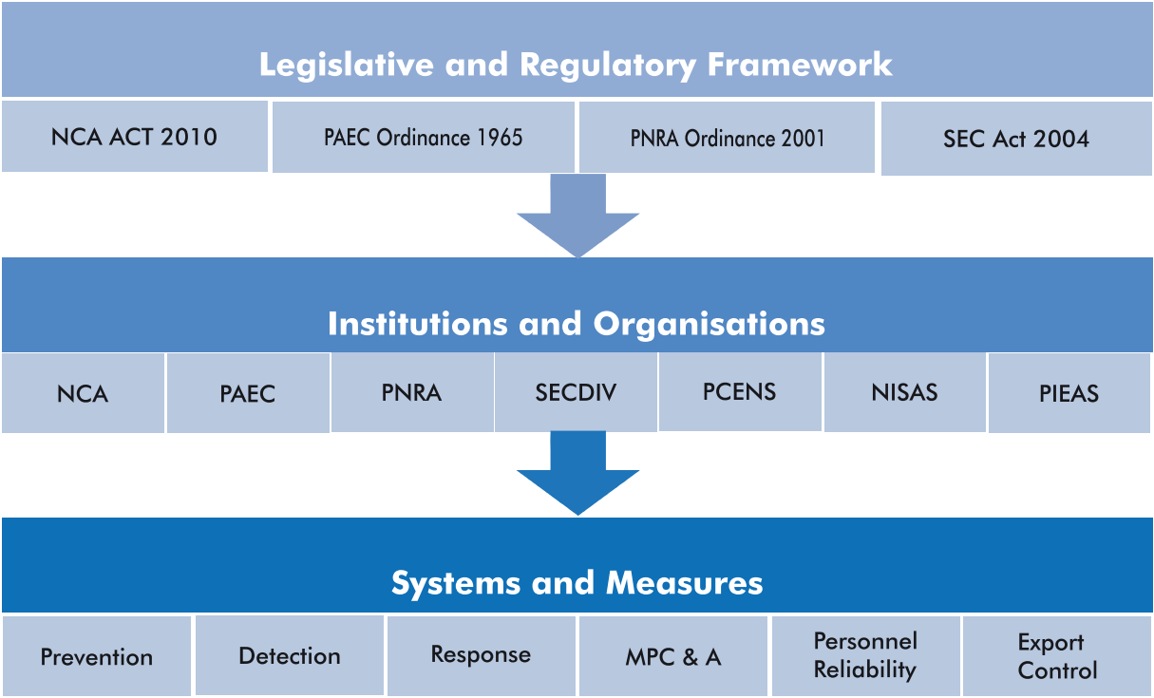
Pakistan’s Nuclear Regime
Notes:
Legislative: independent bodies with enough power
NCA act has wide range of activities
PAEC ordinance made PAEC a statutory body with requisite powers
PNRA regulate the
nuclear and radiation safety and nuclear security aspects of nuclear
installations and radiation facilities
Material Protection, Control and Accounting

Slide 11
Salient Features - Strategic Export Control Act
Controls over export, re-export, trans-shipment and transit of goods, technologies, material and equipment covered under the National Control List.
Wide jurisdiction (also includes Pakistanis visiting or working abroad).
Provide for an authority to administer rules and regulations framed under this legislation. Also provides for the establishment of an Oversight Board to monitor the implementation of this legislation (SECDIV).
Prohibition on diversion of controlled goods and technologies to unauthorized use.
Control over transfer of technology by any means.
Control lists and catch-all provisions.
Licensing and record keeping provisions.
Penal provisions: Up to 14 years imprisonment and Rupees 5 million fine or both, and on conviction, confiscation of offender’s property and assets.

Slide 12
Pakistan’s Nuclear Regime - Institutions and Organizations
NCA
Apex committee with PM as chairman, oversees the whole regime
PAEC
Operator of Nuclear facilities and research and development of nuclear weapons
PNRA
Regulation of
nuclear safety, physical protection, radiation protection, transport
and waste safety in Pakistan
SECDIV
A part of MoFA to administer export controls in accordance with NSG, Australia Group, Missile Control Regime
Notes:
NCA PRP

Slide 13
IAEA Global Concerns
Theft of nuclear weapons
Theft of material to make an improvised nuclear explosive
Theft of other radioactive material for an RDD
Sabotage of a facility or transport
Notes:
Radiological Dispersal Device (RDD) is any device that causes the purposeful dissemination of radioactive material without a nuclear detonation

Slide 14
Pakistan specific concerns
Extremist government in power
Radical’s take over
Terrorist attack on nuclear installations
The insider dimensions

Slide 15
Pakistan’s Nuclear Doctrine
A doctrine is meant to explain how material capabilities can be used to achieve policy goals.
The key policy goal of Pakistan’s nuclear weapons capability is to deter Indian conventional as well as nuclear aggression. Its secondary policy goal, if deterrence fails, is to deny India victory in the event of a war.
Pakistan has a policy of no-first-use against non-nuclear weapon states
Initially our doctrine was minimum-credible deterrence but now covers full-spectrum deterrence
4 thresholds of minimum-credible deterrence: 1) Spatial 2) Military 3) Economics 4) Political
Notes:
Military doctrine is the expression of how military forces contribute to campaigns, major operations, battles, and engagements.

