Slide 1
ASEAN + SAARC + SCO

Slide 2
SAARC (South Asian Association for Regional Cooperation)
Introduction
Member Structure
Functions

Slide 3
SAARC
Institutional Framework
Chamber of Commerce and Industry (SCCI)
SAARC Arbitration Council
South Asian Regional Standards Organization

Slide 4
SAARC
Achievements of SAARC
SAFTA
SAARC Food Bank
SAARC Development Fund
South Asian University

Slide 5
SAARC
Reasons for Failure of SAARC
Frozen Political Conflicts
Dealing with Terrorism
Indian Hegemonic Designs in South Asia
Water Disputes
Lack of People to People Contact
Pathetic Conditions of South Asia

Slide 6
SAARC
Recommendations for SAARC
Political Solutions
Economic Solutions
Institutional Changes
-Role of India
-Conflict Conciliation Groups
- Resolution of Bilateral Disputes

Slide 7
ASEAN (Association of South East Asian Nations )
Introduction
Fundamental Principles

Slide 8
ASEAN
Structure Bodies
ASEAN Summit | Presidential Forum
ASEAN Coordinating Council | Foreign Ministerial Forum
ASEAN Community Council | Minister Level
ASEAN Sectoral Ministerial Bodies | Minister Level
Committee of Permanent Representative | ASEAN State ambassadors
National Secretariats | Administrative Officers
Committees Abroad | Outside ASEAN

Slide 9
ASEAN
ASEAN and the USA
-USA involvement with ASEAN
-Why is USA so much interested in the ASEAN?

Slide 10
ASEAN
Prevailing Issues of ASEAN
ASEAN, China and the South China Sea
Human Rights Violation
-What is the South Chine Sea issue?
-Rohingya Crisis, Myanmar.
Myanmar Coup
Philippines war on Drugs

Slide 11
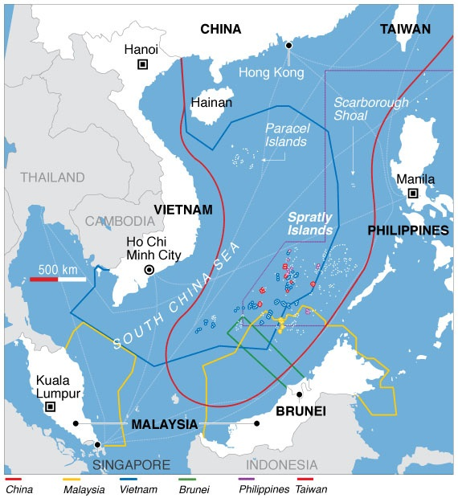
ASEAN

Slide 12
ASEAN
ASEAN and Pakistan
-As member
-Common areas of Collaboration

Slide 13
SCO (Shanghai Cooperation Organization)
Introduction
Structure
Aims of SCO

Slide 14
SCO
Structure of SCO
The Heads of State Council (HSC)
The Heads of Government Council (HGC)
Regional Anti-Terrorist Structure (RATS)
SCO Secretariat

Slide 15
SCO
SCO and Pakistan
(Common Points of Benefits)
-Geo-economic win-win situation for both.
Energy Crisis
The fight against the 3 Evils
Opportunity for enhancing Diplomatic Relations:

Slide 16
SCO
Challenges faced by SCO
Offsetting USA and NATO in the region
The 3 Evils and Security Issues
China vs Russia Leadership

