Slide 1
THE NEW PUBLIC SERVICE
JANET V. DENHARDT
AND ROBERT B. DENHARDT

Slide 2
Group Members
Marium (Leader)
Ali (coordinator)
Mubeen
Aqib
Mohsin
Shehryar
Abida

Slide 3
Public Administration & The New Public Management
“Democracy instead of business”
“Serving” rather than “Steering”
“New Public Service”, a theory rooted in democratic governance and public interest.

Slide 4
Old Public Administration
Government should establish executive authorities, controlling hierarchical organizations and achieving the most efficient operations possible.
Politics-Administration(policy-administration) Dichotomy.
New Public Management
“Run government like a business,”
Use of private sector and business approach in the public sector.
“Competition within units of government and across government boundaries to the non-profit and for profit sectors, performance bonuses, and penalties”

Slide 5
The Need of Public Service
“Those who steer the boat have far more power over its destination than those who row it.”
Governments with their preoccupation with rules and hierarchical chains of command, no longer work very well.
Idea is to have such public administration in the governance system that places public service, democratic governance and civic engagement at the center.

Slide 6
Roots of the New Public Service
Democratic Citizenship - See citizens as citizens (not “customers”)
Sense of Community - All people need to work for the interest of community
Organizational Humanism - Concepts like equality, morality, responsiveness and equity should come in play in Management.
Postmodernism - Governance must be based on sincere and open dialogue among citizens and administrators.

Slide 7
Seven Principles of Public Service
Serve Citizens, Not Customers
Seek the Public Interest
Value Citizenship over Entrepreneurship
Think Strategically, Act Democratically
Recognize that Accountability isn’t Simple
Serve Rather than Steer
Value People, Not Just Productivity

Slide 8
Serve Citizens, Not Customers
Public interest is an outcome of having the same values among citizens rather than grouping individual’s self-interests.
Public servants do not give a reaction to the request of customers. They focus on building relationships of trust and collaboration among citizens.

Slide 9
Old public Administration & Client Service
Concerned with the direct delivery of services in individual and corporate behavior.
Public servants are responsive to clients and constitution.

Slide 10
NPM & Customer Satisfaction
NPM views the relationship between government and citizens as “citizens are customer or consumer.”

Slide 11
NPS & Quality Service for Citizens
The New Public Service recognizes that those who interact with government are not simply customers but rather citizens.
The New Public Service encourages more and more people to fulfill their responsibilities as citizens, and in turn, for public administrators to be especially sensitive to their voices.

Slide 12
Seek The Public Interest
A collective sense of the public interest.
Engaging administrators , politicians and citizens in a process of thinking about a desired future for the nation.

Slide 13
Four Approaches of Public Interest
It is a moral and ethical standard for decision making.
Public interest can’t be measured or observed directly.
The pluralism is a best way to serve the public interest.
To achieve a public value consensus.

Slide 14
Old Public Administration and Public Interest
A strict separation between Politics and Administration was the best way for public servants to serve the interests of the public.

Slide 15
NPM & Public Interest
Individual choices in a market like arena are superior to collective action based on shared values.

Slide 16
New Public Service & Public Interest
To enhance citizenship and serve the public interest.

Slide 17
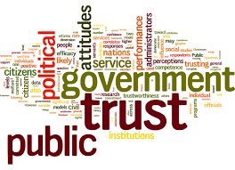
Value Citizenship over Entrepreneurship
The New Public Management creates entrepreneurs. Thus focus is to maximize productivity.
In the New Public Service,
Government is owned and run by the citizens.
Public Administrators must not only share power, work through people, they also must re-conceptualize their role in the governance process as responsible participants, not entrepreneurs.

Slide 18
Value Citizenship over Entrepreneurship
Public programs and resources do not belong to Public Administrators.
Success and failure are not limited to a single private business
public administrators do not single handedly decide what is best for a community.

Slide 19
Think Strategically, Act Democratically
Policies and programs meeting public needs can be most effectively and responsibly achieved through collective efforts and collaborative processes.
Join together all parties in the process of both designing and carrying out programs.
Civic pride and civic responsibility.

Slide 20
Implementation
The study of “implementation” did not exist in the early stages of the development of public administration.
As Wilson and other founding scholars in the field asserted, the political sphere made the decisions, and the administrative apparatus simply and mechanically put them into action.

Slide 21
The Old Public Administration and Implementation
There was little differentiation between the administrative process and the implementation process.
Implementation was what public administration was responsible for is most appropriately evaluated.
The New Public Service and Implementation
In the New Public Service, a primary focus of implementation is citizen engagement and community building.
Citizen engagement is seen as an appropriate and necessary part of policy implementation in a democracy.

Slide 22
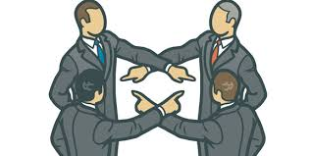
Accountability is Not Simple
Public servants should be more attentive to the market.
They should attend to statutory and Constitutional Law, community values, political norms, professional standards and citizens’ interest.
NPS argues that accountability should be based on the idea to serve citizens’ interest.

Slide 23
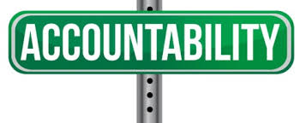
Old Public Administration and Accountability
Public servants do not exercise significant amount of discretion.
They simply implement the laws, rules and standard set forth by elected officials.

Slide 24
NPM and Accountability
Public agencies are not accountable to citizen or to the public or common good.
They are accountable to their customers.
Based on satisfaction of the customers

Slide 25
NPS and Accountability
Accountability in the New Public Service suggests a re-conceptualization of the role of the public servant as leader, steward and emissary of the public interest, not as entrepreneur.
Accountability is broadly defined to encompass a range of professional, legal, political and democratic responsibilities.

Slide 26
Serve Rather than Steer
Types of Leadership
Top down traditional model
A model in which leader was the one who established vision to group, designed way of achieving it and coerced others to action on it.

Slide 27
Serve Rather Than Steer
Value based leadership (transformational leadership )
Value based discussed citizen views can be brought to bear on process of building public policy in democratic fashion but the major focus is on the style of leadership in which administrators work together to achieve goals

Slide 28
Serve Rather Than Steer
Shared leadership
As shared leadership is important in public sector, administrators work with citizens and group of people of all kinds. It helps in improving the elements of empathy, consideration and efficiency.

Slide 29
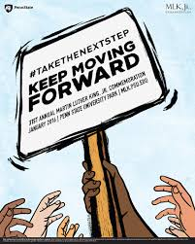
Serve Rather Than Steer
Role of Administrators
Knowledgeable with their duties , responsibilities and the authorities divided among them. They do not become the owners of citizens but work as one to serve them and solve issues.
In the New Public Service, shared and value based leadership is seen as function and responsibility at all levels of organization.

Slide 30
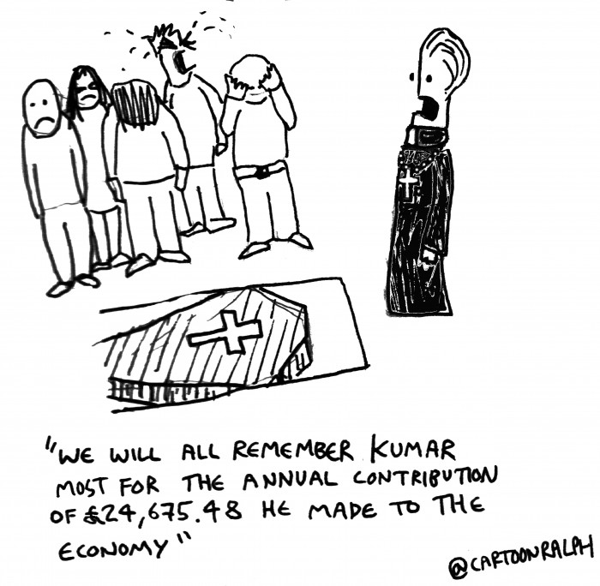
Value people, Not just Productivity
Public organizations become successful if they give value and respect to their worker.
The New Public Service suggests rational attempts to control human behavior.
We need to encourage workers higher level motivations and
values and not treating people as a machine.
The communication between management and workers are both formal and informal.

Slide 31
Value People, Not just Productivity
Management should encourage their employees and share their feelings, values, and ethics within the corporate environment.
In the new public service, shared leadership, collaboration and empowerment become the norm both inside and outside the organization.

Slide 32
Value People, Not just Productivity
If public servants are expected to treat citizens with respect , they must be treated with respect by those who manage public agencies.
The public service motives of citizens and employees alike can be recognized, supported and rewarded.

