Slide 1
Pakistan and Regional Organizations
SARFRAZ HUSSAIN ANSARI (CSP)
34th Common- PA&AS
Director Finance
MBA (Int. Fin) - UIBE Business School, Beijing
M.Sc. Public Administration (PF) - QAU Islamabad
Fellow Pakistan Institute of Public Finance & Accountancy
SAP-FI Certified, Certified Performance Auditor
Visiting Faculty:
QAU-School of Management Sciences
National Officers Academy
National Institute of Management

Slide 2
Regional & global organizations
Current Affairs & Pakistan Affairs

Slide 3
Multilateralism for Regional & Global Cooperation
Globalism---IGOs
Regionalism: Regional Organizations
SAARC
ECO
SCO
EU
ASEAN
NAFTA
Arab League
OIC
Gulf Cooperation
Council
International Political Order
LoN
UN
ICJ
International Economic Order
World Bank
IMF
WTO
Lecture-1
Lecture-4
Lecture-2
Lecture-5
Lecture-3

Slide 4
Sources of Study
NOA Current Affairs Book by Fareed Khan
NOA Pakistan Affairs Book
My Lectures
Official Websites of these Organizations
CSS Five Year Papers
Watch BBC ‘Outside Source’, Aljazera and DW

Slide 5
Talking Points/ Food for thought
Globalism & Regionalism
Internalization and the notion of ‘Collective Security’ and shard future
Nationalism Vs Super-nationalism
Which is more important?
If both are important at the same time, whom to accord priority to?
Notes:
Slowbization…..

Slide 6
National Security Vs Collective Security
What is national security?
Who is responsible for national security?
What is ‘Self Defense’? (Article 51 of UN)
What is International Security?
Who’s responsible for Int. Security?
What is ‘Collective Security’

Slide 7
Regional Integration and Regionalism
Regionalism
The theory and practice of regional rather than national systems of administration or economic, or socio-cultural, or political affiliation.
Regional Cooperation Organizations and Role of Pakistan
SAARC
ECO
SCO

Slide 8
Factors that contribute in Power Politics & Competition
Tangible
Intangible
Strong Economy
Modern Technology
Political Stability
Geography
Leadership
Social Cohesion
Population Quality
Diplomacy
National Identity
On the basis of these factors certain countries start playing defining and leading role in the regional organizations they are member of.

Slide 9
Outline
Introduction
Background
Brief History (Genesis)
Members (and membership criteria)
Charter, Objectives, Principles
Structure
Functions
Issues and Challenges
Geo-Strategic, Geo-Economic, ideological, trade, cultural etc
Latest/current developments
Future Prospects
Recommendations (if required)
Conclusion

Slide 10
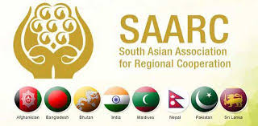
SAARC

Slide 11
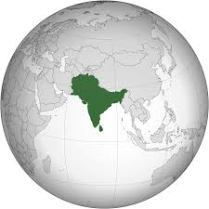
Geo-Economic and Geo-Strategic Importance of SAARC Region
SCO
South Asia is a Bridge Asian Countries
ECO
Indo-Pacific Region and Great Game in the Indian Ocean
SAARC
ASEAN
Pakistan is a Bridge for the Region

Slide 12
Historical Background (Why SAARC)
1. Role of Leadership
President Ziaur Rahman, in December 1977, discussed regional cooperation with the Indian PM.
in 1977, King Birendra of Nepal stressed for close regional cooperation
2. South Asian countries facing common problems demands joint action
3.A compact landmass perfect for regional Integration.
So, the officials of the seven countries met in Colombo in April 1981
4. The Colombo Plan
regional cooperation for reaping max. benefits from the aid for South Asian countries.
5. Regionalism on the Rise in 1970s and 1980s

Slide 13
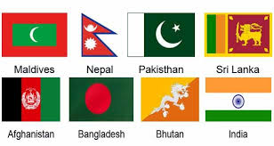
In 1983, the FMs adopted the Declaration on
South Asian Association for Regional Cooperation (SAARC)
The SAARC Charter was signed in Dhaka on 8 December 1985.
The Secretariat in Kathmandu- since 1987.
Initially seven, now eight member States
Afghanistan joined SAARC in 2007
Notes:
Afghanistan joined SAARC in 2007

Slide 14
SAARC Permanent Members
SAARC Observers
Afghanistan
Bangladesh
Bhutan
India
Maldives
Nepal
Pakistan
Sri Lanka
Australia
China
the European Union
Iran
Japan
the Republic of Korea
Mauritius
Myanmar; and
the United States of America.
observer states—a status that entitles them to express their opinion, engage in dialogues, and give advice but denies them decision making and voting rights.
Notes:
observer states—a status that entitles them to express their opinion and give advice but denies them voting rights.

Slide 15
Article I- SAARC OBJECTIVES
To Promote Welfare Of The Peoples of SOUTH ASIA
To Accelerate Economic Growth and Social Dev.
To Promote Collective Self-reliance
To Dev. Mutual Trust and Understanding of One Another's Problems;
To Promote Cooperation;
Among Member States
With Other Developing Countries;
at International Forums; and
With International And Regional Organizations

Slide 16
Article II-PRINCIPLES (Values)
Promoting peace, stability, and progress in the region
Respect for the principles of
Sovereign equality
Territorial integrity
National independence
Non-use of force
Non-interference in the internal affairs of other states and
Peaceful settlement of all disputes;
Fostering mutual understanding, good neighborly relations and meaningful cooperation

Slide 17
SAARC-Institutional framework
Sructure

Slide 18
1. SAARC Summit
Total 18 Summits held. 19th Summit was cancelled in 2016
Once a year
4. Secretariat
5. Programming Committee
Kathmandu. Sec Gen
3-year Term of Office
6. Technical Committees
7. Committee on Economic Cooperation
For particular fields
2. Council of Ministers
3. Standing Committee
Meets twice a year
Foreign Secretaries. Meet twice a year
Commerce & Trade Secretaries
Notes:
Summit cancelled due to Uri attack on 18-Sep-2016

Slide 19
Article III-SAARC SUMMIT
Meetings Of The Heads Of State Or Government
once a year
Unanimous decision
All members should meet
Article V- STANDING COMMITTEE
The Standing Committee comprising of the Foreign Secretaries
Assist and facilitate the Council of FMs
Article VI- TECHNICAL COMMITTEES
Article IV-COUNCIL OF Foreign MINISTERS
A) formulation of the policies of the ASSOCIATION;
B) review of the progress of cooperation
C) decision on new areas of cooperation;
D) establishment of additional mechanism under the ASSOCIATION
E) decision on other matters of general interest to the ASSOCIATION.
The council of ministers shall meet twice a year.

Slide 20
Article-VIII SAARC SECRETARIAT
There shall be a Secretariat of the ASSOCIATION.
Performs day to day administrative functions
Esala R. Weerakoon, from Sri Lanka is the current Secretary General from 1st March 2020
3 year term of office
Article IX- FINANCIAL ARRANGEMENTS
The contribution of each Member State towards financing of the activities of the ASSOCIATION shall be voluntary.

Slide 21
SAARC-A Critical Analysis
Key Issues/Challenges Are:
Regional Integration & Infrastructure Development
Energy Needs are on the rise
Climate Change, Food Security, Poverty Alleviation,
Science & Technology and Education For Human Development
Trade, Tourism, Culture And People-to-People Contact
Regional Security, Terrorism and Cooperation In Counter-terrorism.

Slide 22
SAARC-geo politics

Slide 23
SAARC- Regional Power Politics
1. Two dominant players-Pakistan and India off setting each other’s influence
the Balance of Power in South Asia and Nuclear deterrence
Kashmir issue as the nuclear flash point
Enmity with India since independence
India’s influence in Bangladesh, Nepal and Bhutan due to proximity
Playing proxies in each other’s spheres of influence

Slide 24
SAARC-Critical Analysis …conti
2. The Changing Regional Balance of Power & SAARC
India’s increasing involvement in Afghanistan and our strategic depth
Pakistan tries to offset it while lobbying with Maldives, Sri Lanka and Afghanistan
3. Increasing influence of China in South Asia
China also off sets India- it invites other global players in the region
Recent row between China and India at LAC in Galwan Valley, Laddakh
4. Presence of US in the Region and Indo-Pacific
5. SAARC-ECO-SCO
The Emerging ‘Asian Order’

Slide 25
The Geo-Strategic Region Claimed by Pakistan, China and India

Slide 26
SCO
ECO
ASEAN
Geo-Strategic and Geo-Economic importance of Pakistan in SAARC Region.
Pakistan: A Regional Hub for
SAARC-ECO-SCO

Slide 27
Energy Corridors and Importance of Pakistan

Slide 29
SARC: Successes
SAFTA was negotiated (but still a pipedream)
SAARC Food Bank in 2011 in Pakistan
South Asian University in New Delhi
SAARC Development Fund in 2010
SAARC Arbitration Council
South Asian Regional Standards Organization

Slide 30
Hurdles in SAARC Integration
SAARC Charter Needs Amendments
SAARC-A Region without Regionalism
India’s Look East Policy
Bangladesh and Sri Lanka Looking towards ASEAN
Pakistan’s tilt towards ECO and SCO
Extra Regional Actors Influence Indo-Pacific Politics
Indian Hegemony and Pakistan’s India centric Policies
Lack of Leadership, Trust and mutual Respect
Use of Force as a Tool to Resolve Contentious Issues
Notes:
to achieve South Asian Economic Union (SAEU) in a phased and planned manner through a Free Trade Area, a Customs Union, a Common Market, and a Common Economic and Monetary Union.

Slide 31
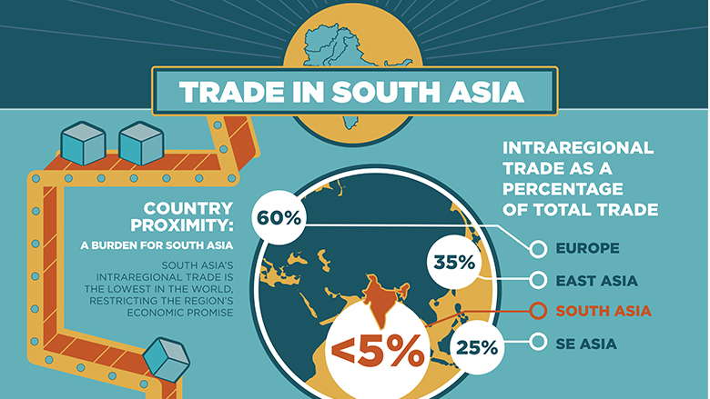
SAARC-Free Trade Area
In 1995, the first step towards a South Asian Free Trade Area (SAFTA)
The SAFTA Agreement was signed on 6 January 2004 during 12th SAARC Summit held in Islamabad, Pakistan.
Leading subsequently towards
a Customs Union,
Common Market and
the Economic Union.
It is still a pipedream

Slide 32
Future Scenarios
Future expansion of SAARC???
Three Scenarios
SAARC would lose its importance and effectiveness and will be disintegrated- chances are remote and dim
Status Quo- more likely
Revival and Future Expansion- a challenge

Slide 33
SAARC: Conclusion
Areas of Cooperation
(the Pull Factors)
Areas of Conflict
(the Push Factors)
Human Resource Dev
Agriculture, Food Security, Sustainability, climate change
Poverty Alleviation, health
Biotechnology, IT & Telecom,
Trade and energy corridors
Tourism
Kashmir Issue
Border Disputes
Trade Disputes
Regional Imbalance
Terrorism and interference in internal affairs
Public Opinion of mutual hatred and distrust

Slide 34
SAARC COVID Response
SAARC COVID-19 Emergency Fund-March 15, 2020
June-2020, PM of Pakistan contacted PM of Bangladesh and discussed regional issues and reviving of SAARC

Slide 35
and the emerging ‘Asian order’ It’s an attempt to counter US influence in Asia
The Shanghai Cooperation Organization

Slide 36
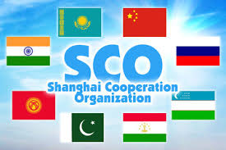
http://eng.sectsco.org/about_sco/

Slide 37
The Shanghai Cooperation Organization (SCO)
A permanent intergovernmental organization started as Shanghai-5 Mechanism in 1996
Created on 15 June 2001 in Shanghai (China) by
the People's Republic of China,
the Republic of Kazakhstan,
the Kyrgyz Republic,
the Russian Federation,
the Republic of Tajikistan, and
the Republic of Uzbekistan.
Notes:
SCO Secretary-General VLADIMIR NOROV from January, 2019

Slide 38
The Charter was signed during the St. Petersburg SCO Heads of State meeting in June 2002
It entered into force on 19 September 2003.
This is the fundamental statutory document which outlines
The Organization's Goals
Principles
Structure, and
Core Activities.
SCO accounts for over 40% of the world’s population and over 30% of the globe's gross domestic product
Trade among SCO members had risen to US$6 trillion in 2020 from US$667 billion when the group was founded in 2001.
Notes:
combating terrorism, separatism, extremism, drug trafficking and transnational organised crime. These have been long-standing objectives of the SCO

Slide 39
SCO-Members, Observers, Dialogue Partners
member states
China,
India,
Kazakhstan,
Kyrgyzistan
Pakistan,
Russia
Tajikistan
Uzbekistan
Iran
observer states
Afghanistan,
Belarus,
and
Mongolia
dialogue partners
Azerbaijan,
Armenia,
Cambodia,
Nepal,
Turkey, and
Sri Lanka.

Slide 40
The SCO Goals
The SCO's main goals are;
Strengthening Mutual Trust Among The Member States;
Promoting Their Effective Cooperation In Politics, Trade, The Economy, And Other Areas;
Making Joint Efforts To Maintain And Ensure Peace, Security And Stability In The Region; and
Combating three evils-terrorism, separatism, and extremism
Regional economic linkages
Establishment Of A Democratic, Fair And Rational New International Political And Economic Order.

Slide 41
SCO-Structure
The Heads of States Council (HSC) is the supreme decision-making body in the SCO.
It meets once a year and adopts decisions and guidelines on all important matters of the organization.
The Heads of Government Council (HGC)
meets once a year to discuss the organization's multilateral cooperation and priority areas, to resolve current important economic and other issues
approve the organization's annual budget.
3. SCO Foreign Minisaters Council
4. The Council of National Coordinators of SCO Member States (CNC)
acts as the SCO coordination mechanism.

Slide 42
4. the SCO Secretariat based in Beijing
5. the Executive Committee of the Regional Anti-Terrorist Structure (RATS) based in Tashkent.
The SCO Secretary-General and the Director of the Executive Committee of the SCO RATS are appointed by the Council of Heads of State for a term of three years.
Notes:
the meeting of the SCO Council of Heads of State held via videoconference on 10 November 2020,

Slide 43
Critical analysis
SCO

Slide 44
Sco and the rise of china Counterbalancing US Influence Economic Infrastructure Diplomacy & Strategic Alliances Central Asia South Asia East Asia

Slide 45
Old Silk Route Map

Slide 46
Regional Connectivity: Belt and Road Initiative Map

Slide 52
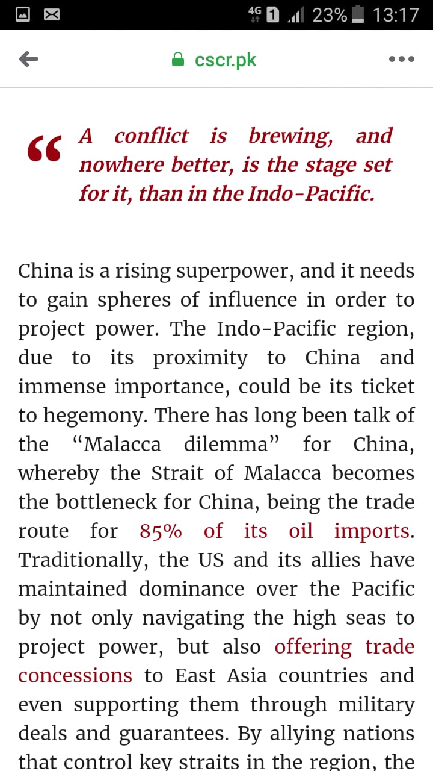
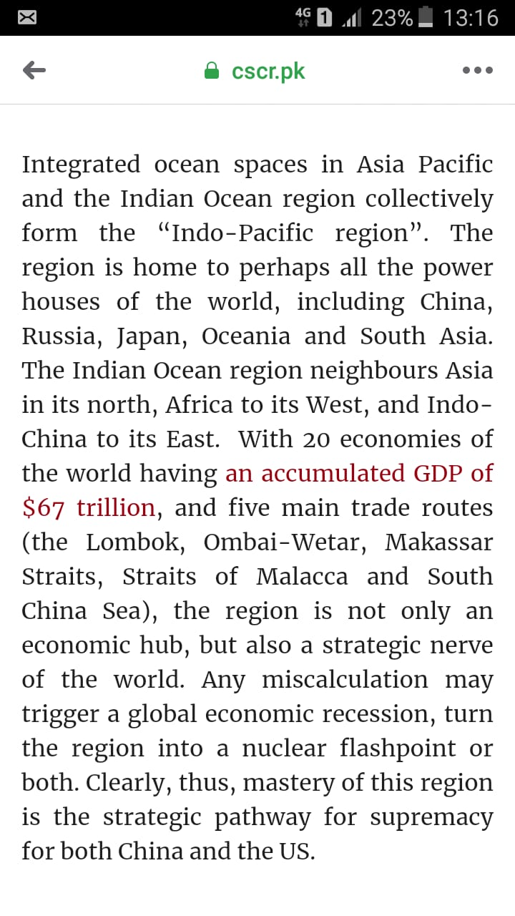

Slide 53
SCO Summit 2022
15-16 Sep. the 22nd Summit of SCO
Samarkand, Uzbekistan
To discuss geopolitical and economic uncertainty
to discuss mutual security concerns, such as Afghanistan
China commit to train 2,000 law enforcement personnel for SCO member states in the next five years

Slide 54
Analysts were interested in the following themes:
China’s expanding national security narrative and SCO
economic opportunities and risks through infrastructure development and trade.
significance of an Iran-Turkiye-China-Russia SCO alliance, and
why the SCO shouldn’t simply be viewed as an anti-Western alliance?

Slide 55
The role of Iran and Turkiye at the Samarkand summit was of much greater importance
with Iran signing a membership agreement to become a permanent SCO member and
Turkiye announcing its bid for permanent membership.

Slide 56
SCO and Pakistan
Pakistan was an Observer from 2005 to 2017
The meeting of the Heads of State Council was held on 8-9 June 2017 in Astana.
Status of a full member of the Organization was granted to India and Pakistan.

Slide 57
SCO: Advantages for Pakistan
SCO has become a matter of significance for Pakistan
SCO and Geo-Strategic and Geo-Economic Benefits for Pakistan
Pakistan to become a hub of regional connectivity.
SCO can achieve its objectives of security and connectivity with the participation of Pakistan.
In terms of SCO, based on Pakistan's experience, the country can offer consultation in anti-terror policies for the success of RATS.

Slide 58
SCO: Advantages for Pakistan
Relations with China and Russia strengthened
Pakistan has not been isolated diplomatically
Pakistan can get security, trade and economic benefits from SCO and ECO
Establishing a balance between China and US- a real challenge
Improving Pakistan’s image- a difficult task
Notes:
US-India in August 2016 signed Logistics Exchange Memorandum of Agreement (LEMOA) that will reportedly facilitate the two allies to use each other’s military facilities to check China’s growing influence.

Slide 59
Conclusion
While reviewing the 'Modern Great Game', the SCO is emerging significantly to contain US influence in Central and South Asian region.
China is building political and strategic capital in the region
The Cold War 2.0 with containment of China
Central Asia
South Asia
East Asia
Therefore, US seriously monitoring the activities of the SCO.
As many observers label the SCO merely as an anti-NATO bloc
An Iran-Turkiye-China-Russia coalition has the potential to be a powerful alliance against the Western liberal order.

Slide 60
CSS Questions: SCO
China, Pakistan-Russia cooperation will find suitable support mechanism in Shanghai Cooperation Organization (SCO). Elaborate. 2020
What are the opportunities and challenges for Pakistan as one of the new members of the Shanghai Cooperation Organization (SCO)? CSS-2018
Q. No. 5. Explore the significance of Shinghai Cooperation Organization (SCO) for Pakistan. CSS-2017

Slide 61
ECO
http://eco.int/index.php
Economic Cooperation Organization

Slide 63
Economic Cooperation Organization (ECO)
An inter-governmental regional organization encompassing countries from
Europe,
Central Asia, and
South Asia
The overall objective of the organization is the sustainable economic development of its member states and the region as a whole

Slide 64
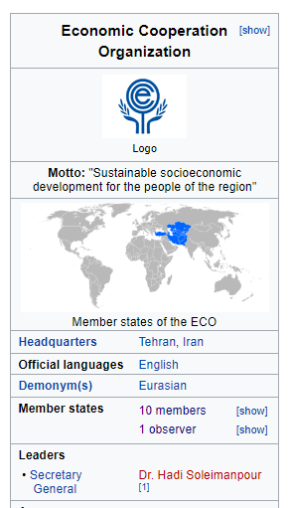
Background
Established as Regional Cooperation for Development (RCD) in 1964 by Iran, Pakistan and Turkey
Renamed as “ECO” in 1985.
The ECO's secretariat in Iran
its economic bureau is in Turkey
its scientific bureau is in Pakistan.

Slide 65
Objectives & Principles of Cooperation
To promote sustainable economic development
progressive removal of trade barriers for expansion of trade
increased economic cooperation and gradual integration with the world economy;
Development of transport & communications infrastructure
Effective utilization of the agricultural and industrial potentials with environmental protection
Exchanges in educational, scientific, technical and cultural fields
Effective cooperation with other regional and international organizations

Slide 67
Membership
According to the Article XIII of the Treaty Of Izmir (1977, 1990, and 1996)
“Any State enjoying geographical contiguity with the ECO region and/or sharing the objectives and principles of ECO may apply to become a member of the Organization.”
Currently ten countries from West and South Asia, Caucasus and Central Asia are Members of the Organization:
Notes:
TREATY OF IZMIR (14 September 1996)

Slide 68
Member States
In 1992 Afghanistan and six Central Asian Republics, also joined

Slide 69
ECO Organs
The ECO functions through its intergovernmental machinery, Secretariat and specialized agencies and regional institutions.

Slide 70
ORGANIZATIONAL STRUCTURE OF ECO
There shall be,
ECO Summit
a Council of Ministers,
a Council of Permanent Representatives,
a Secretariat, and
Specialized Agencies in specific fields of cooperation.
a Regional Planning Council,
Notes:
he Republic of

Slide 71
1. ECO-Summit
the Article IV of the Treaty of Izmir
the Heads of State/Government meet biennially or more often if considered necessary.
The Summit meetings review the objective conditions and progress in implementation of ECO programmes and projects
exchanging views on regional and global issues of common interest to the ECO region.
Since ECO enlargement in 1992, 15 Summit meetings have been held.
The last meeting, 15th ECO Summit, was held on November 28, 2021 in Ashgabat, Turkmanistan.

Slide 72
Summits Held So Far
14th :Turkey organized the 14th ECO Summit virtually on March 4, 2021
Notes:
Turkey organized the 14th ECO Summit virtually on March 4, 2021

Slide 73
2. COUNCIL OF MINISTERS
the policy and decision-making body that approves annual workplan and programs
It comprises the Ministers of Foreign Affairs or any other representatives of full ministerial rank as may be nominated by the governments
responsible for decision on/approval of policies, strategies, and work programs
3. SECRETARIAT
comprises a Secretary-General and staff
its Headquarters in Tehran
The Secretary-General is elected and appointed by
the Council of Ministers
for a non-renewable term of three years
Notes:
The incumbent H.E. Ambassador Khusrav Noziri of Tajikistan who took over his responsibilities as the 13th Secretary General of the ECO in August 2021.

Slide 74
4.The Regional Planning Council (RPC)
The Regional Planning Council (RPC) is the main technical planning body within ECO which comprises the heads of the Planning Organizations of the Member States

Slide 75
ECO Vision 2025
A-Vision Statement
"ECO will pave the way to a territory of integrated and sustainable economies as well as free trade area achieved by highly educated societies and improved governance through enhanced cooperation“
B-Key Areas of Cooperation
Trade
Transport and Connectivity
Energy
Tourism
Economic Growth and Productivity
Social Welfare and Environment
C- Principles of Cooperation
Sustainability
Integration
Conducive Environment

Slide 76
Critical Evaluation
it is a trade bloc for the member states connected to
The Mediterranean through Turkey
The Persian Gulf via Iran, and
The Arabian sea via Pakistan
It provides a platform to improve socio-economic development
promotes trade and investment opportunities.
The dream is to establish a single market for goods and services, much like ASEAN or the EU

Slide 77
Terrorism and extremism: a common challenge for all the ECO members
Peace in Afghanistan and the Middle East: a key to ECO success
Iran and Saudi Arabia: Rivalry over Middle Eastern politics and options for Pakistan
Iran under US sanctions and options for Pakistan
the Iran–Pakistan-India (IPI)gas pipeline, as well as a Turkmenistan–Afghanistan–Pakistan-India (TAPI) pipeline
Indian influence in Iran and Afghanistan
CPEC as a nodal point for regional connectivity

Slide 78
23-24 Jan. 2023
26th ECO Council of Foreign Ministers Meeting
Tashkent, Uzbekistan
The theme is- “Year of Strengthening Connectivity”

Slide 79
SCO-SAARC-ECO
CHANGING REGIONAL DYNAMICS & FORMATION OF NEW ALIGNMENTS

Slide 80
The Changing regional Dynamics of South Asia
Dividends of Afghan Peace Process for Pakistan and the Region
India has been sidelined in this peace process
Iran Drops India From Chabahar Project
Delay In Funding from India
India gradually reduced its oil imports from Iran since 2017
China signed a ten year $400 Bil. investment deal with Iran for oil
India has been sidelined in Iran
India is moving to US camp---India to be a pivot for the US new containment policy
Russia improving ties with Pakistan and Afghanistan
Iran already has closed ties with Russia
The New Great Game and emerging realignments of regional powers
Repercussions for SCO-SAARC-ECO
The questions will be???
Should we isolate India in the region or bring her back from the US camp?
What policy options India have in the SCO-SAARC-ECO region?
India’s ‘Look East Policy’- ASEAN and APEC

